Slide 1

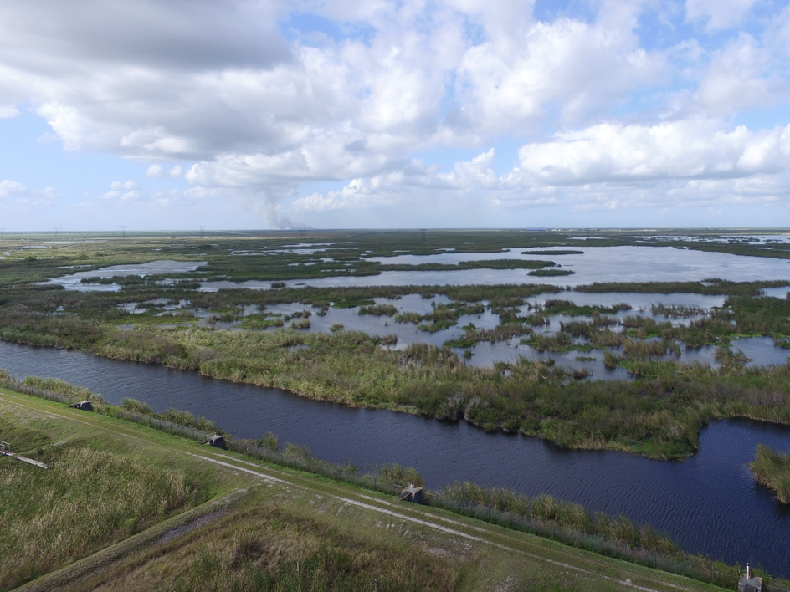


Avoiding sensor overload:
UAS sensor fundamentals for mapping professionals
Earl Soeder, PSM
GPServ (Duncan Parnell)
Adam Benjamin, PSM, GISP
UF/IFAS Fort Lauderdale R.E.C.
November 7, 2019
SWFL GIS Symposium

Slide 2
UAS Sensors & Payloads
UAS Background
Imaging Sensors/Payloads

Slide 3
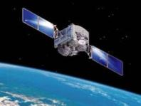
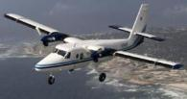
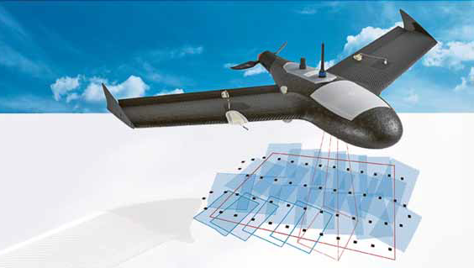
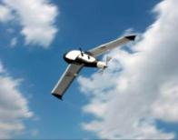
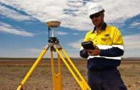
UAS Background: Why UAS Aerial Imaging?
Fills cost effective niche in geospatial data acquisition between traditional surveying technologies and traditional photogrammetry
Rapid mobilization/deployment for sUAS
High spatial res. (GSD) data acquisition
  f(flying height, side/end overlap)

Slide 4
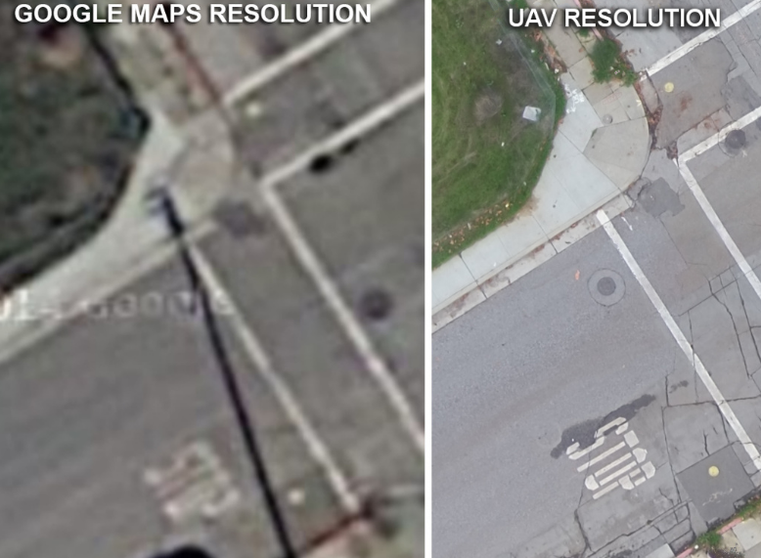
UAS Background: Why UAS Aerial Imaging?
Notes:
http://www.westcoastplacer.com/drone-services/

Slide 5
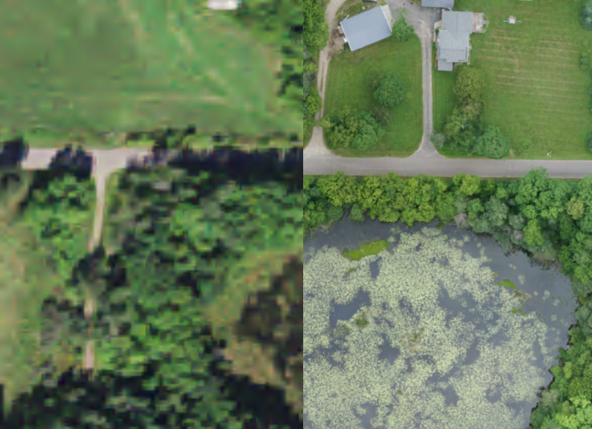
UAS Background: Why UAS Aerial Imaging?
NAIP Imagery
Orthophoto Mosaic – ZX5 – 100m

Slide 6
UAS Background: Why UAS Aerial Imaging?
UAS imagery can be processed to provide high spatial resolution maps that other data sources cannot match in terms of quality

Slide 7
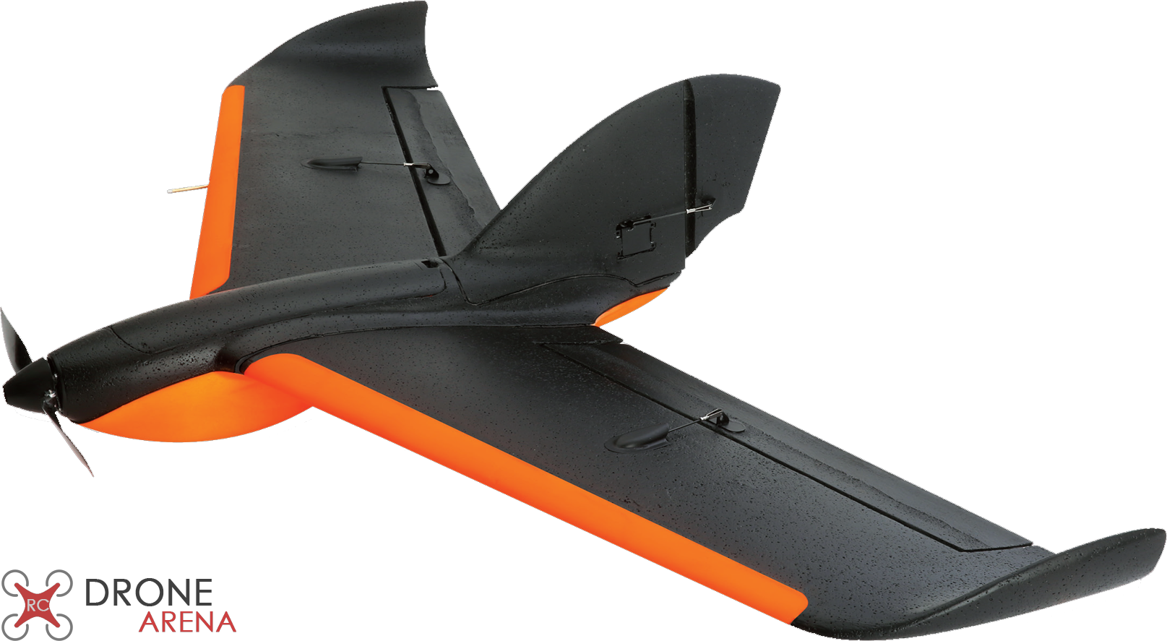
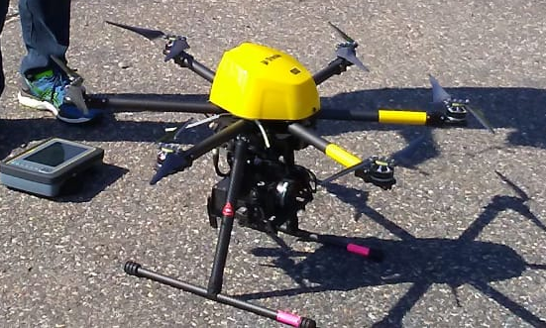
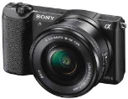
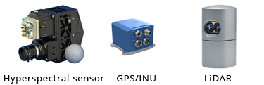

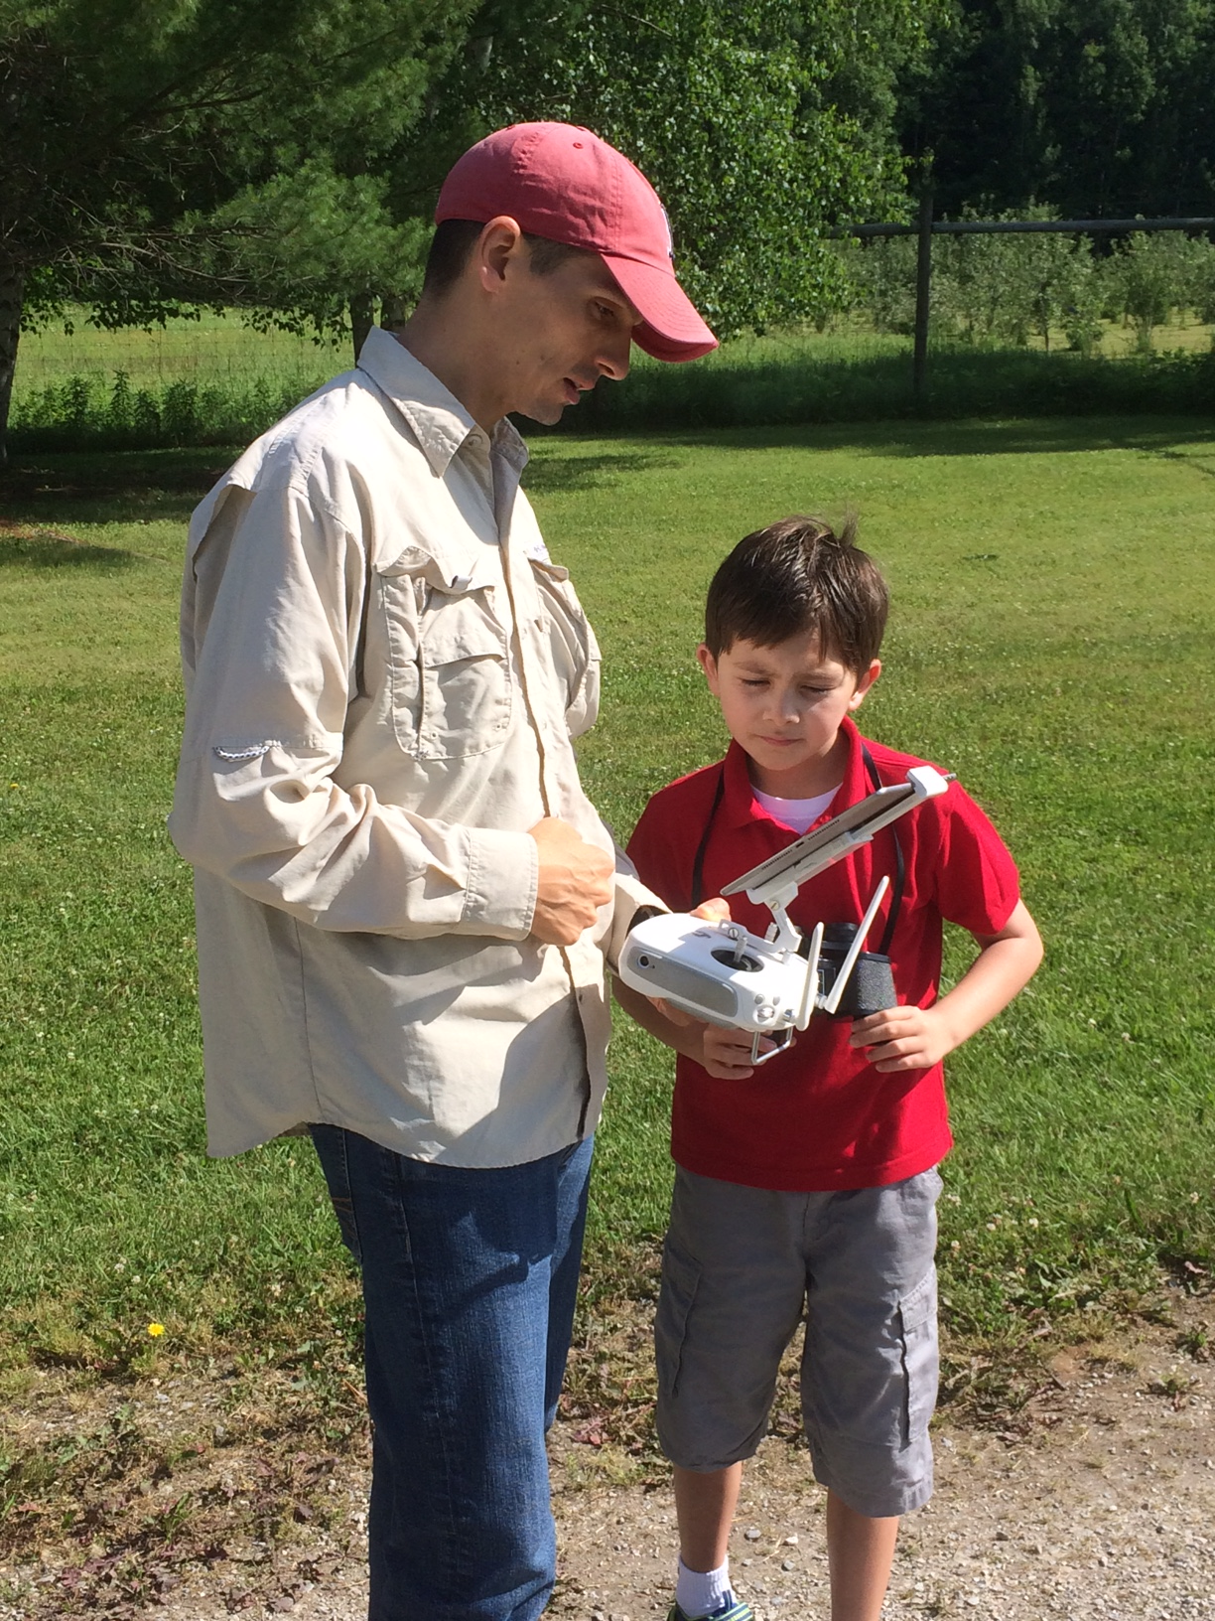
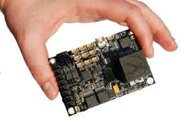


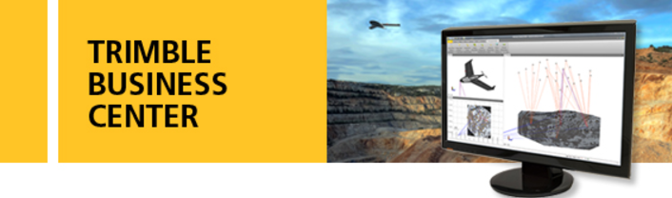
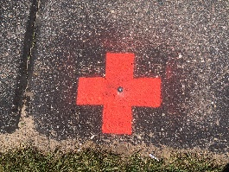
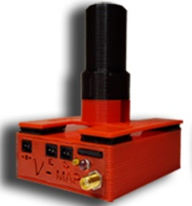
UAS Background: Components
Platform
(motors, props)
Payload
UAS
Communication System/pilot
Airspace
Software
(planning, processing)
Autopilot
Control
Notes:
Sensors are most important component for meeting UAS mission objectives

Slide 8
Sensors & Payloads
For discussion:
Imaging
  RGB (Images & Video)
  IR (Images)
    Multispectral, Thermal, Hyperspectral
  Lidar (Point Clouds)
Non-Imaging
  Power Sources
  Air Quality Monitoring
  Water Sampling
  Spray/Release Devices

Slide 9
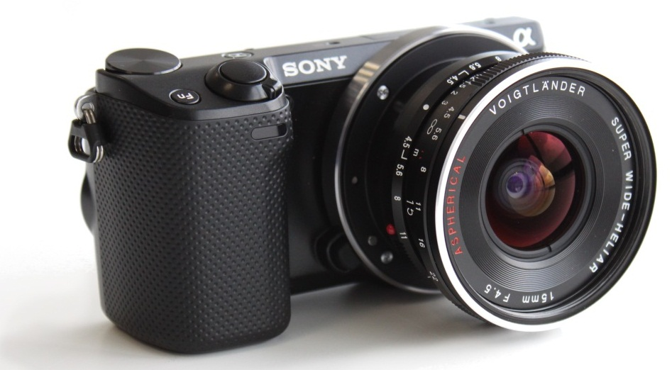
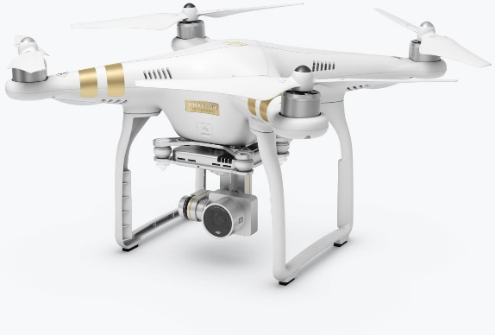
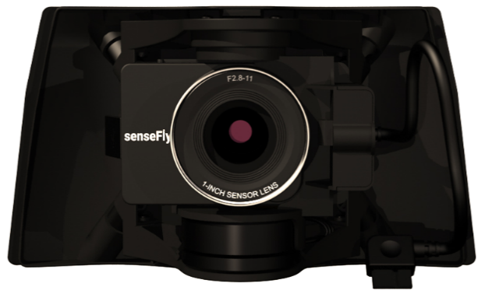
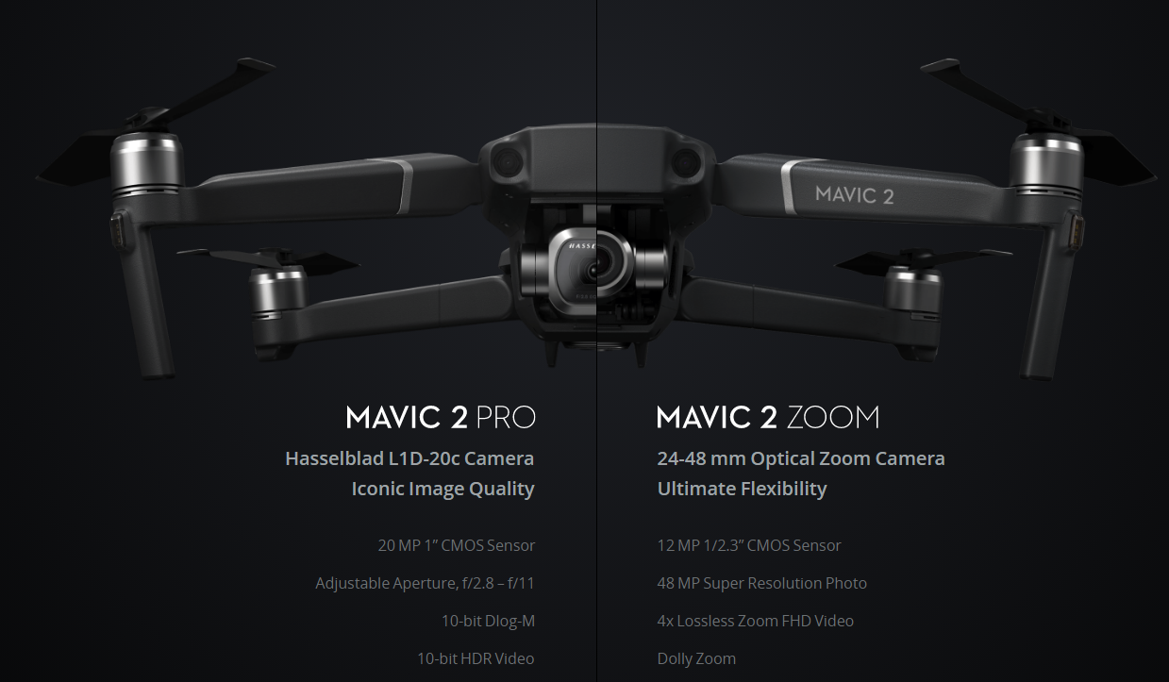
Imaging PL: RGB (Images & Videos)
Examples/Typical Uses:
RGB: most common imaging UAS sensor
Sony DSLR
(Image/Video)
DJI Phantom (Image/Video)
eBee SODA 3D
(2 oblique/1 nadir)
Notes:
https://www.sensefly.com/camera/sensefly-soda-3d-mapping-camera/

Slide 10

Imaging PL: RGB (Images & Videos)
Important Considerations:
Camera shutter
Global (Mechanical)
Rolling
Source: Pix4D

Slide 11
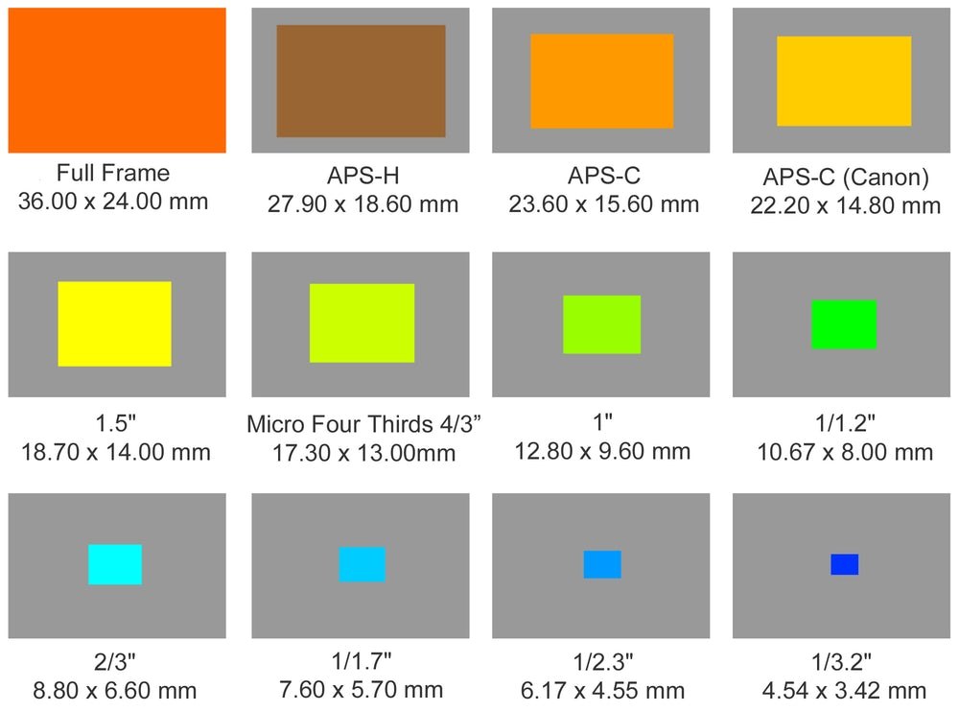
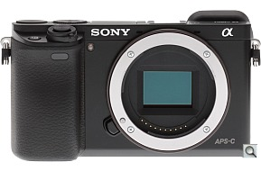

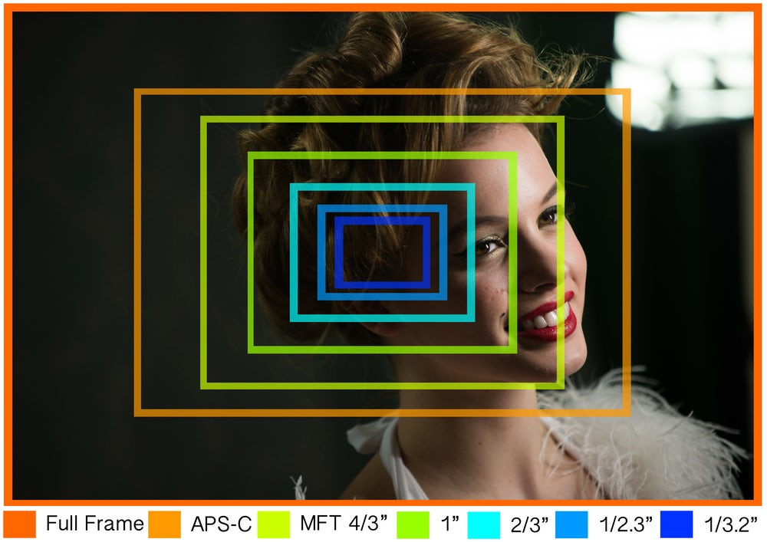
Imaging PL: RGB (Images & Videos)
Important Considerations:
Physical sensor matters → FOV
Source: Newatlas
XXXX

Slide 12
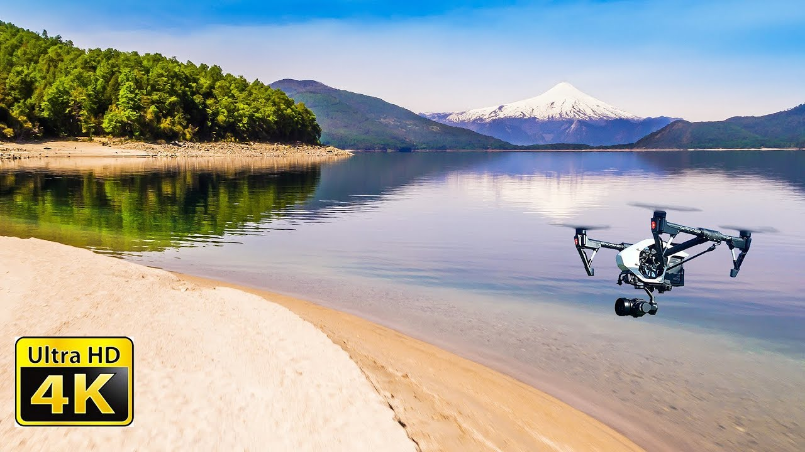
Imaging PL: RGB (Images & Videos)
Important Considerations:
Platforms (fixed wing vs VTOL) contribute to feasibility and quality of video
For video, determine end product needs
  4K HD is data intensive
Source: YouTube
4K 60 fps drone footage - Patagonia (YT)

Slide 13
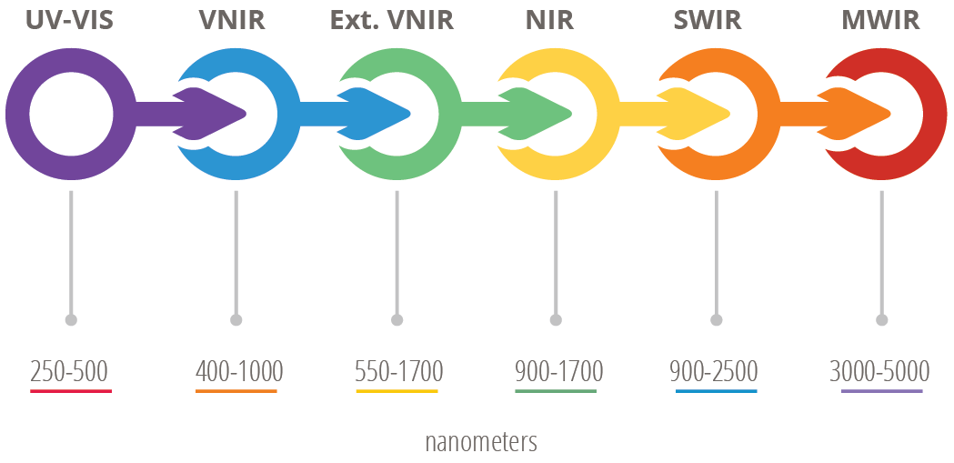
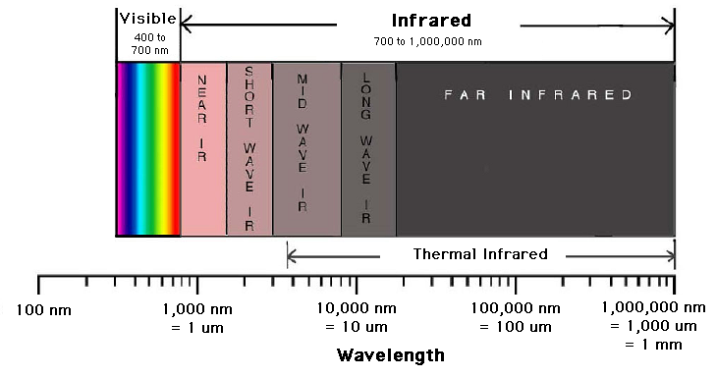
Imaging PL: IR (Images)
Technology Overview:
Electromagnetic Spectrum:
  Vis & NIR (400-1000nm) for veg
  LWIR (8-15μm) for thermal
Source: Digital Earth Watch
Notes:
1000nm = 1um
http://dew.globalsystemsscience.org/key-messages/near-infrared-and-the-electromagnetic-spectrum
https://en.wikipedia.org/wiki/Infrared

Slide 14
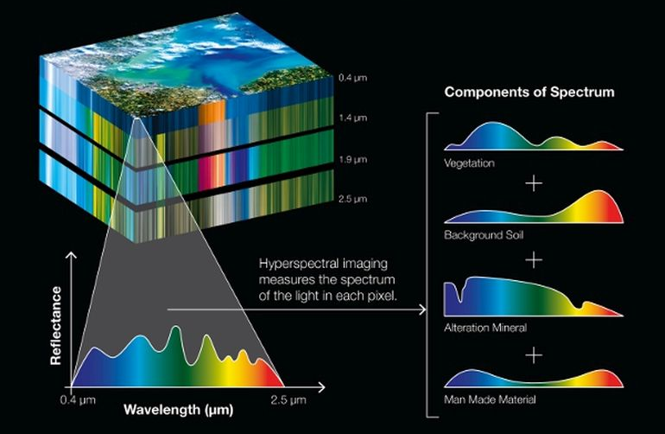
Imaging PL: IR (Images)
Technology Overview:
Electromagnetic Spectrum:
Notes:
1000nm = 1um

Slide 15
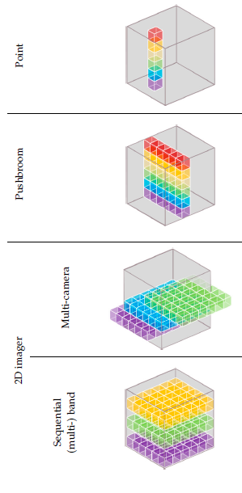
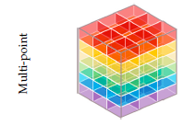
Imaging PL: IR (Images)
Technology Overview:
IR sensor data capture techniques
  Impacts how image/data cube is produced
Notes:
1000nm = 1um

Slide 16
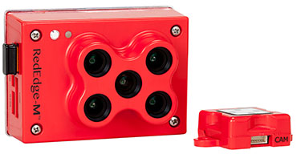
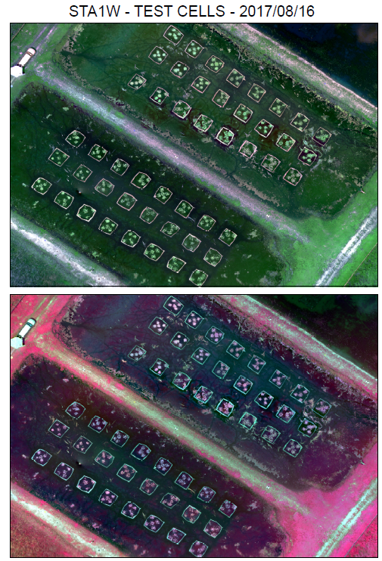
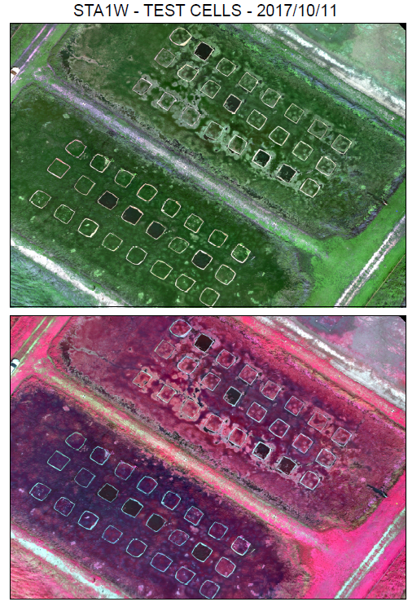
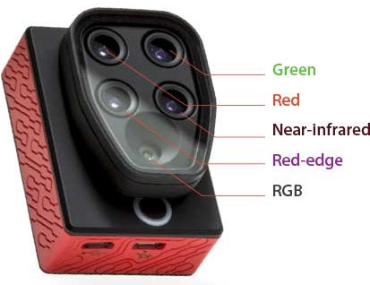
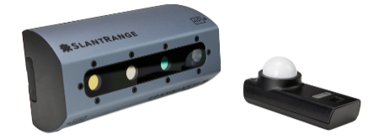
Imaging PL: IR (Images)
Examples/Typical Uses:
Multispectral: 4-5 bands (1-2 NIR)
MicaSense RedEdge
Parrot Sequoia
SlantRange 4P+
XXXX
Notes:
https://www.slantrange.com/product-sensor/

Slide 17
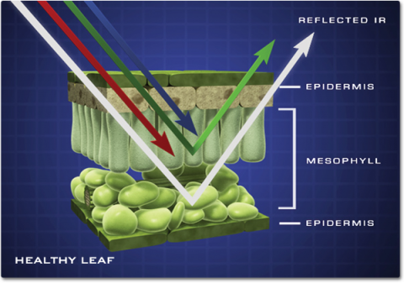

Imaging PL: IR (Images)
Examples/Typical Uses:
Multispectral: Absorption & Reflectance Principles
Source: NASA

Slide 18
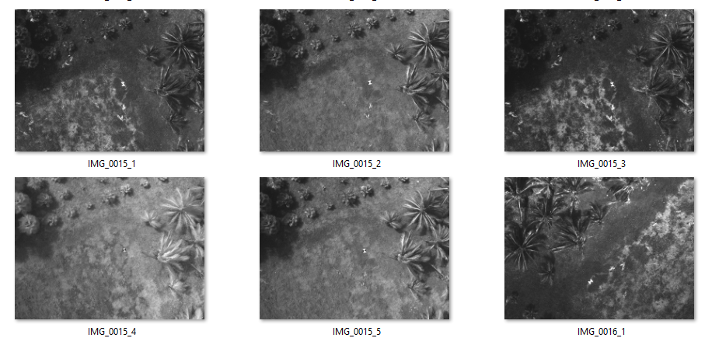
Imaging PL: IR (Images)
Examples/Typical Uses:
Multispectral: Multi-camera output example (RedEdge)
Blue (475nm)
Green (560nm)
Red (668nm)
NIR (840nm)
RedEdge (717nm)
Blue (475nm)
Notes:
If rededge diagram is needed, see here: https://www.questuav.com/media/case-study/multispectral-questuav-micasense-rededge/

Slide 19
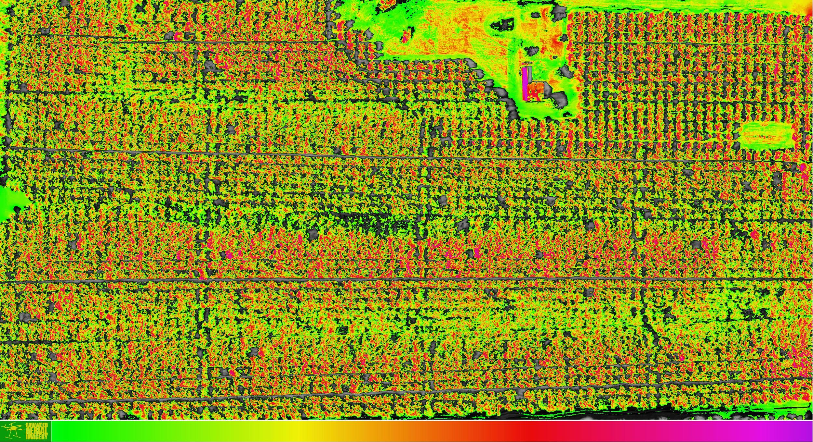
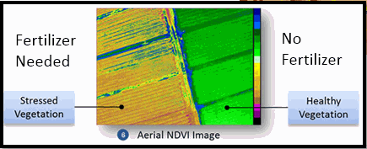
Imaging PL: IR (Images)
Examples/Typical Uses:
Multispectral: vegetation health (NDVI)
Source: SAM

Slide 20
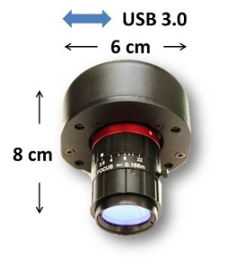
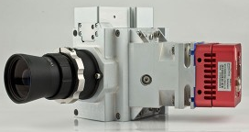
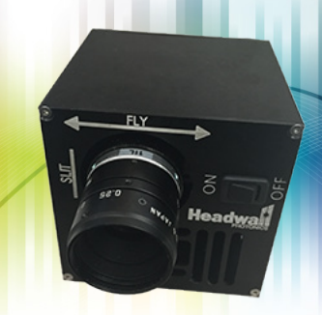
Imaging PL: IR (Images)
Examples/Typical Uses:
Hyperspectral: Diversity, Species, Status/stress, Nutrients
Bayspec
SPECIM
AisaKESTREL
Headwall
Nano-Hyperspec
Source: E. Broadbent
Notes:
http://www.bayspec.com/spectroscopy/oci-uav-hyperspectral-camera/
Bayspec makes UAV1000 which is pushbroom. UAV2000 is snapshot
https://cdn2.hubspot.net/hubfs/145999/June%202018%20Collateral/NanoHyperspec0118.pdf
http://www.specim.fi/hyperspectral-remote-sensing/
Diversity, Species, Status and stress, Nutrients

Slide 21
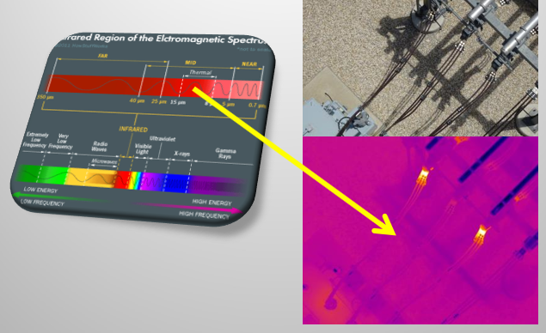
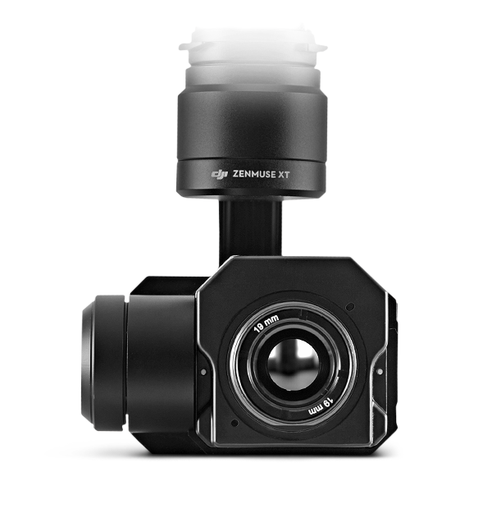
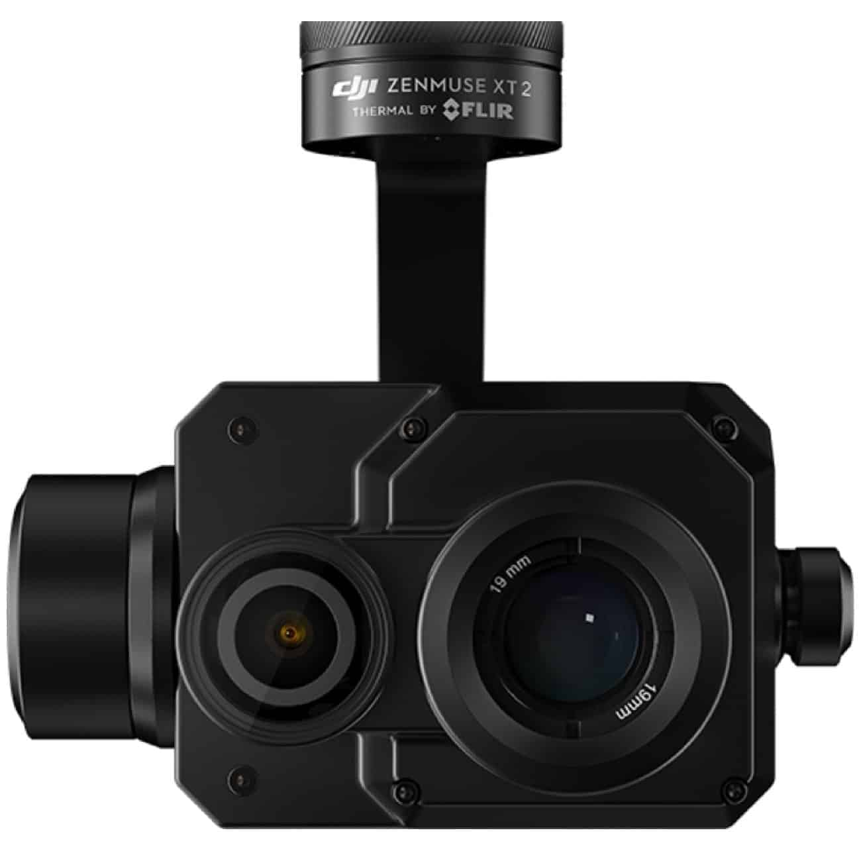
Imaging PL: IR (Images)
Examples/Typical Uses:
Thermal: 8-15μm
Source: SAM
FLIR Zenmuse XT
FLIR Zenmuse XT2
Notes:
https://www.flir.com/products/zenmuse-xt-premium-aerial-thermal-imaging/

Slide 22
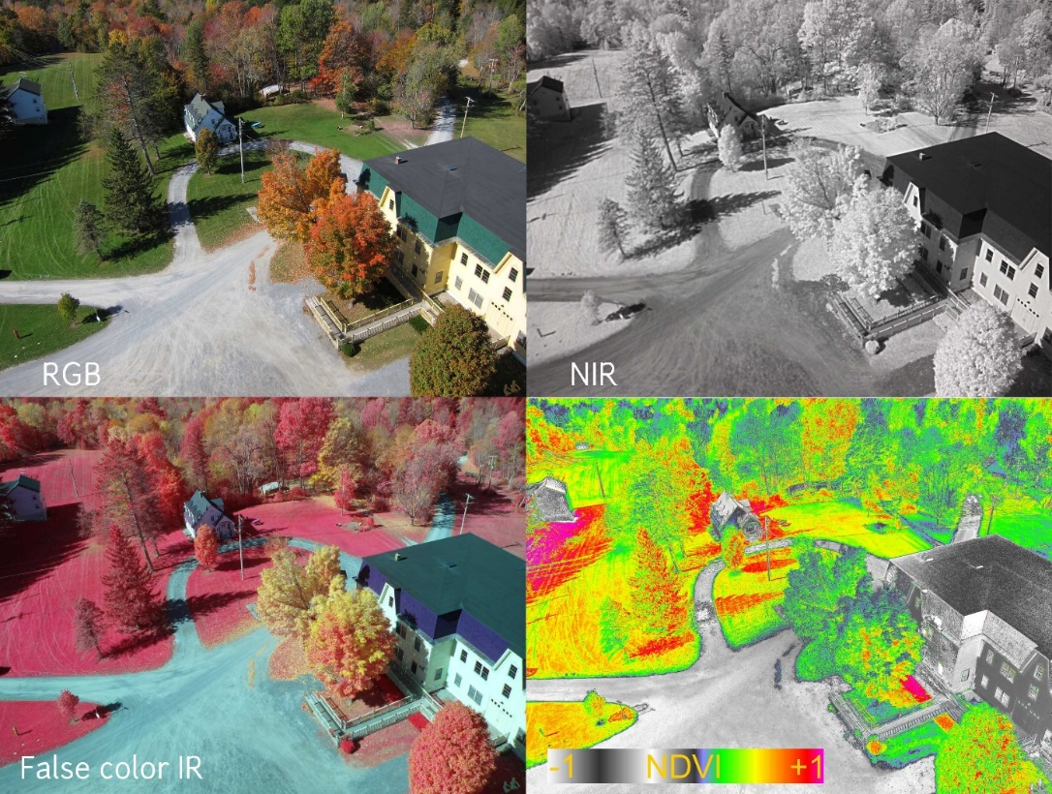
Imaging PL: IR (Images)
Important Considerations:
Data capture technique → high accuracy INS may be required (expensive!)
Consider spat. res. req. for given application
  Community vs species classification
  Thermal typically poor spat. res.
Conversion of irradiance to
reflectance (MS/HS)
  Radiometric calibration!
  Buyer beware on simple,
  OTS cloud-based processing
  solutions

Slide 23
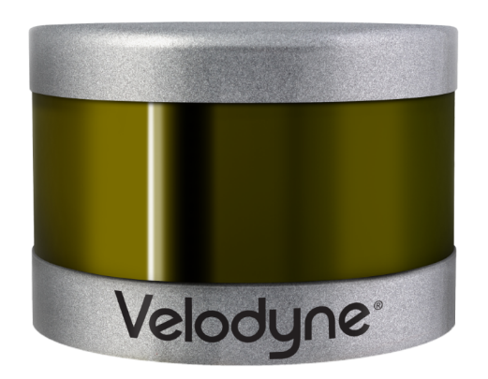
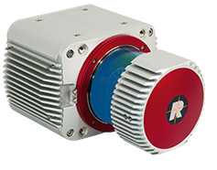
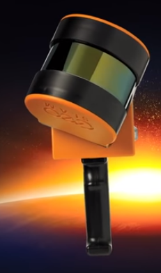
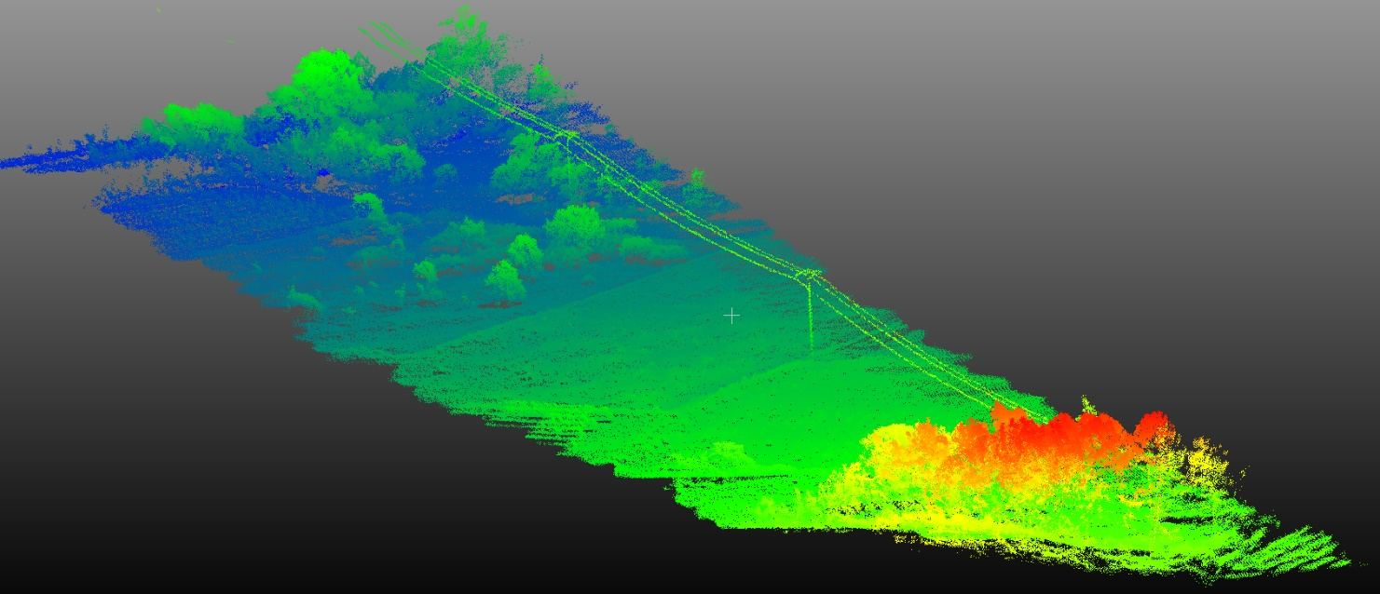
Imaging PL: Lidar (Point Clouds)
Examples/Typical Uses:
Lidar
UF Stadium Lidar
Velodyne
VLP-16
Riegl
VUX-1UAV
GeoSLAM Zeb Horizon
GeoSLAM ZEB Horizon Promo (YT)
XXXX
Notes:
gWmq2EKZj0Q
http://www.riegl.com/products/unmanned-scanning/riegl-vux-1uav/
VUX SPECS - 10 mm survey-grade accuracy
scan speed up to 200 scans / second
measurement rate up to 500,000 meas./sec
(@ 550 kHz PRR & 330° FOV)

Slide 24


Imaging PL: Lidar (Point Clouds)
Important Considerations:
Similar to pushbroom hyperspectral, needs quality INS to georef PC
Number of returns/pulse is important for veg. areas
Range → low-end designed for cars (>100m)
Future improvements:
Source: SPAR
https://support.geocue.com/waveform-data-terrascan/
Notes:
http://www.mapix.com/wp-content/uploads/2018/07/63-9229_Rev-H_Puck-_Datasheet_Web-1.pdf
https://www.spar3d.com/news/lidar/mits-10-lidar-chip-will-change-3d-scanning-know/

Slide 25


Imaging PL: Sensor Fusion
Examples:
GeoCue - True View
Source: Geocue
Notes:
https://geocue.com/products/trueview/
Has applanix APX for INS

Slide 26


Imaging PL: Sensor Fusion
Examples:
GatorEye – Unmanned Flying Laboratory
Source: E. Broadbent

Slide 27

THANK YOU!
?s
abenjamin1@ufl.edu
mygeomatics.com
abenjamin1@ufl.edu
mygeomatics.com
earl@gpserv.com
www.gpserv.com

