Slide 1
NOAA’s Digital Coast More Than Just Data
Tarice Taylor
Lynker Team on contract with NOAA Office for Coastal Management

Slide 2
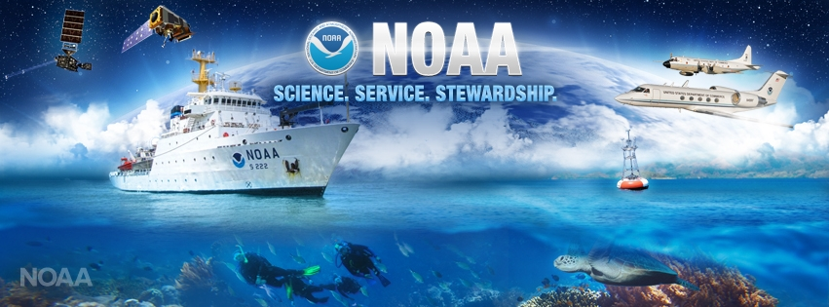
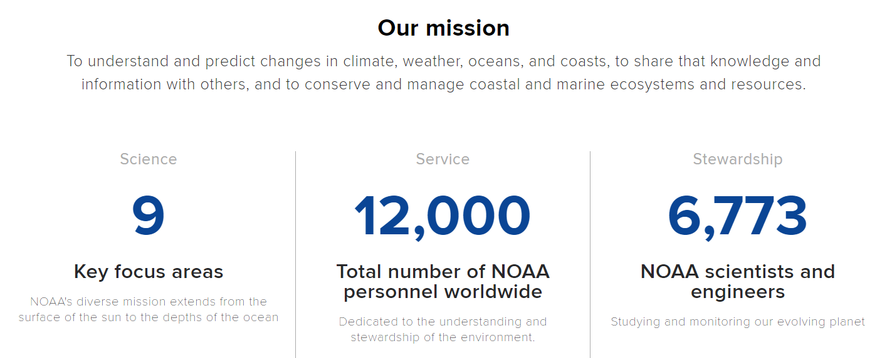

Slide 3
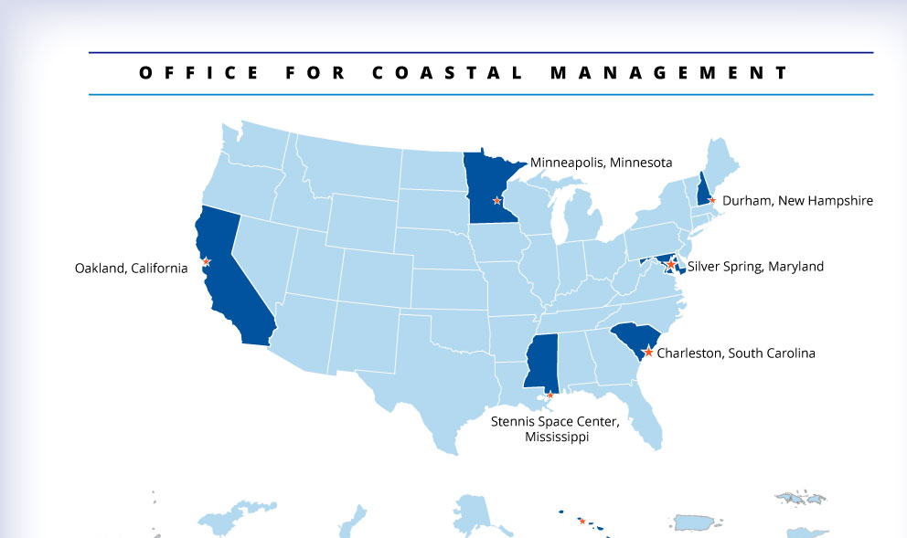
Approximately 250 people around the country
Notes:
• “Boots on the ground” is a foundational concept. Home offices are in Charleston and Silver Spring, but staff members are located throughout the coastal zone, working to serve coastal managers.
This agency, housed within NOAA’s National Ocean Service, oversees major initiatives that include the National Coastal Zone Management Program, the Coral Reef Conservation Program, the Digital Coast, and the National Estuarine Research Reserve System.
OCM fosters sound approaches to coastal management through collaborative and leveraged approaches, science-based decision making, capacity building, smart governance and investments, and inspiring, educating, and motivating people

Slide 4
Digital Coast Partnership
American Planning Association (APA)
Association of State Floodplain Managers (ASFPM)
Coastal States Organization (CSO)
National Association of Counties (NACo)
National Estuarine Research Reserve Association (NERRA)
National States Geographic Information Council (NSGIC)
The Nature Conservancy (TNC)
Urban Land Institute (ULI)
NOAA Office for Coastal Management (OCM)
Notes:
Key Message: The Digital Coast Partnership started in 2007 with 6 members: NOAA, ASFPM, CSO, NACo, NSGIC, and TNC. It was expanded in 2010 to include APA and again in 2013 to include NERRA and ULI.
These national level organizations represent coastal managers at various scales: state (CSO) and local (NACo), or represent subject matter expertise in coastal issue areas: coastal inundation (ASFPM), natural/nature-based techniques (TNC), geospatial information management (NSGIC), planning (APA) and real estate/land development (ULI).

Slide 5
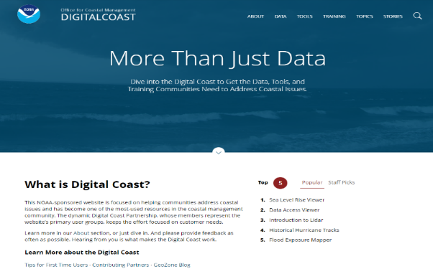
Digital Coast Enabling Platform
coast.noaa.gov/digitalcoast
Notes:
Key Message: Most people know the Digital Coast by our web presence, but it is important to note that the Digital Coast is more than just a website. It is also a Partnership (more on this in a moment). The Digital Coast Enabling Platform is built on the interaction between the Digital Coast Partners and users and the website. This connection is critical to the platform’s success.

Slide 6
More About Digital Coast
Approach: Bring the geospatial and coastal management communities together
Outcome: A constituent-driven, integrated enabling platform supporting coastal resource management

Slide 7
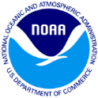
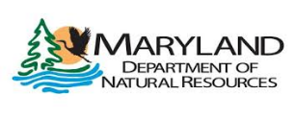
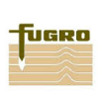
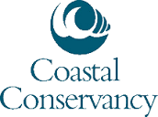
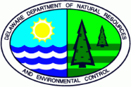
A Small Sampling of Our Contributors
Federal | State | NGO | Academic | Private

Slide 8
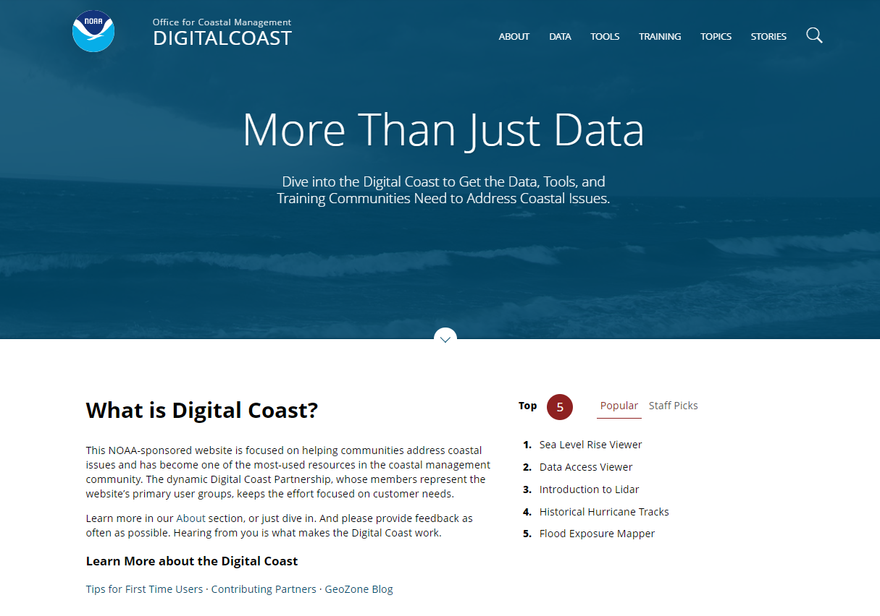
Digital Coast Website
Data, tools, training, and case studies
Enhanced utility and application
Demonstration of geospatial information
Notes:
8

Slide 9
Sample of Coastal Community Questions
How many people in county’s coastal floodplain?
How can I assess stormwater flooding risk?
What are potential impacts of coastal storms and sea level rise?
How many jobs in my state or county are supported by the ocean?
Where can I find training and other learning resources?
Where do I find lidar and other geospatial data for my area?
How is the coastal landscape changing over time?

Slide 10
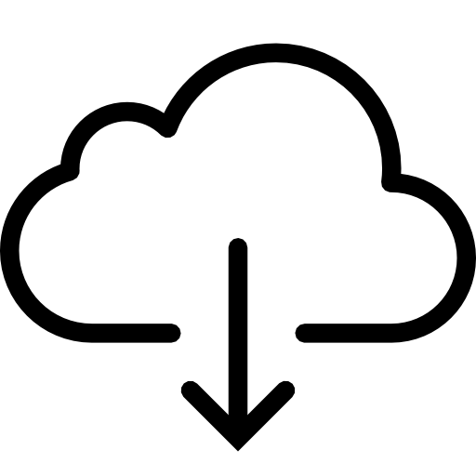
A Broad Spectrum Approach: Facilitating Use and Application
DISCOVER
DOWNLOAD
MAP
ANALYZE
LEARN
SHARE
DATA
INFORMATION
ACTION
Notes:
DISCOVER info on the C-CAP land cover data set, DOWNLOAD land cover data for your community via the Data Access Viewer, DEVELOP mash-ups with ESRI and Open Geospatial Consortium map services, ANALYZE change in your county with Land Cover Atlas, LEARN from data experts through recorded webinars, SHARE outcomes with others through stories from the field

Slide 11
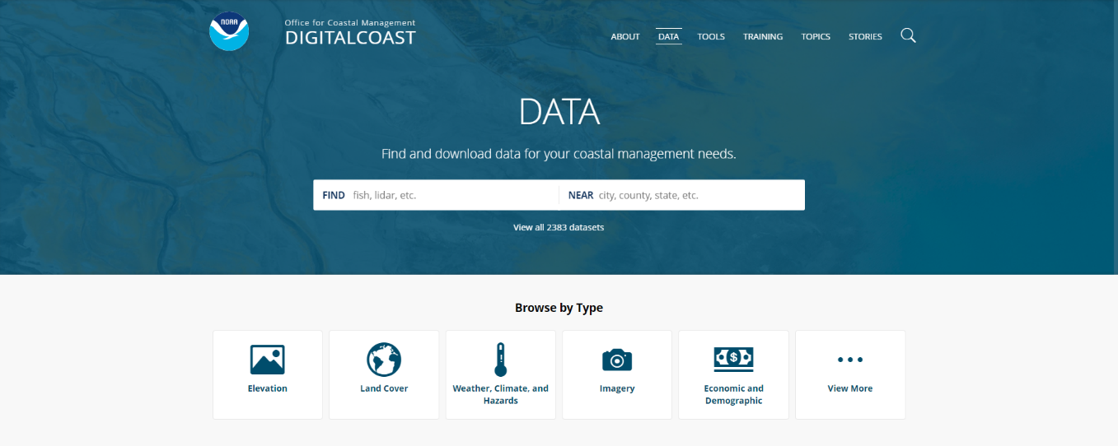
Digital Coast by the Numbers
Training
190+ learning resources
Stories from the Field
120+ narratives
Data
100+ terabytes
40+ national-level data sets
Tools
65+ tools
Notes:
Data
100+ terabytes of high-resolution elevation data, land cover data, and orthoimagery
200+ web mapping services
Linkages to over 40 national-level coastal data sets
Tools
An inventory of over 68 tools – many provide visualization and analysis capabilities without need for GIS software
Training
Over 190 learning resources
Classroom and online instructor-led training, self-guided resources, publications & quick references, case studies, videos & webinars
Stories from the Field
120+ narratives that demonstrate the application of geospatial information to coastal issues

Slide 12
Notes:
Key Message: The mapper is a screening-level tool with existing national data that are locally relevant. The mapper was developed to get the conversation started around coastal flood hazard risks and associated vulnerabilities, but we encourage users to obtain local data to conduct more detailed analyses, if necessary.
The concept for a coastal flooding composite hazard layer contained within the tool was initially developed for coastal areas of New York after Hurricane Sandy to depict geographically dependent susceptibility to coastal flooding, storm surge, and long-range inundation impacts. The mapping method was modified and expanded to the rest of the East Coast, Gulf of Mexico, and Pacific and Caribbean islands and territories for the Coastal Flood Exposure Mapper. This map layer aggregates risk information for multiple coastal flood hazards. This map shows the gradient of coastal flood risk that ranges from areas outside the FEMA 1% annual chance floodplain that are still at risk from high magnitude, low frequency events like major land-falling hurricanes and tsunamis, to areas nearer the coast that are also at risk from higher frequency flood events, wave impacts, and long-term sea level change. At any given location the user can query which coastal flood hazards may impact that spot. This layer should not be confused with, and may not be substituted for, any existing regulatory risk maps or associated boundaries. These maps are for planning purposes only.

Slide 13
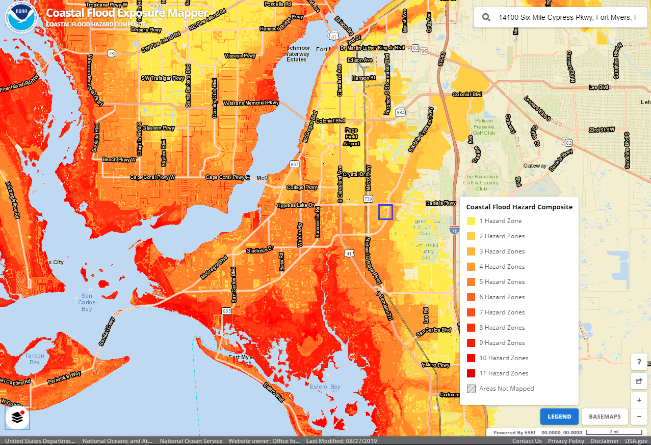
Coastal Flood Exposure Mapper
Notes:
The concept for a coastal flooding composite hazard layer contained within the tool was initially developed for coastal areas of New York after Hurricane Sandy to depict geographically dependent susceptibility to coastal flooding, storm surge, and long-range inundation impacts. The mapping method was modified and expanded to the rest of the East Coast, Gulf of Mexico, and Pacific and Caribbean islands and territories for the Coastal Flood Exposure Mapper. This map layer aggregates risk information for multiple coastal flood hazards. This map shows the gradient of coastal flood risk that ranges from areas outside the FEMA 1% annual chance floodplain that are still at risk from high magnitude, low frequency events like major land-falling hurricanes and tsunamis, to areas nearer the coast that are also at risk from higher frequency flood events, wave impacts, and long-term sea level change. At any given location the user can query which coastal flood hazards may impact that spot. This layer should not be confused with, and may not be substituted for, any existing regulatory risk maps or associated boundaries. These maps are for planning purposes only.

Slide 14
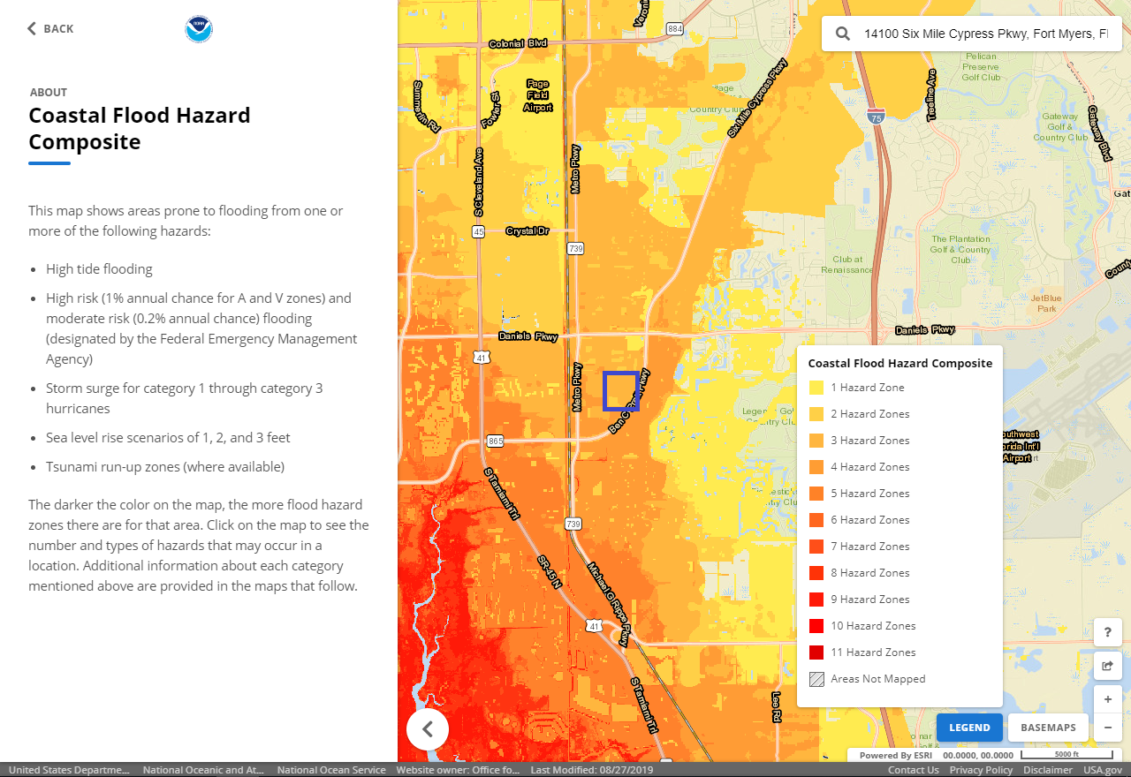
Coastal Flood Exposure Mapper

Slide 15
Questions?
Tarice.Taylor@noaa.gov

