Slide 1
Land Use Modeling
Lee County MPO – 2045 LRTP
GIS Symposium November 7th, 2019

Slide 2


Metro Forecasting Models
Nationally Recognized Forecasting Firm
  Specializes in land use development forecasting
  Creators of the Interactive Growth Model®
  Used by governments and private industries for over 35 years
  Staff consists of planners, economists, and research specialists
Dr. Paul Van Buskirk,
PhD, AICP, PE
David Farmer, AICP, PE, CGC

Slide 3
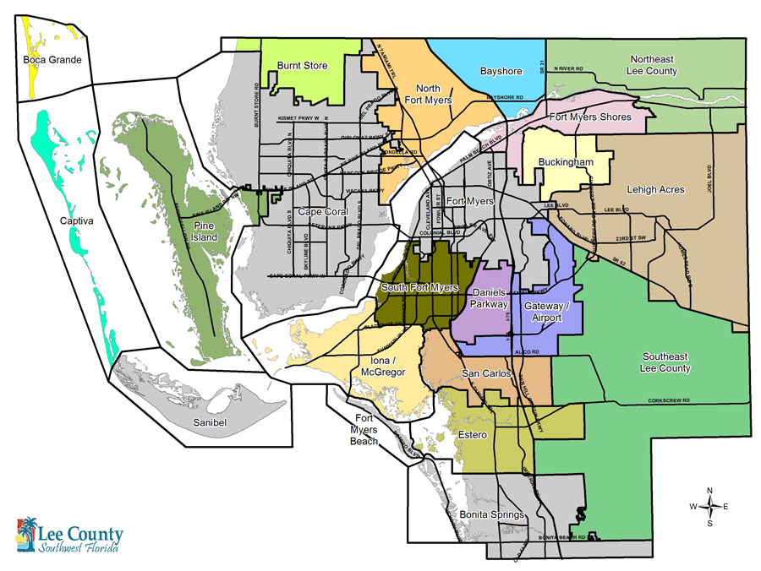
By the Numbers
Lee County:
1,566 zones
22 planning communities
6 cities
Analyzed:
Vacant Land
Demographics
Long-term trends

Slide 4

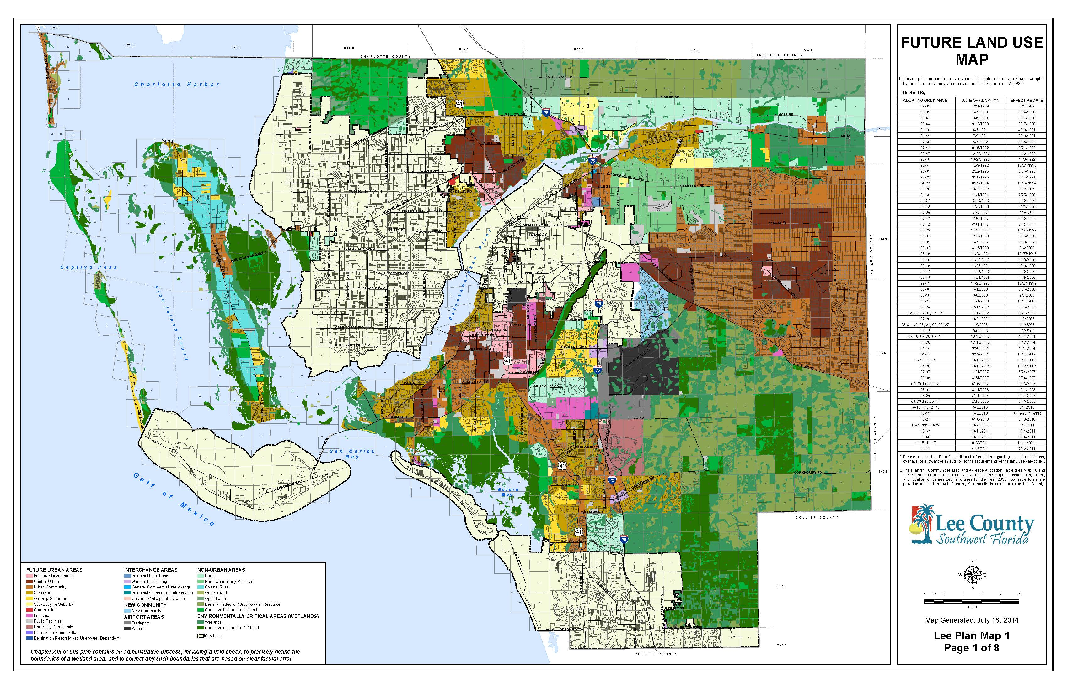
Integrating Land Use
GIS collects and layers spatial datasets
Provides a comprehensive overview of growth factors
Provides ability to analyze planning communities individually

Slide 5

Lee County Data
2045 Spatial Socioeconomic Data for Traffic Models
Housing units
People
Generators and attractors (origins and destinations of trips)
  Commercial retail
  Commercial office
  Shopping Centers
  Industrial
  Schools
  Hotels

Slide 6
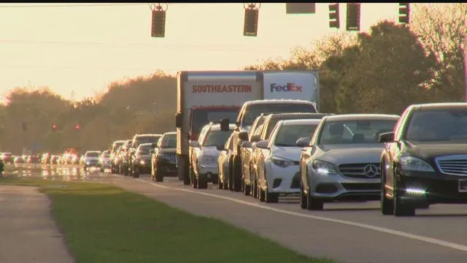
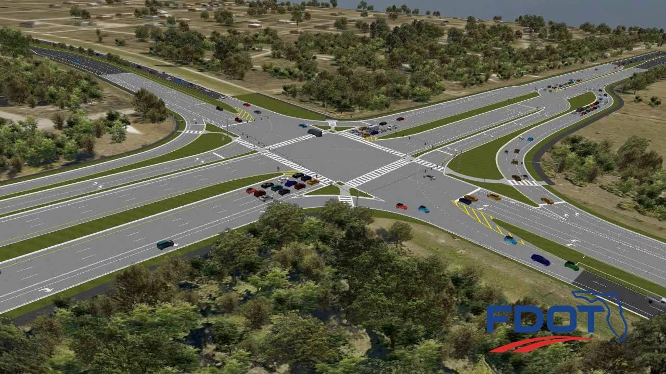
Planning for Transportation
Where will future schools, parks, and shopping centers be located? How will this affect trip lengths?
Are infrastructure plans appropriate to support growth?
Spatially forecasting growth with GIS is vital to the planning process.

Slide 7
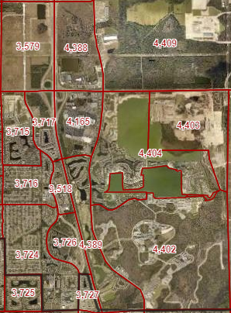
Land Use Analysis w/ GIS Tools
Accurate baseline of existing land uses and structures by TAZ
Growth potential for developable vacant land at Buildout
  Cleaned property appraiser data
  Zoning/FLU
  Wetlands
  Enhanced 911 Data (E 911)
  Average distance to municipal utilities

Slide 8
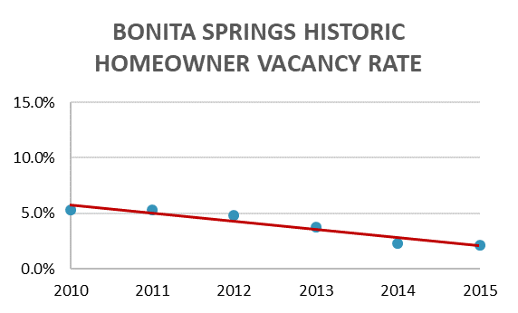
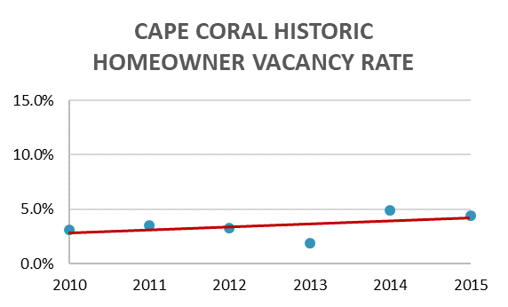
GIS Demographic Analysis
Demographics help us understand the housing demand and future population of each area
Using GIS, census demographic data is pulled and analyzed by TAZ
Evaluated spatial trends in household size and vacancy rate

Slide 9
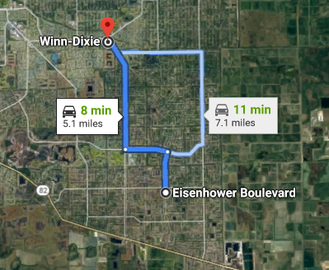
GIS Origin & Destination Planning
Spatially identify trip attractors (commercial services, schools, parks)
Forecasting where residents will live and work
Manage trip distribution

Slide 10
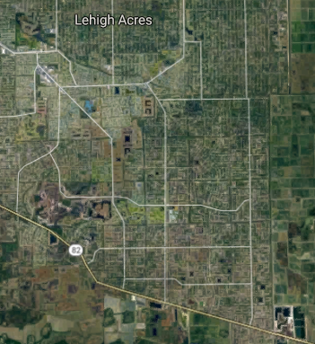



GIS Origin & Destination Planning
In 2045
Grocery trips (annually):
252,148
Vehicle Miles Travelled (annually) without local shopping center:
  2,571,910 VMT
Compare to local shopping center which would result in only 1,285,955 VMT
2045

Slide 11
Dave@metroforecasting.com
239-913-6949
Metroforecasting.com

