Slide 1
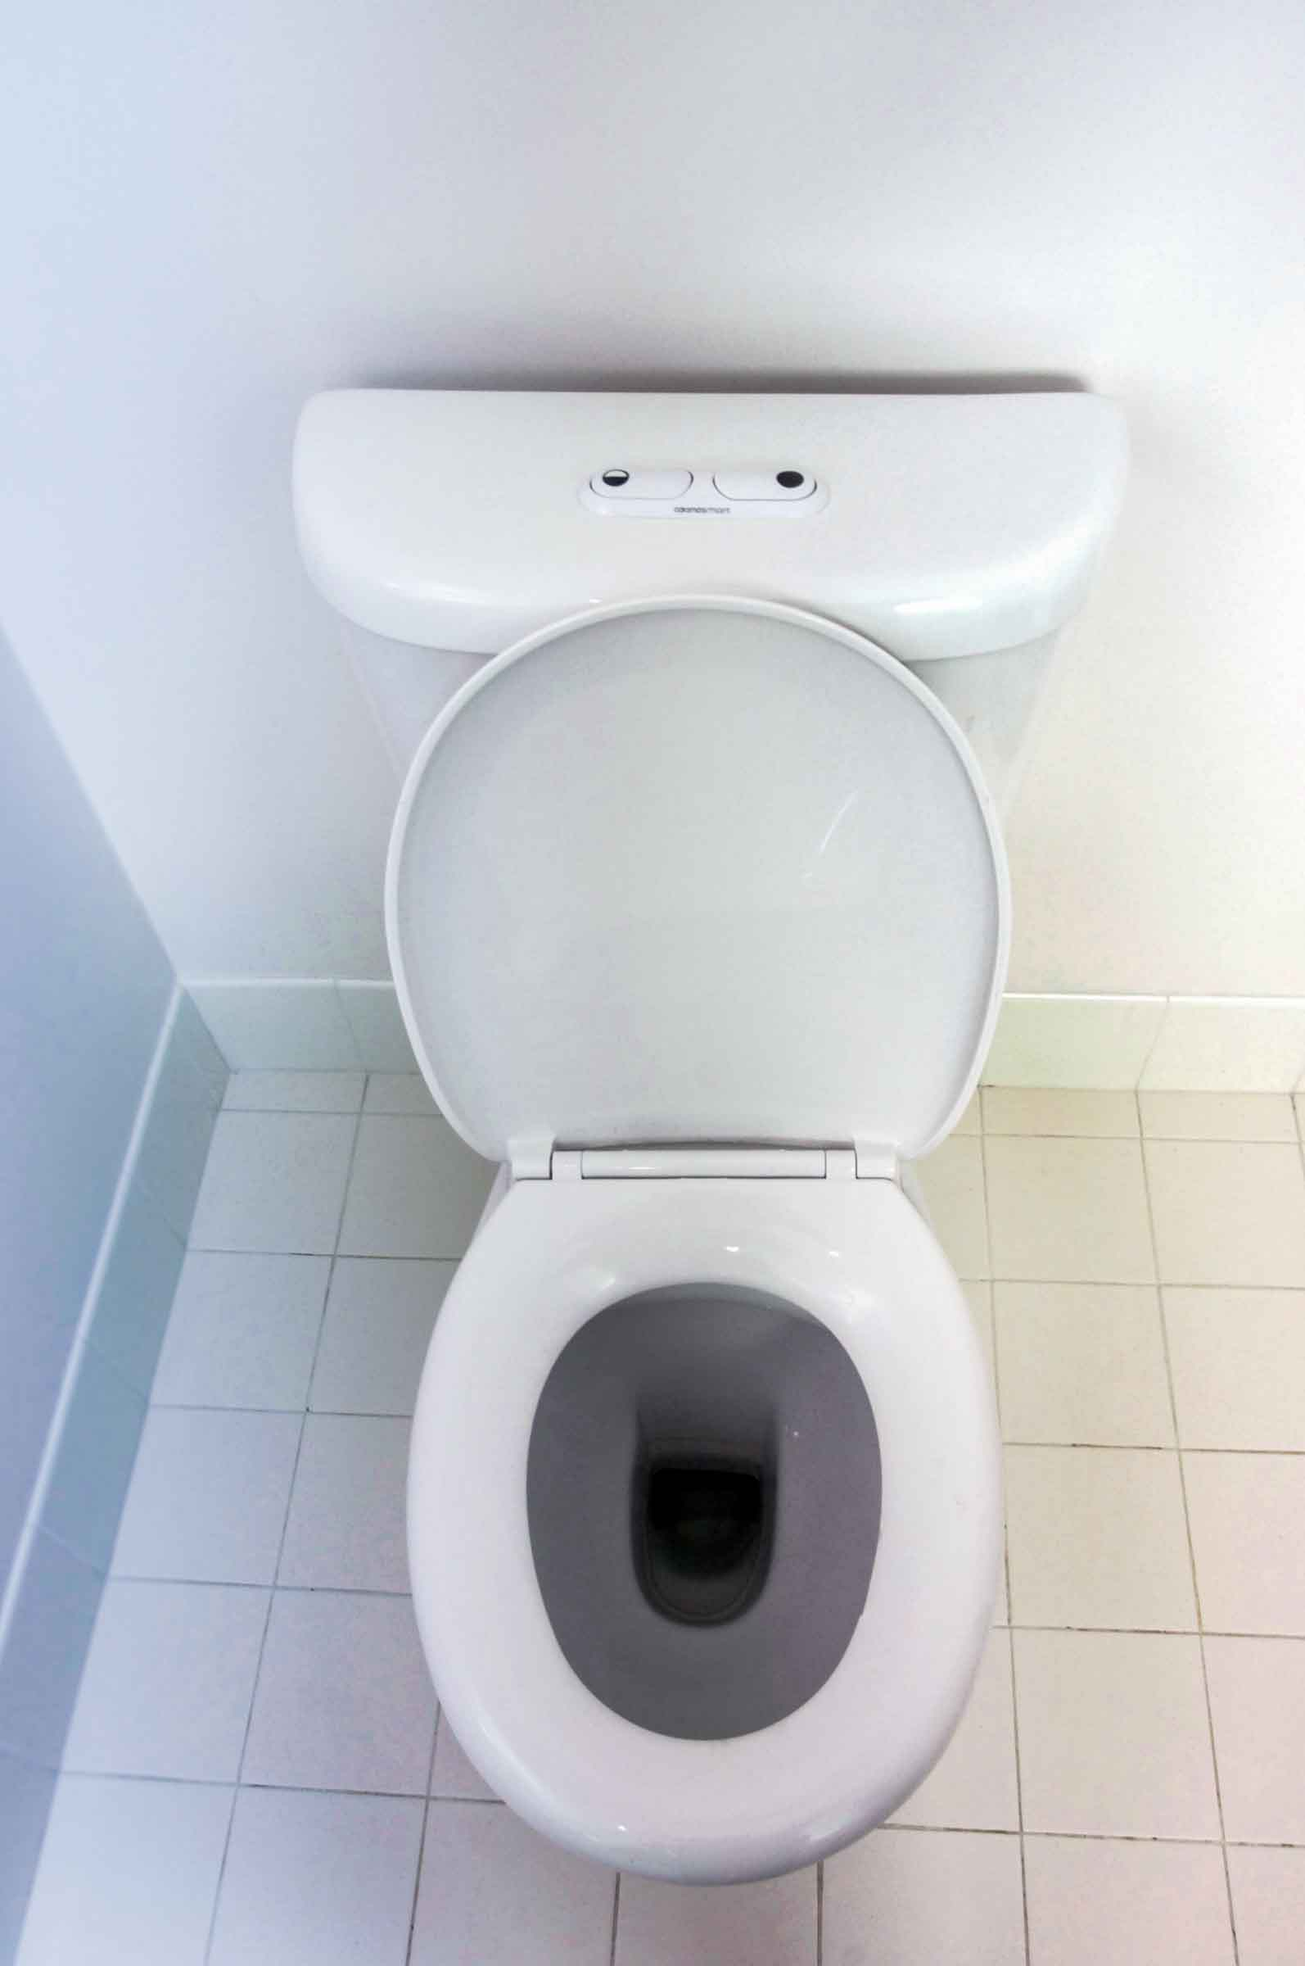
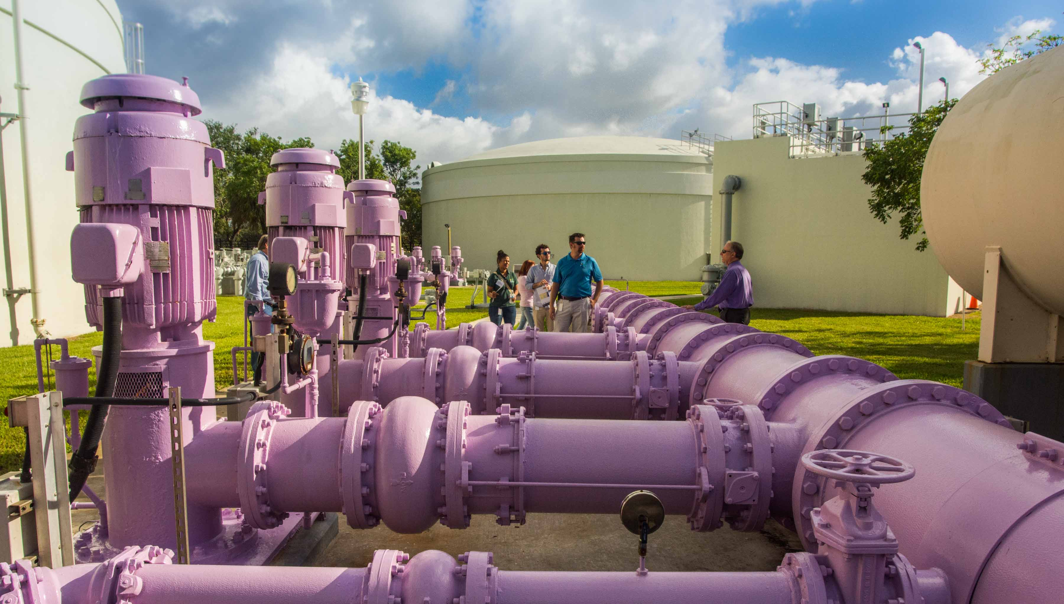
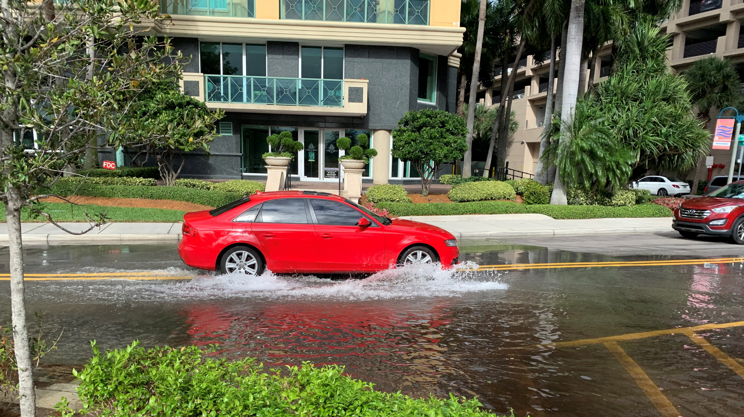
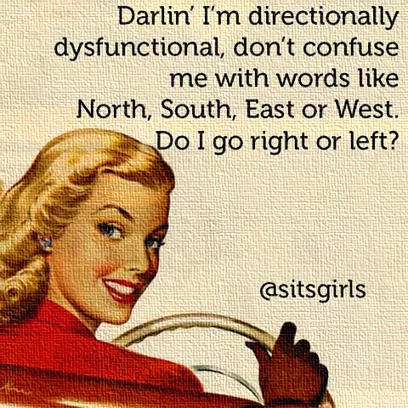
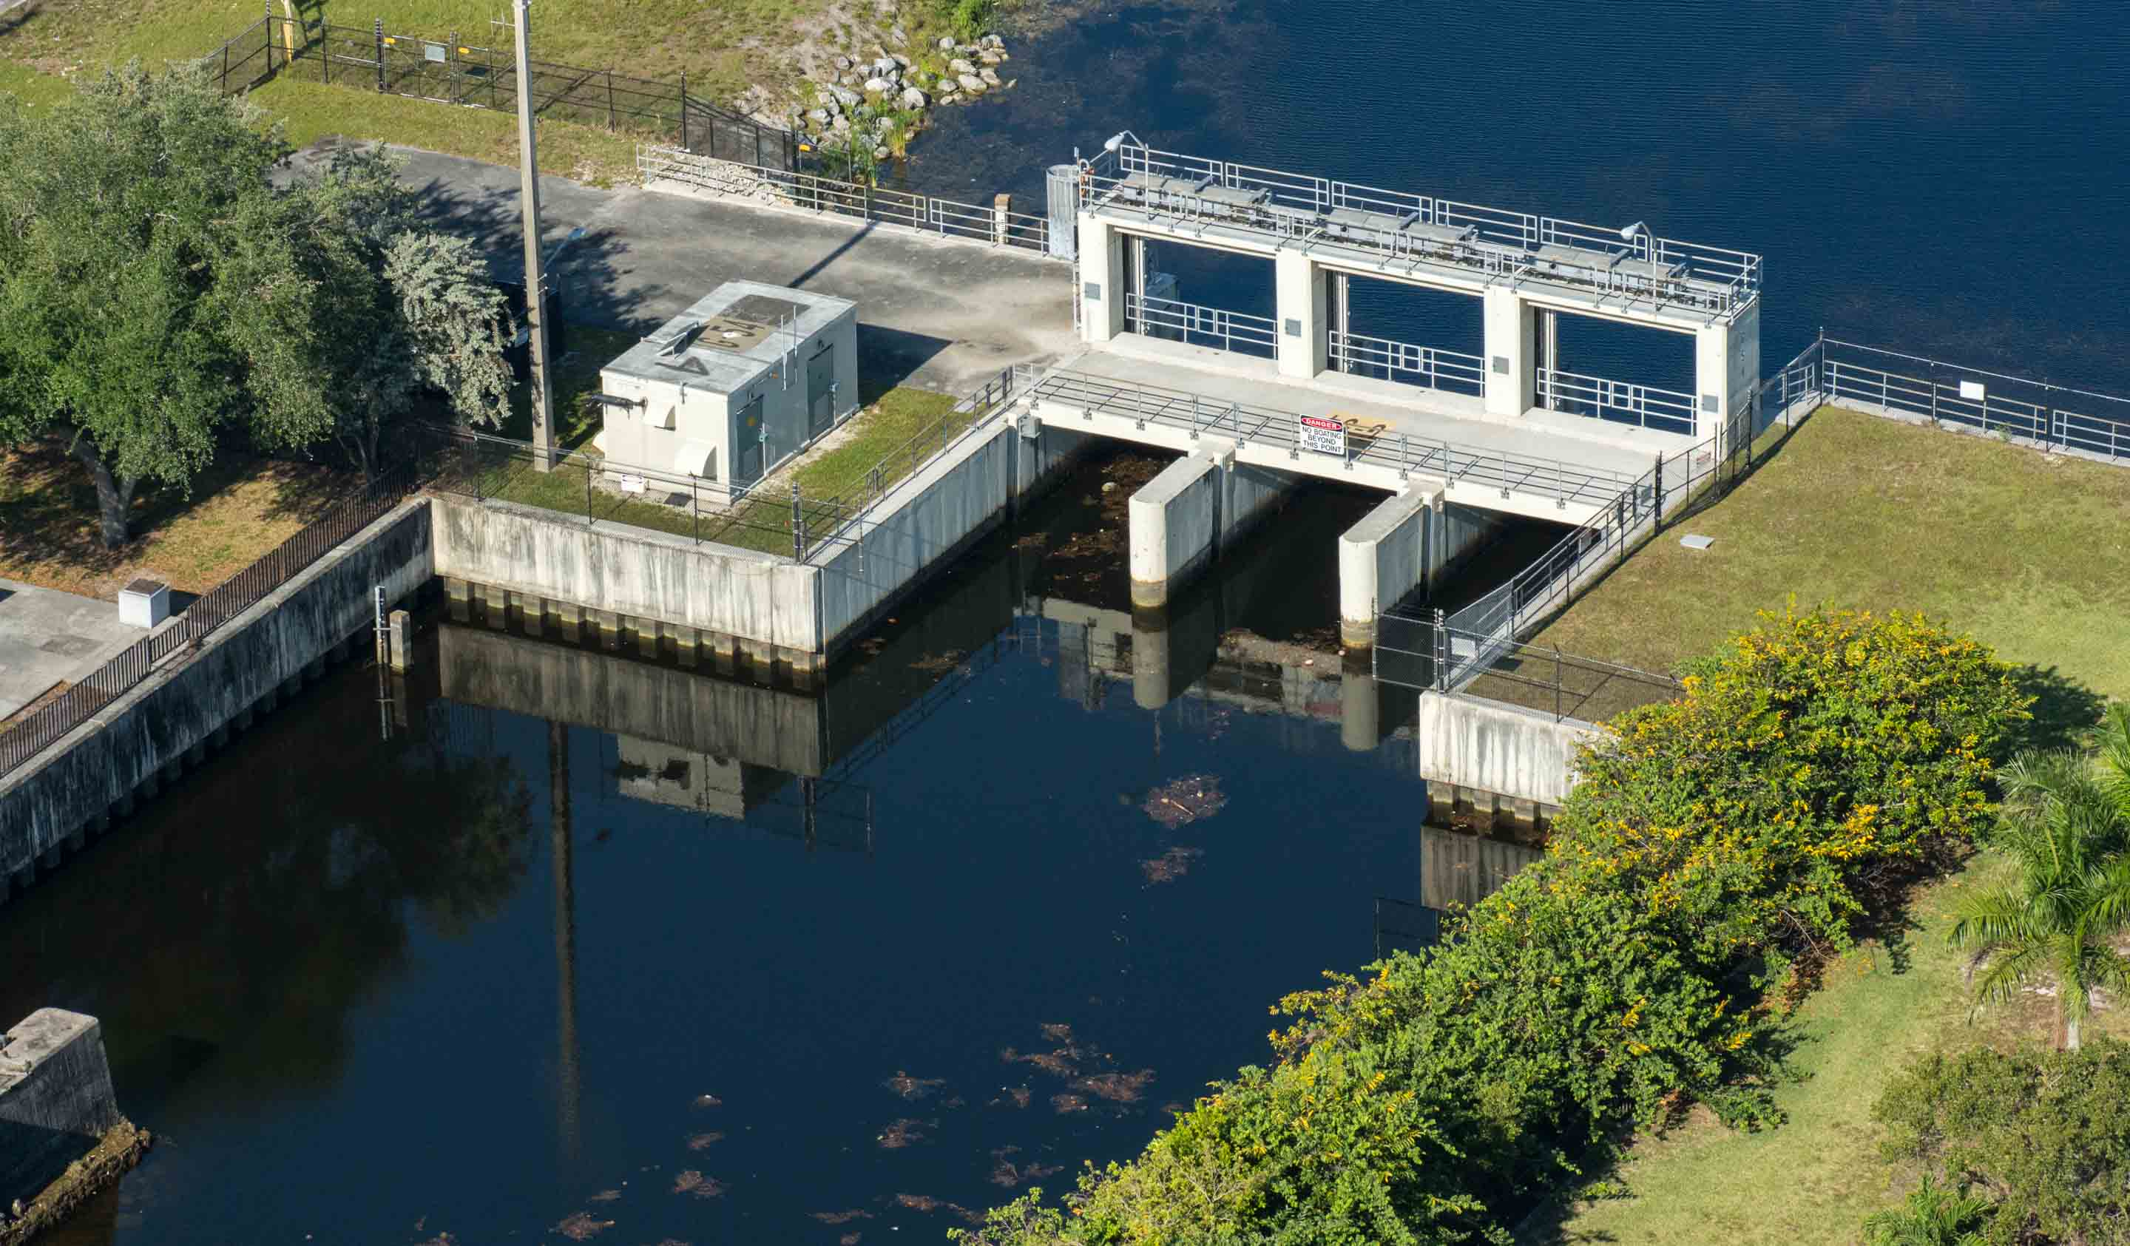
Combatting Climate Change and Resolving Future Water Vulnerabilities
Developing Dashboards for Water Utilities Resilience
Southwest Florida GIS Symposium
November 7, 2019
Sean Mador, GIS graduate student
Katie Lelis, GISP

Slide 2
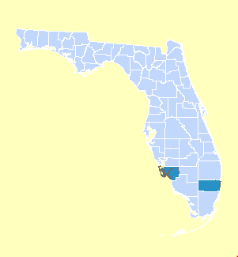
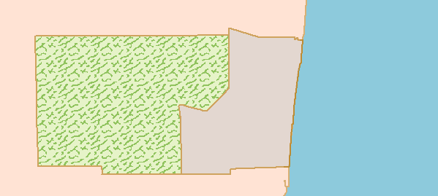
Population
Climate
Limited Water Supply
Many Stakeholders
Regional Evaluation / Collaboration to Optimize Water Management
Everglades
Urban
Atlantic
Ocean

Slide 3
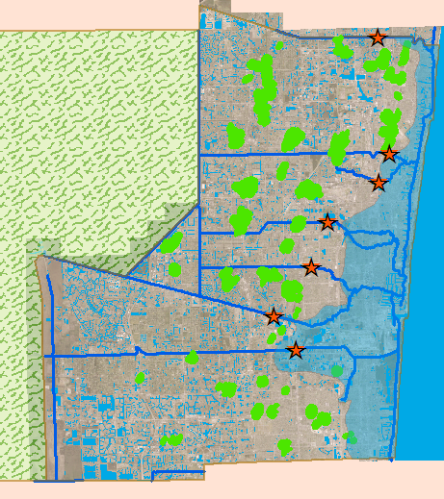
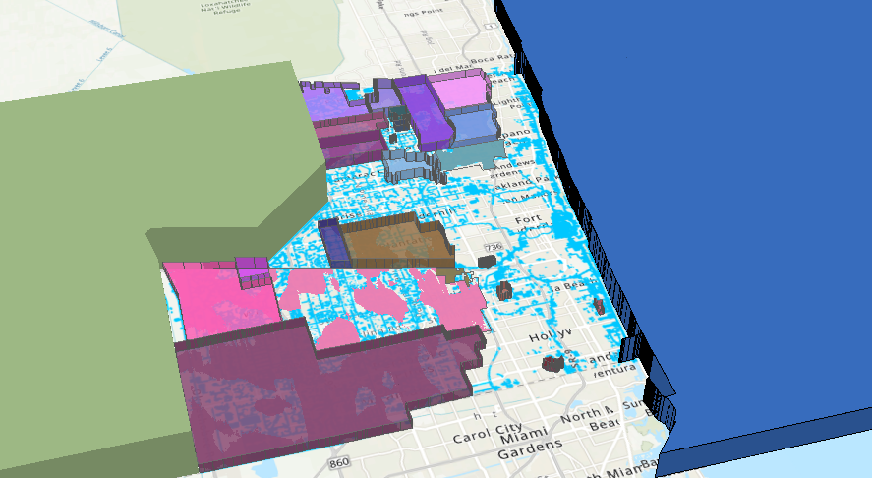
Climate Uncertainty Saltwater Intrusion Sea Level Rise

Slide 4
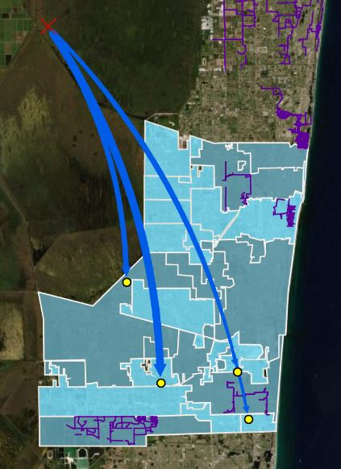
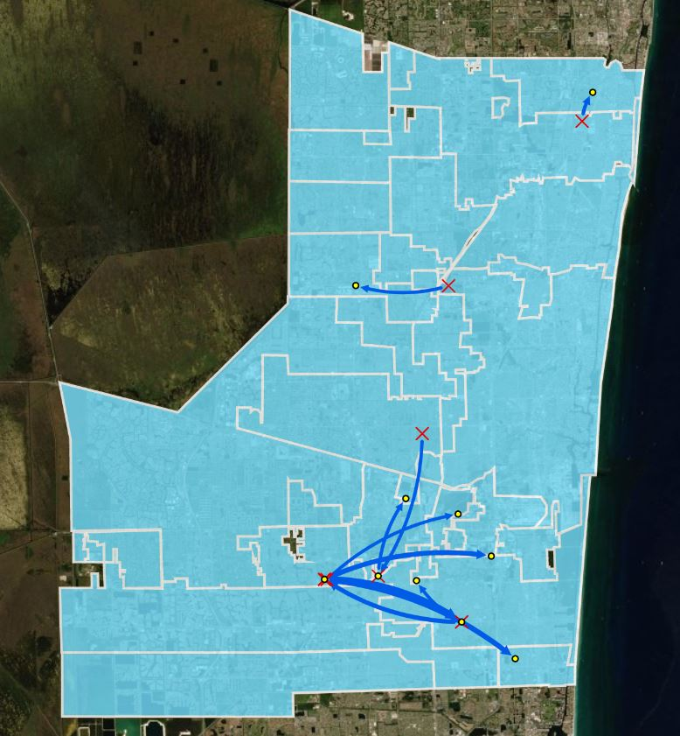
Water Conservation Utility Sharing Alternative Water Supply

Slide 5
Irrigation Restrictions
Year-Round
Conservation
Landscape
Ordinance

Slide 6
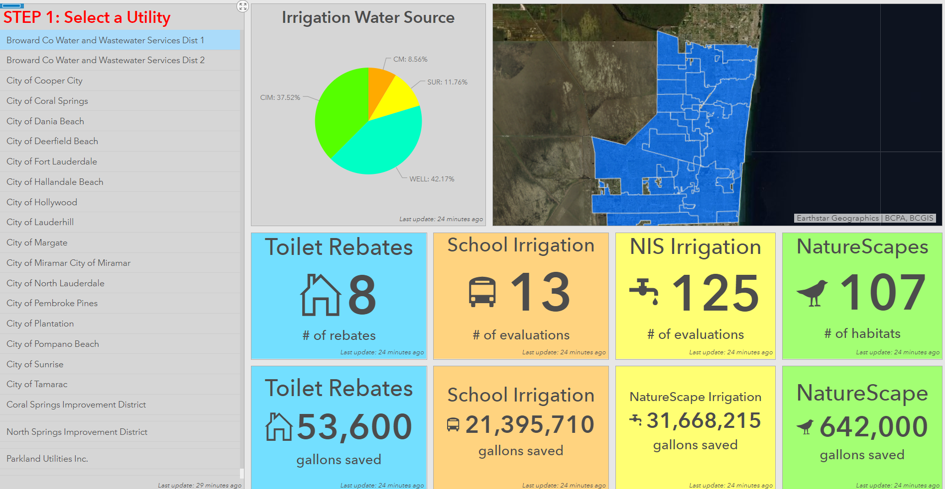
Water Conservation

Slide 7
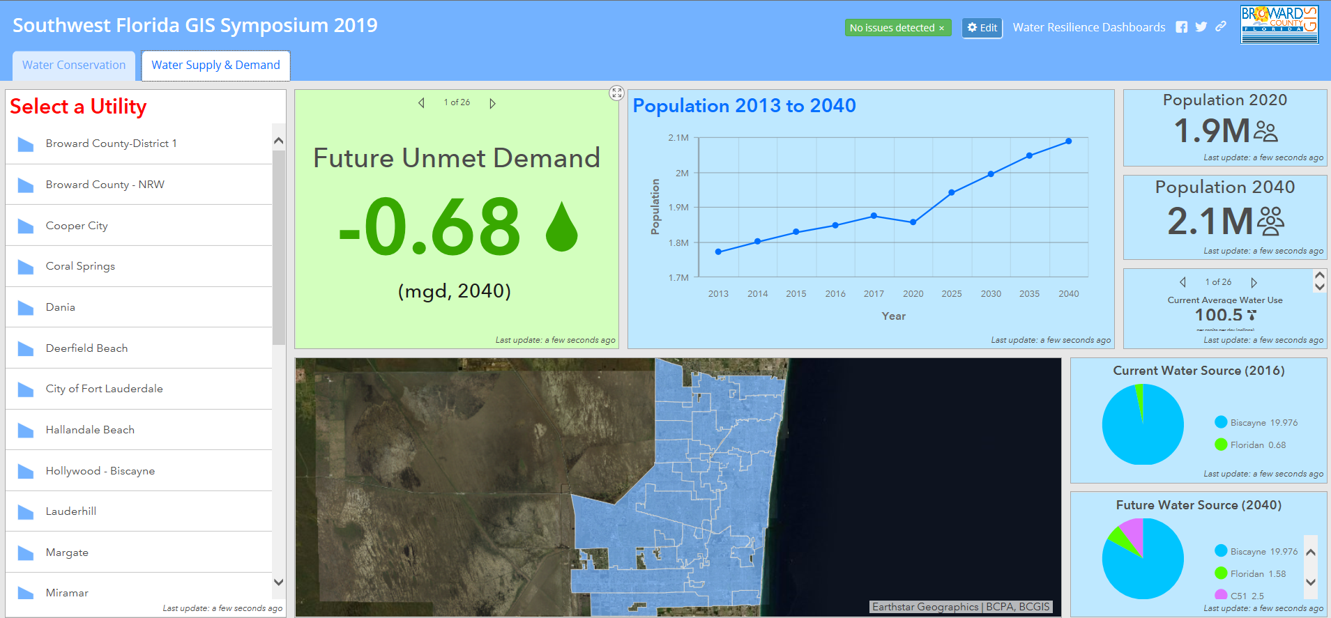
Water Supply and Demand

Slide 8
Road Bumps
Multiple Data Sources and Widely Varying Formats
Data creation and QA/QC extremely time consuming (topology errors, bad spreadsheets, #records <> #features)
Dashboard limitations require that all planning, design, and analysis be done behind the scenes before starting
ArcMap still performs better than ArcGIS Pro when it comes to analysis
Moving Forward
Equity Dashboard – (demographics, water cost, PCUR)
Q: How does water bill vary throughout the County, and is there any correlation between income and water cost?
Energy Dashboard – (water source, treatment type, energy consumption to produce and distribute)
Q: How much energy to produce drinking water?
Future Challenges
How do we keep it current? How to automate updates?
At this point we can only minimally automate because so many data sources/ formats/ manipulation
Takeaways
Regional approach, adaptive management
Operations Dashboard allows solutions to be revealed that may not be found any other way by combing complicated data into a simple format
Keep it simple, and then simplify

Slide 9
Thank You
Questions?

