Slide 1
Creating Data, Calculating Area and Saving Money Using ESRI’s Web AppBuilder
SHELLIE WATTS
GIS Coordinator
Lee County, BOCC

Slide 2
The Problem

Slide 3
The Problem
East District | Est. Acres | Note
Alva Boat Ramp | 1
Alva Wayside Park | 2
Buckingham Center | 1
Buckingham Park | 10
Charleston Park | 2
Ft Myers Shores Nature Trail | 1
Lehigh Middle School Soccer |  | Outside of Soccer fields
Hi Shellie,
I’ve been working on the park mowing contract and could use your help to check some of the acreages of some of our sites. On the attached list of parks the sites highlighted need to be checked while some are new and don’t have any acres listed at all.
I can definitely work with you on this if that would make it easier since I know most of the facilities. I’m trying to get mowing acreages that are realistic for bidding, no athletic fields are to be included they’re all mowed by park staff.
Thanks for any help you can provide,
Bob

Slide 4
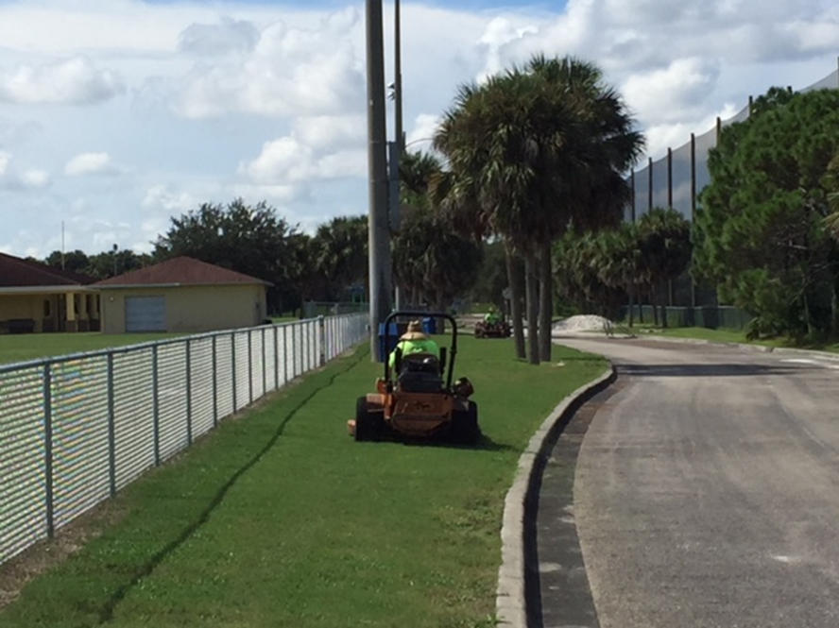
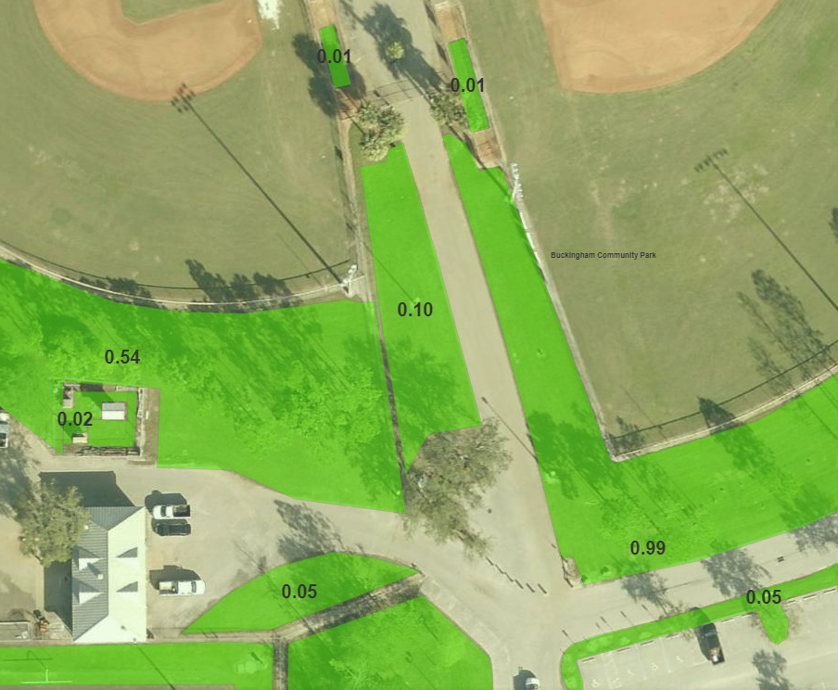

Slide 5
The Solution
Identify Parks that require Contract Mowing
Make a user-friendly, flexible web app to create Mowing Area polygons that field calculate acreage on the fly
Teach multiple non-gis staff to create and edit polygons, all at the same time
Task 1
Task 2
Task 3

Slide 6
What is Web AppBuilder for ArcGIS?
Web AppBuilder for ArcGIS is an intuitive what-you-see-is-what-you-get (WYSIWYG) application that allows you to build 2D and 3D web apps without writing a single line of code. It includes powerful tools to configure fully featured HTML apps. As you add your map and tools, you can see them in the app, and use them right away.
You can do the following with Web AppBuilder for ArcGIS:
Create HTML/JavaScript apps that run on any device.
Build the apps you need using ready-to-use widgets.
Customize the look of your apps with configurable themes.
Host your apps online or run them on your own server.

Slide 7
Title and Content Layout with Chart

Slide 8
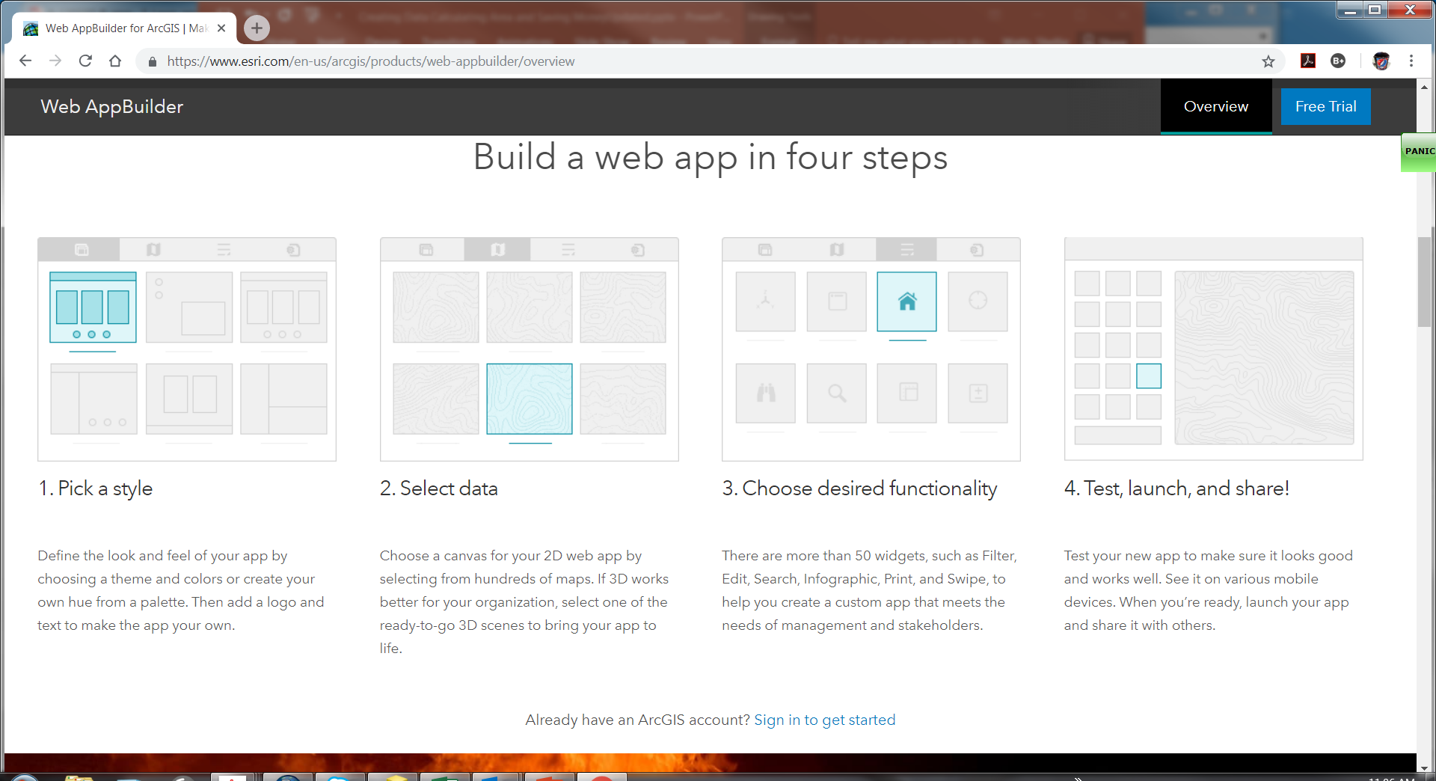

Slide 14
This is what it looks like
Mowing App

Slide 15
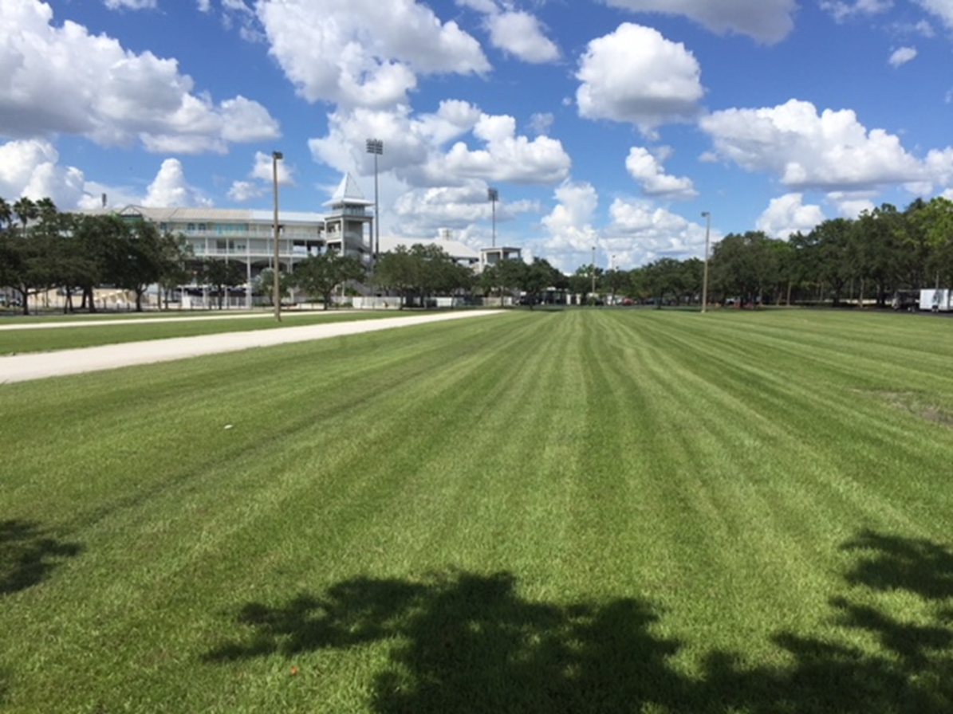
Park | Original Contract | Actual Acres to Mow | Difference
Lakes | 35 | 25.60 | 9.40
Three Oaks Park | 20 | 16.09 | 3.91
Estero Park | 20 | 21.63 | -1.63

Slide 16
Data Results
Over paid for more than 100 Acres
Saved $45,600 annually
Even with adding 9 additional sites.

Slide 17
Benefits of using ESRI
Minimal time to set up – no coding
Staff with no GIS Experience created the data, without the middle man (me)
Game changer

