Slide 1
Automating and Validating Edits
with the attribute assistant and attribute rules
Josh Ittenbach - GIS Coordinator
Lee County GIS

Slide 2
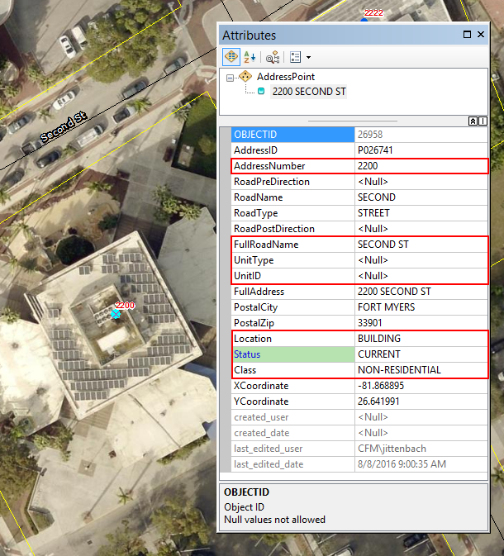
Why automate?
Automating reduces the chance of making errors during data entry.
Automating saves time, especially when a significant portion of your job includes editing the same data.
The address points feature class contains 17 editable fields…
but I only manually edited 7.

Slide 3
Attribute Assistant

Slide 4
What is the Attribute Assistant ?
“The Attribute Assistant Add-In is an editor extension that uses a series of predefined methods to populate attributes when you create new features or edit existing features in a geodatabase.”
ArcMap Only (ArcMap Standard or Advanced 10.2.1, 10.4 – 10.6)

Slide 5
Attribute Assistant Methods
Methods are predefined to perform certain actions based on user defined configuration.
There are currently 71 different methods that can be used.
Methods can be triggered by:
Feature creation
Attribute change
Geometry change
Manual

Slide 6
Attribute Assistant Add-In Installation
Download the add-in and required tables from: https://solutions.arcgis.com/shared/help/attribute-assistant/
Close ArcGIS applications.
Double-click AttributeAssistant.esriAddIn to run the installer.
Click Install Add-In.

Slide 7
Attribute Assistant Configuration
Copy the DynamicValue and GenerateID tables to the same database containing the feature classes you will be editing.
Add the DynamicValue table, GenerateID table, and the feature class you will be editing to a map document (mxd).
Enable the Attribute Assistant toolbar.

Slide 8
Attribute Assistant Dynamic Value Table
The DynamicValue table is used to configure what fields are updated, which methods are used, and when rules will run.
Table Name - This field defines which table the Attribute Assistant action will be applied to.
Field Name - This field defines the field upon which the Attribute Assistant actions will be applied or the field to monitor for changes.
Value Method - This field defines the actions that occur when the Attribute Assistant is enabled and features are modified or configured.
Value Info - This field defines the parameters and configuration of each method. Values in this field will vary depending on the value method you are configuring.
On Create - This field defines if the Attribute Assistant actions will be applied when a feature is created.
On Change (Attribute) - This field defines if the Attribute Assistant actions will be applied when a feature has an attribute change.
On Change (Geometry) - This field defines if the Attribute Assistant actions will be applied when a feature's geometry has been updated.
On Manual - This field defines if the Attribute Assistant actions will be applied only when the Attribute Assistant "Run Manual Tools for Selected Features" tool is run.
Run Weight - This field defines the weight of the action. Those configured methods with higher weights will run first. This can allow for certain rules to be run before others.
Use the source name of tables (not layer names) and field names (not aliases).

Slide 9
Attribute Assistant Generate ID Table
The GenerateID table stores a sequential ID number for use with the Generate ID or Generate ID By Intersect methods
Sequence Name - This field defines the name of the sequence (field name).
Sequence Counter - This field defines the current value of the sequence.
Interval Value - This field defines the interval at which the sequence will increase.
Do NOT version the GenerateID table!
If versioned duplicate ID’s may be generated.

Slide 10
Attribute Assistant Examples

Slide 11
Attribute Rules

Slide 12
What are Attribute Rules?
“Attribute rules are user-defined rules created to enhance the editing experience and help enforce data integrity.”
ArcGIS Pro Only (Introduced in ArcGIS Pro 2.1)
“Attribute rules are a property of the dataset they are created against. They have a 1:1 relationship against the dataset they are created on; therefore, they cannot be shared across the geodatabase by multiple datasets. When the dataset is deleted. the attribute rules are deleted with it.”
Currently if data is published using the “Reference registered data” option, attribute rules can be used by web layers.
Future updates will enhance how attribute rules work across the ArcGIS platform.

Slide 13
Attribute Rule Types
Currently there are two types of attribute rules:
Calculation rules
Constraint rules
“Calculation rules are used to automatically populate attribute configurations on a feature when another attribute is set.”
“Constraint rules specify permissible attribute configurations and general relationships on a feature. They are not used to populate attributes like calculation rules but to ensure that specific conditions are met on a feature.”

Slide 14
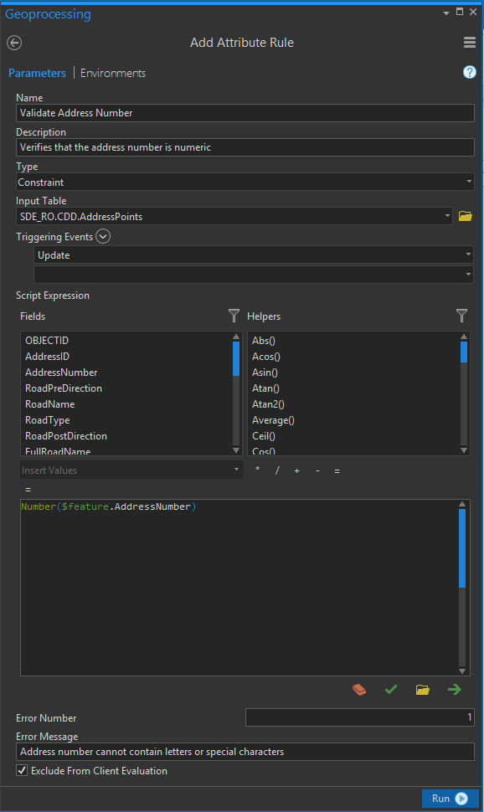
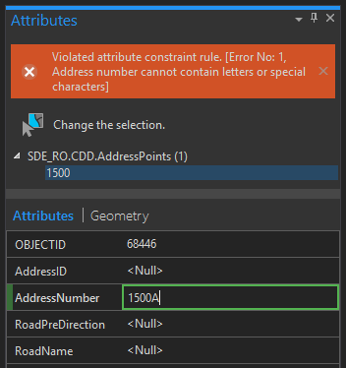
Attribute Rules Configuration
Rules are created with the “Add Attribute Rule” geoprocessing tool.
Other tools are available to delete, disable, enable, export, and import rules.
“When adding multiple calculation rules, the order in which rules are added determines the evaluation order. This is important when there are dependencies from other fields being calculated for the feature being stored.”

Slide 15
Attribute Rules Issues
“There is currently no cross-layer or cursor support for attribute rules. Attribute rules are only supported on the row (feature) being evaluated.”
“Attribute rules are currently only supported on enterprise geodatabase datasets.”
“Once you have added attribute rules to a dataset, the minimum client version for the dataset is ArcGIS Pro 2.1. This means that the dataset will no longer be available for use in ArcGIS Desktop.”

Slide 16
Questions?

