Slide 1
Managing Large Raster Collections of Aerial Imagery and Topographic DEMs – A Case Study for South Florida
6th Annual
Southwest Florida GIS Symposium
Tim Liebermann and David Kirouac
October 27, 2016
Notes:
Tim’s Intro – I’ve been giving talks on managing collections of topo DEMs for a dozen years or more, and I could have saved a lot of explanation time by having “Best Available” tattooed across my forehead. This presentation is more about “where we’re at and what we’ve learned” than a finished “how-to” session. I acknowledge my co-author, Dave Kirouac, who’s actively embracing the new paradigm for GIS. I’m more of an old fuddy-duddy, and any blame for reactionary views or inept language falls on me.

Slide 2
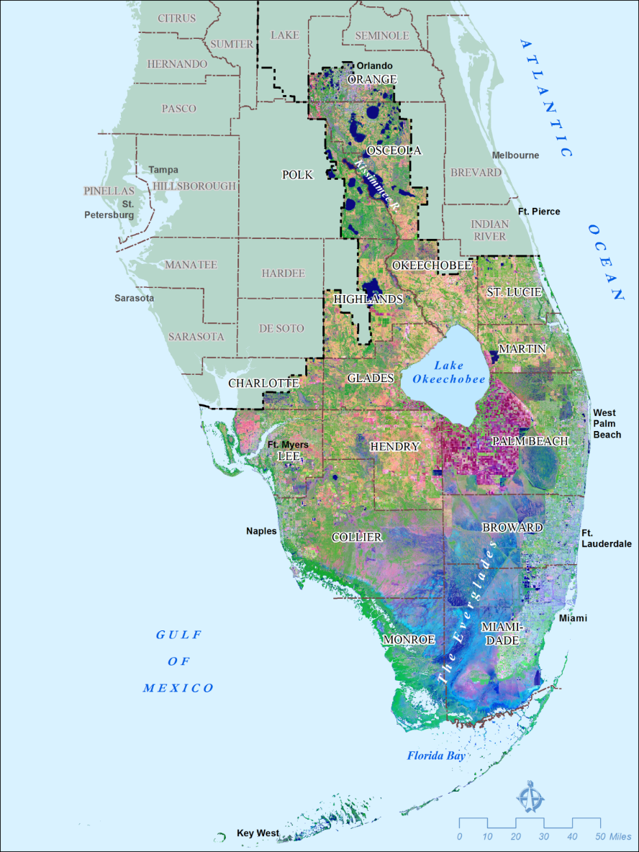
S.F.W.M.D.
Who we are and what we do
Oldest and largest of the State’s five water management districts
Manage and protect water resources for southern Florida
Partner with other State agencies, collaborate with Federal and local governments
“Protector of the Everglades since 1949”
Notes:
For this presentation I’ve included a lot of older slides and maps to provide an historical perspective on the topic, and also to provide something to keep you occupied as I drone along.

Slide 3
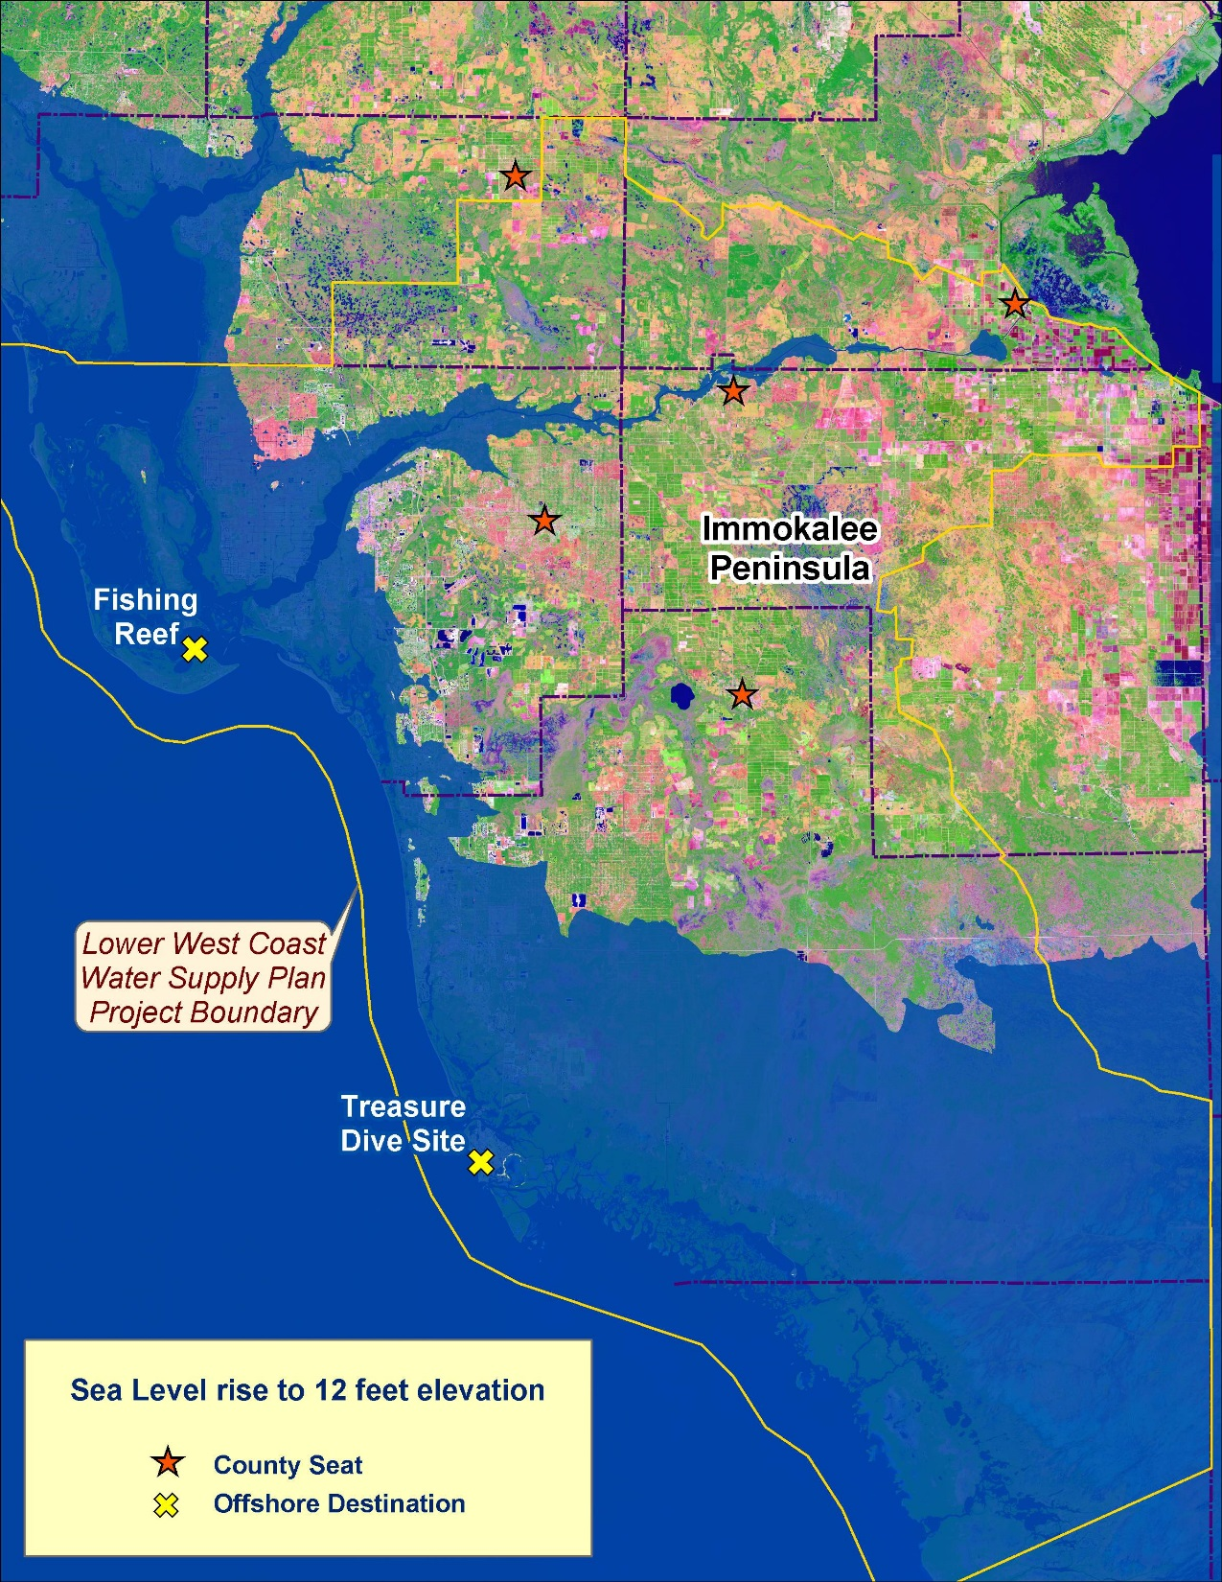
Geospatial Services Section
Formed in 2015 within the IT Department
Consolidated about 20 GIS specialists from multiple departments
Our Ongoing Mission
Maintain and advance the current level of support for all District programs
Reorganize and modernize hundreds of GIS datasets
Accomplish a total transformation to the next generation of technology and service
The benefits of living and working in interesting times…
2004
Notes:
Our section leaders are committed to implementing all the principles we heard about yesterday in the keynote sessions, so they’re keeping us busy with “total transformation”.
This presentation has two main components: aerial imagery and topographic DEMs. First, the imagery…

Slide 4
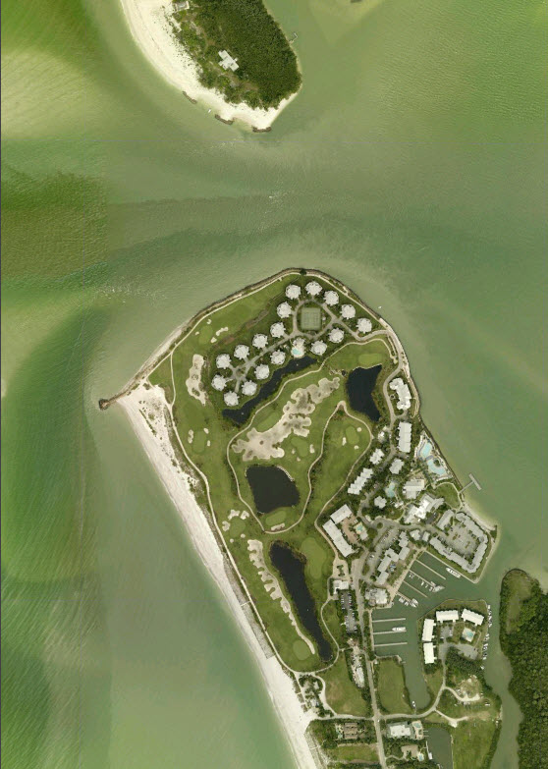
Online Collection of Aerial Imagery
Maintain library of aerial imagery
7 TB of storage on network
Mainly tiled images by county (16 and more), multiple years back to 2000
Also several libraries of project-based imagery online – typically non-stereo, compressed
Includes image mosaics, published image services, metadata, tile indexes
Primarily intended for in-house access by desktop users
Boca Grande,
Lee County, 2016

Slide 5
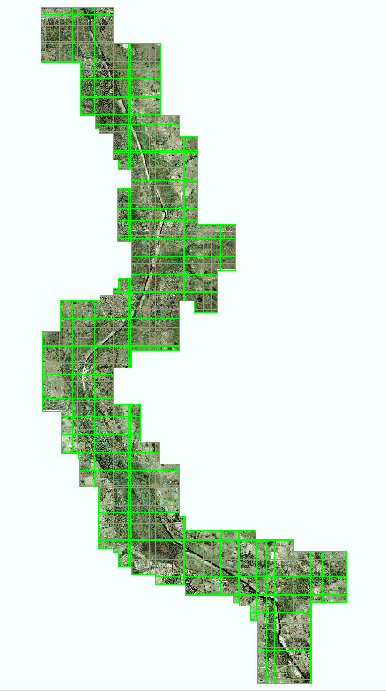
Aerial Imagery for District Projects
Maintain extensive library of current and historical aerial imagery
25 TB, mostly stored offline on external drives
Acquisition is funded by the projects, data management is not
Includes stereo images, 4-band, uncompressed
Occasional, intensive use by project specialists
Valuable for vegetation mapping, floodplain restoration, seagrass monitoring, historical record
Need to retain in original format as data-of-record
Permanent online storage has been requested
Kissimmee River Restoration,
2005, 6-in, RGB, TIFF

Slide 6
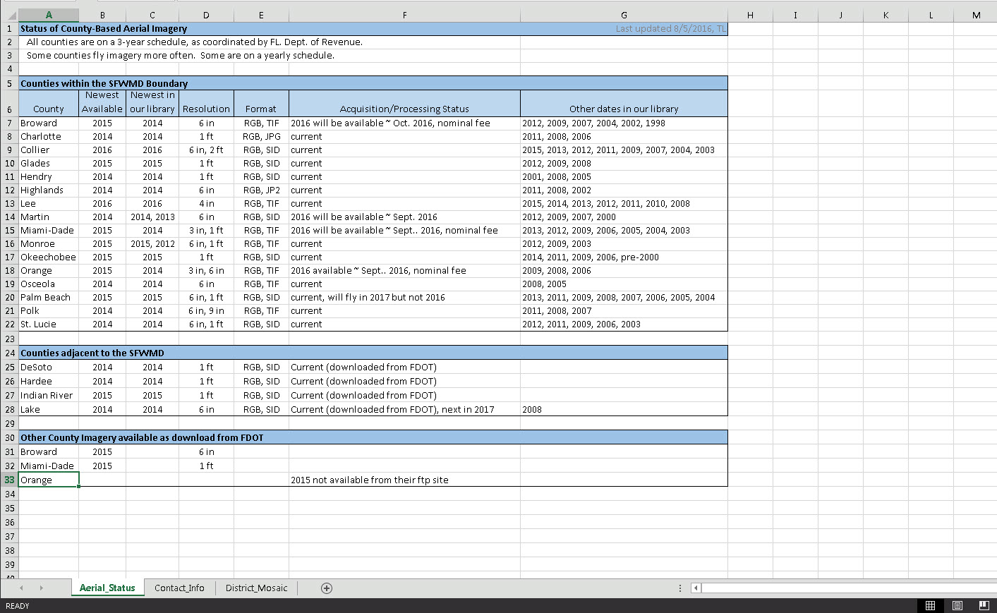
Ongoing Program with Counties
Obtain newest imagery
Process to image mosaics and map services
Publish a District-wide mosaic
Fits into existing resources, no money budgeted for acquisition
Notes:
Over the years we’ve developed some standard practices and procedures in order to stay organized and current, without spending much or requiring much support.

Slide 7
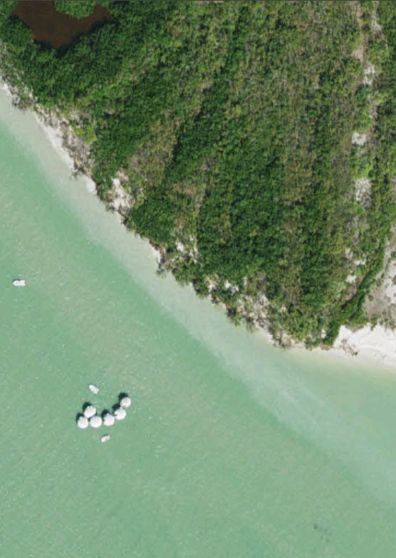
However…
Disk space is full
Slow and tedious process to get new hardware, even from within the IT Department
Adding more online storage or contracting – raises issues of cost, disk space, backup storage and procedures, software licensing, caching of images, data management and processing, and requires extra labor
“The Cloud” could potentially solve the disk storage problem, but the need for new imagery will continue
Management decisions become more difficult when there are multiple unknown factors
Receding shoreline at Cape Romano, Collier County, 2016

Slide 8
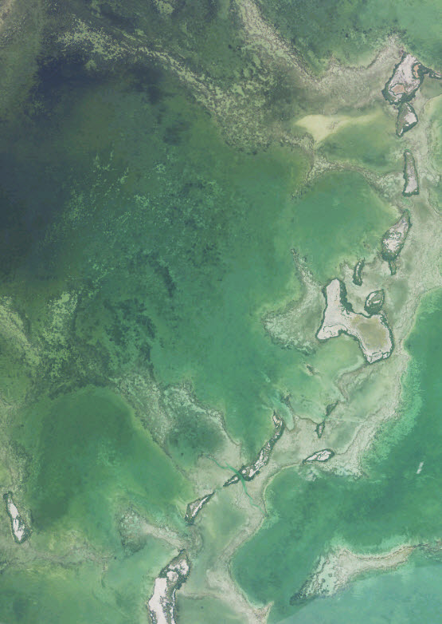
Furthermore…
Commercial options for acquiring, processing, storing, and serving imagery have been explored
Can be costly, not guaranteed to remain up-to-date
Solutions don’t always meet our needs
Involves contracting and legal issues, which slow and complicate the process
Meanwhile…
Customers want today’s imagery today, want multi-platform accessibility, and want all products to have the same data and consistent look-and-feel, want it to be cool, and of course want time sliders on everything
Florida Bay,
USDA NAIP, 2013

Slide 9
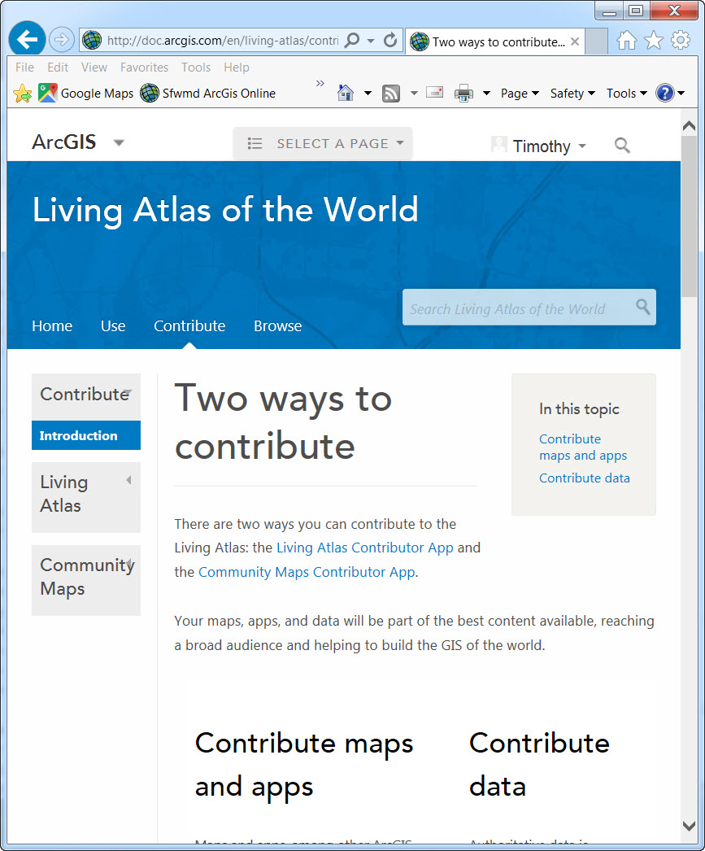
Community Maps to the Rescue
Esri Living Atlas of the World
Accepts current imagery that meets standards
Transfer data by external drive
Esri processes into Web-Mercator and standardized format, creates image caches for rapid display, blends with other data to maintain seamless coverage, provides basic color balancing
Published as a web-based mapping service, incorporated into the World Imagery Basemap
Available for all platforms and apps
Approximately 3-months to process 16 counties into Basemap
It’s free, and minimal paperwork is required (a one-page simple agreement)

Slide 10
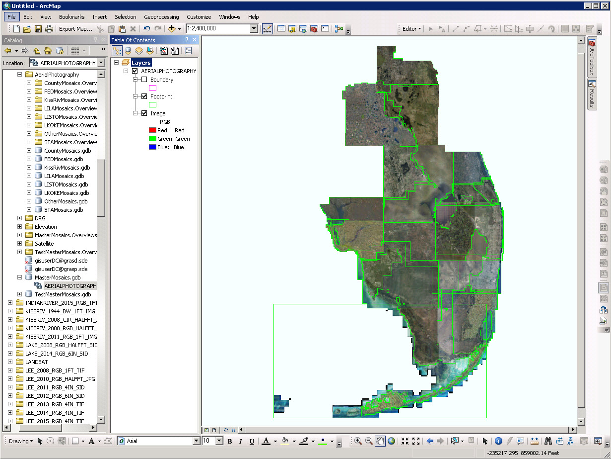
Notes:
Here’s an image mosaic, showing the sixteen counties that we sent to Esri earlier this year.

Slide 11
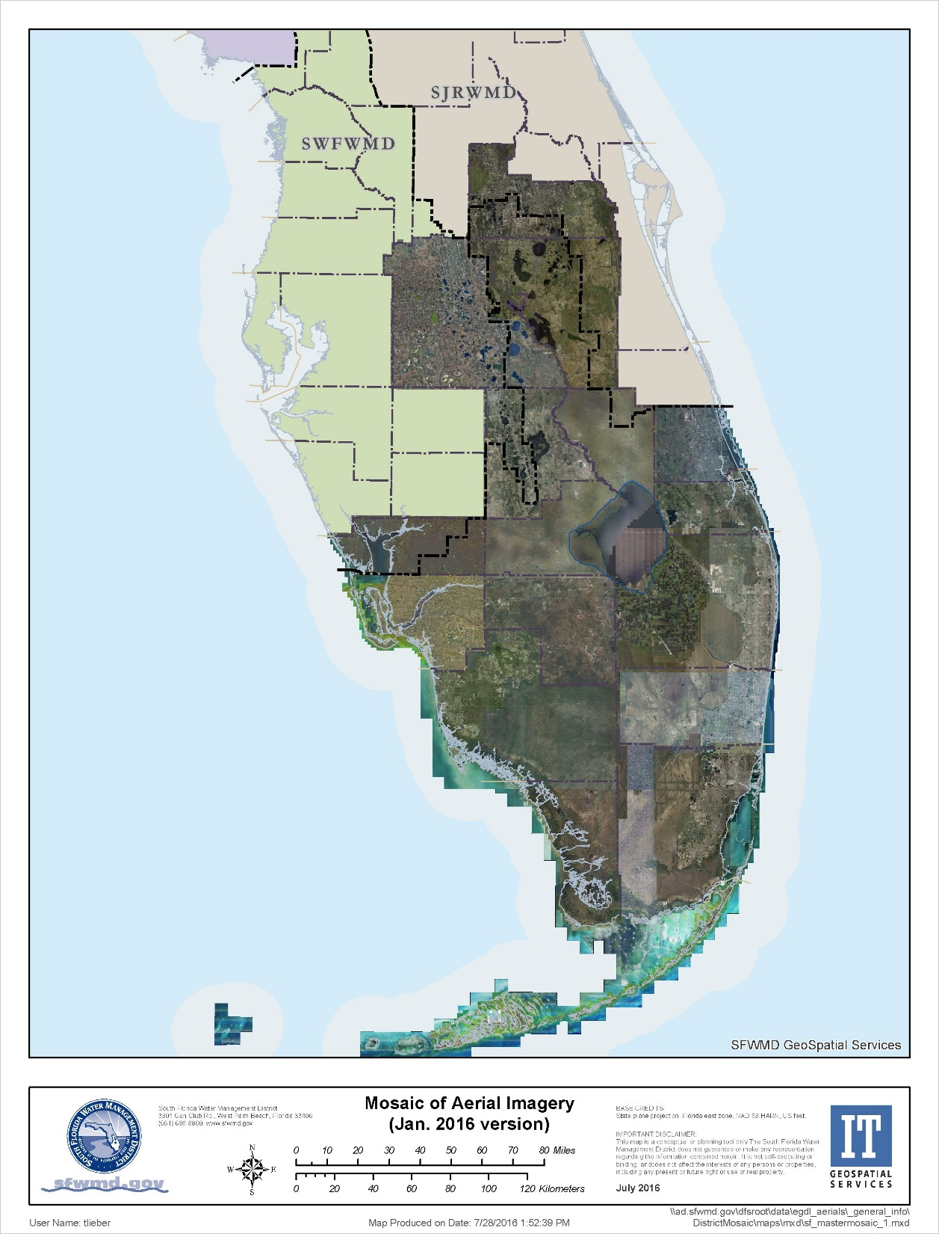
What we still do…
Serve as clearinghouse for new aerial imagery for southern Florida
Process tiled image collections into image mosaics
Provide imagery to the Community Maps program (3 or 4 times per year)
Our Typical Processing Steps
Obtain tiled images on external drive
Reformat to compressed TIFF with pyramids (also compressed)
Copy to network file system
Create image mosaic with overviews
Create metadata and other supporting info
Publish locally as an image service
Collaborators are welcome !!
Notes:
This is the same image mosaic, published as a service for our desktop users with ArcMap. Note that there are differences in tint and brightness among the different counties.

Slide 12
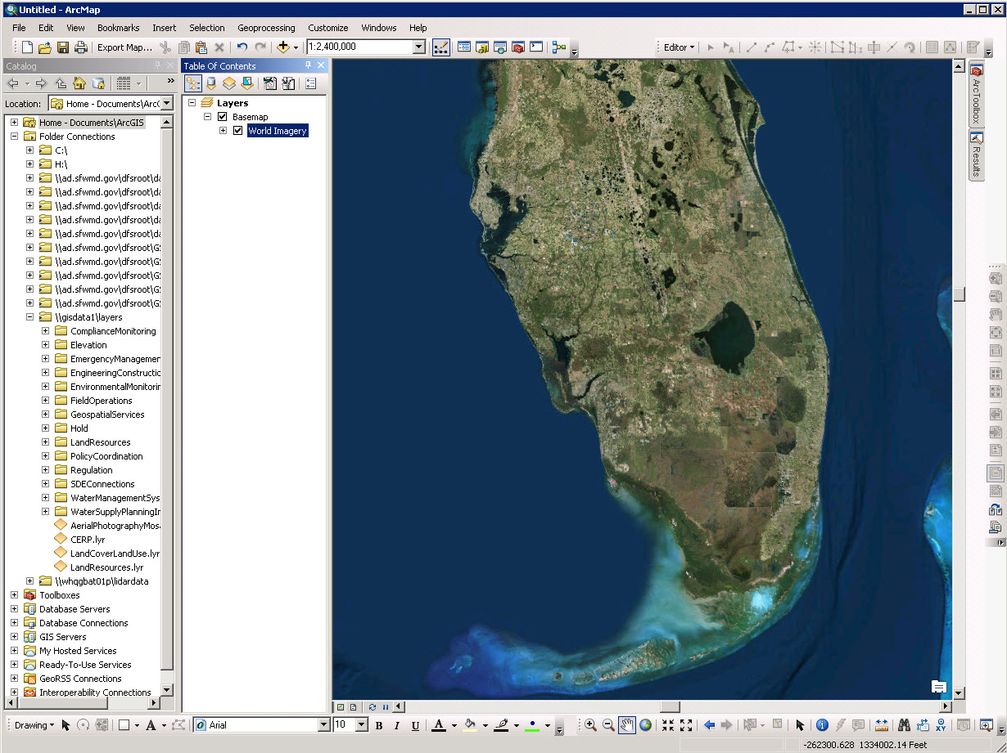
Notes:
This is the standard basemap that Esri now provides to users worldwide on all platforms. The data that we provided has been processed, cached, and merged with the other imagery in their collection. Note that their processing also included some color balancing, so the product has a consistent appearance.

Slide 13
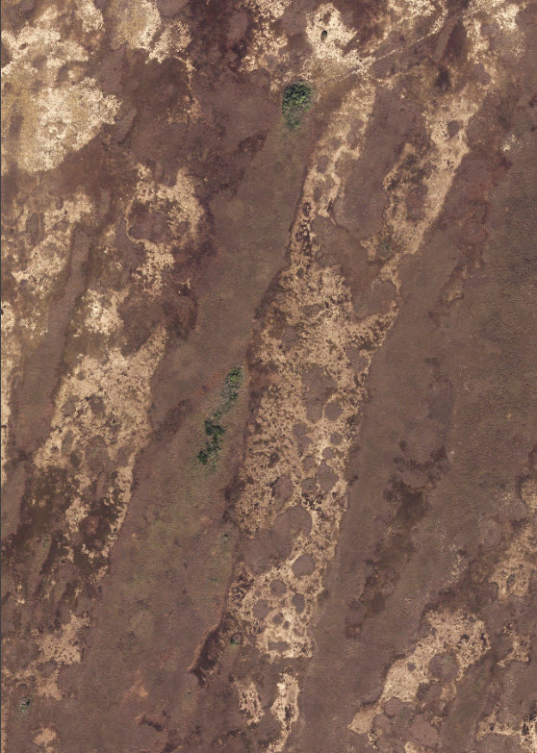
What we don’t have to do…
Create and maintain duplicate copies of imagery in Web-Mercator
Create image caches
Create our own web-based image-map services
Package imagery for public download
Pay for extra storage and/or management
What we still haven’t done…
Implement a solution for our 25 TB of off-line project-based imagery
Resolve plans for new system architecture and bring new disk space online
Implement time-enabled maps for our older imagery (county and project) – Community Maps?
River of Grass,
Miami-Dade County, 2015
Notes:
So that’s where we are with our aerial imagery. Any questions before I move along to the topo DEMs?

Slide 14
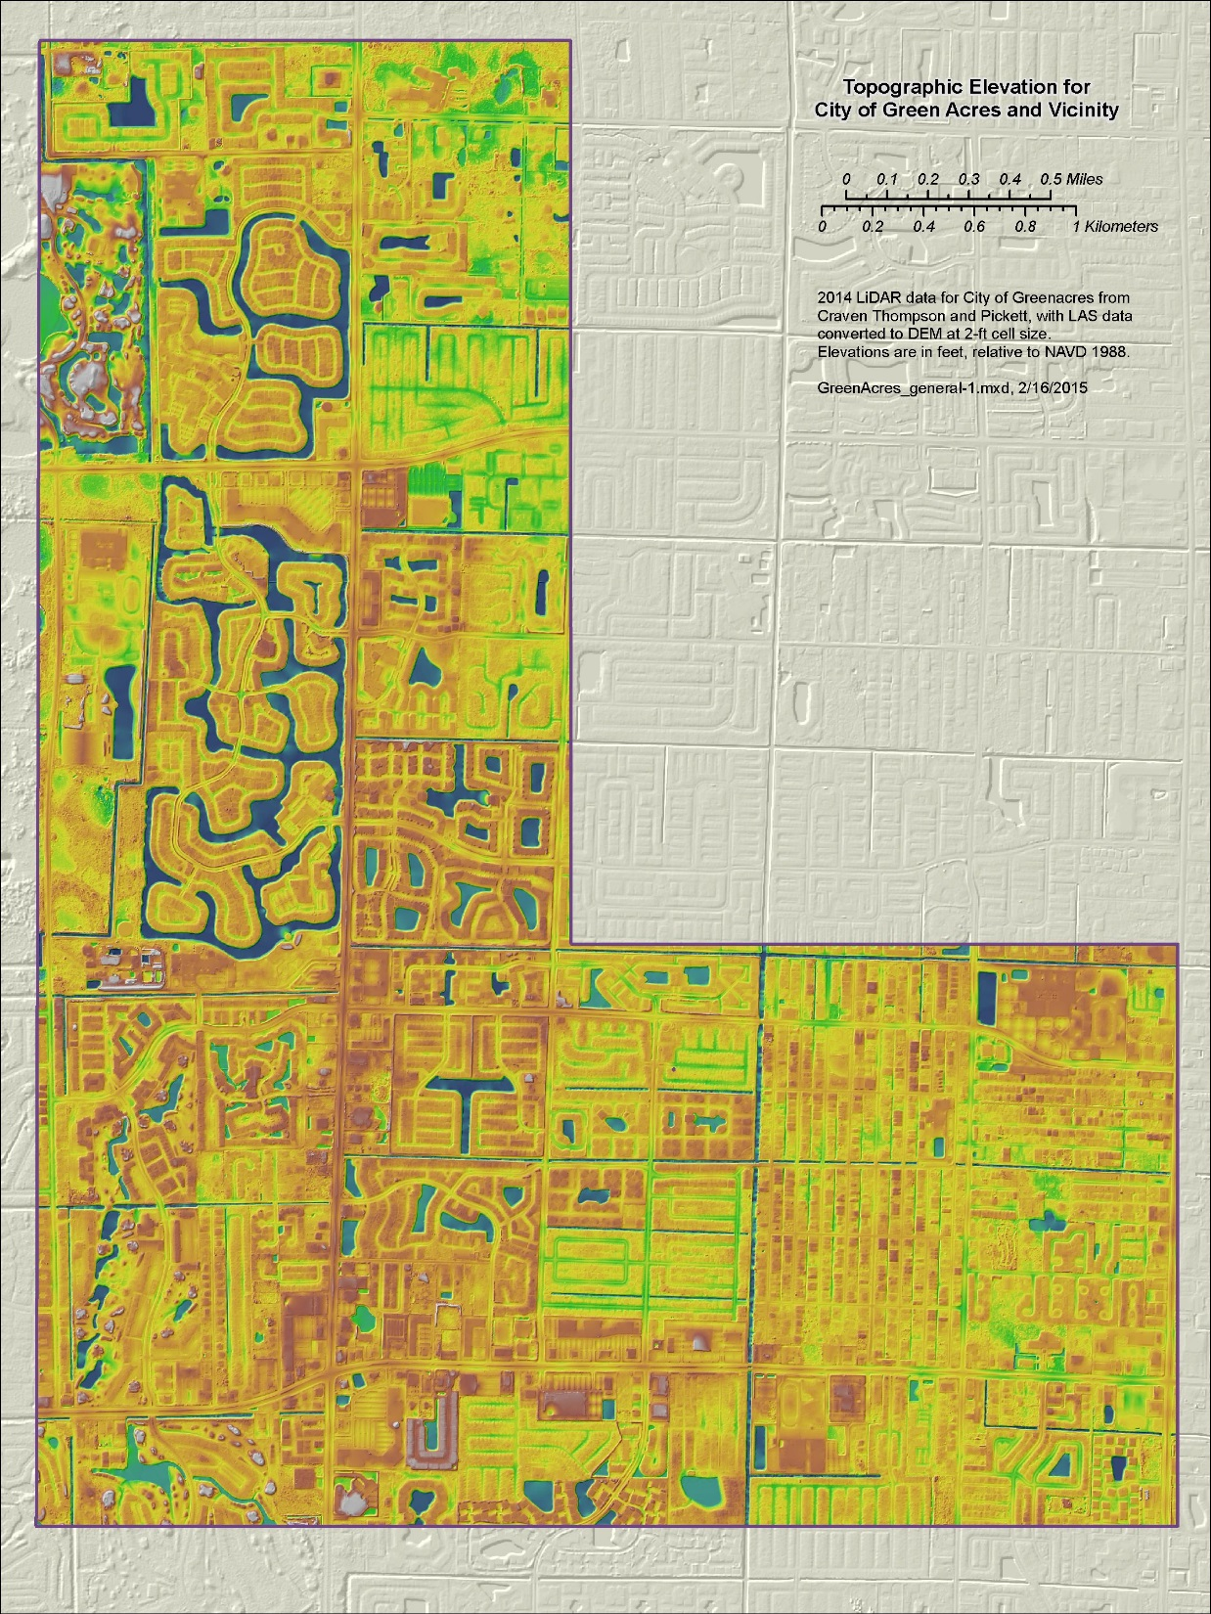
Managing a Raster Collection of Topographic DEMs
DEM is a standard format for GIS elevation data
DEMs are usually accompanied by supporting data or derivatives – breaklines, contours, QA/QC reports, metadata, and source data such as LiDAR LAS files
SFWMD has actively managed a DEM library for more than 15 years
We maintain more than 80 DEM datasets of varying age, detail, accuracy, and level of documentation
Yet there are still serious gaps in the coverage modern topo and inconsistencies between datasets
Example of high-quality LiDAR from local government
Notes:
Does everyone understand what I mean by “raster” and “DEM”? Would you like any explanation?
-- Explain terms or concepts if needed…

Slide 15
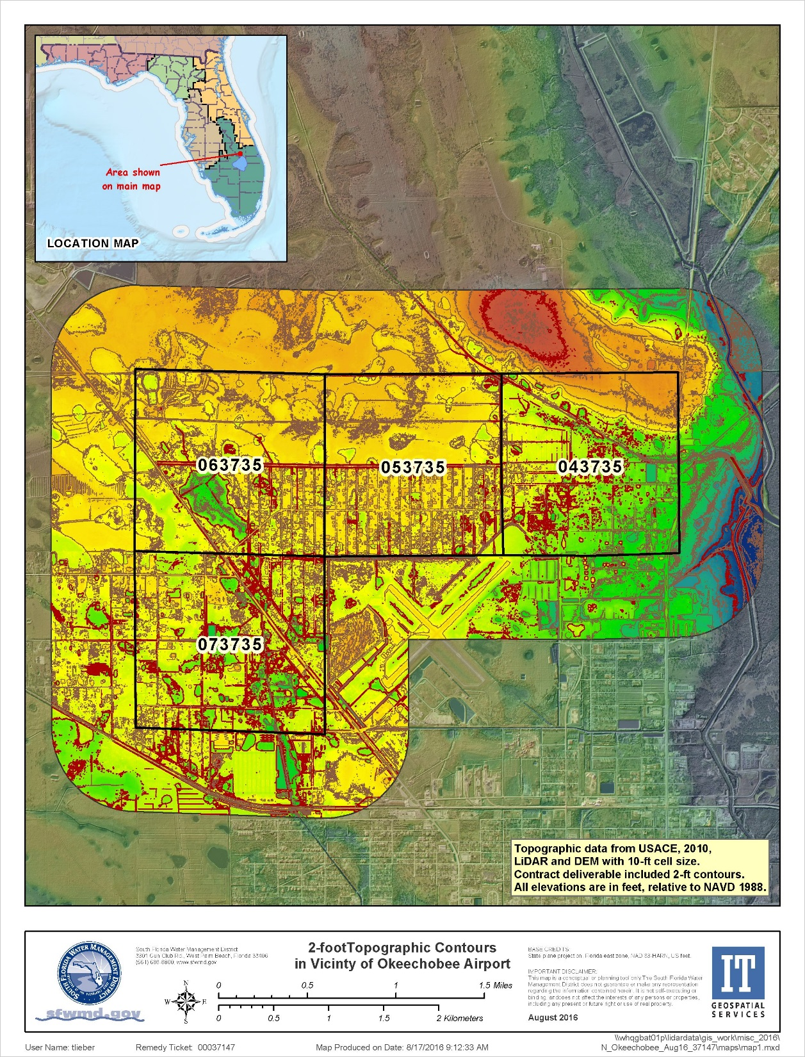
Challenge and/or Opportunity
Like aerial imagery, management of topographic DEMs faces a transformation in technology, data, and customer service
Modern data requires more space on disks already full – e.g. 2 TB for Miami-Dade source data
Existing workflows are too slow and cumbersome, unable to keep pace with new needs and data
Need to support web-based applications as well as continue to use desktop for processing and analysis
Example of custom work for a data request from the public

Slide 16
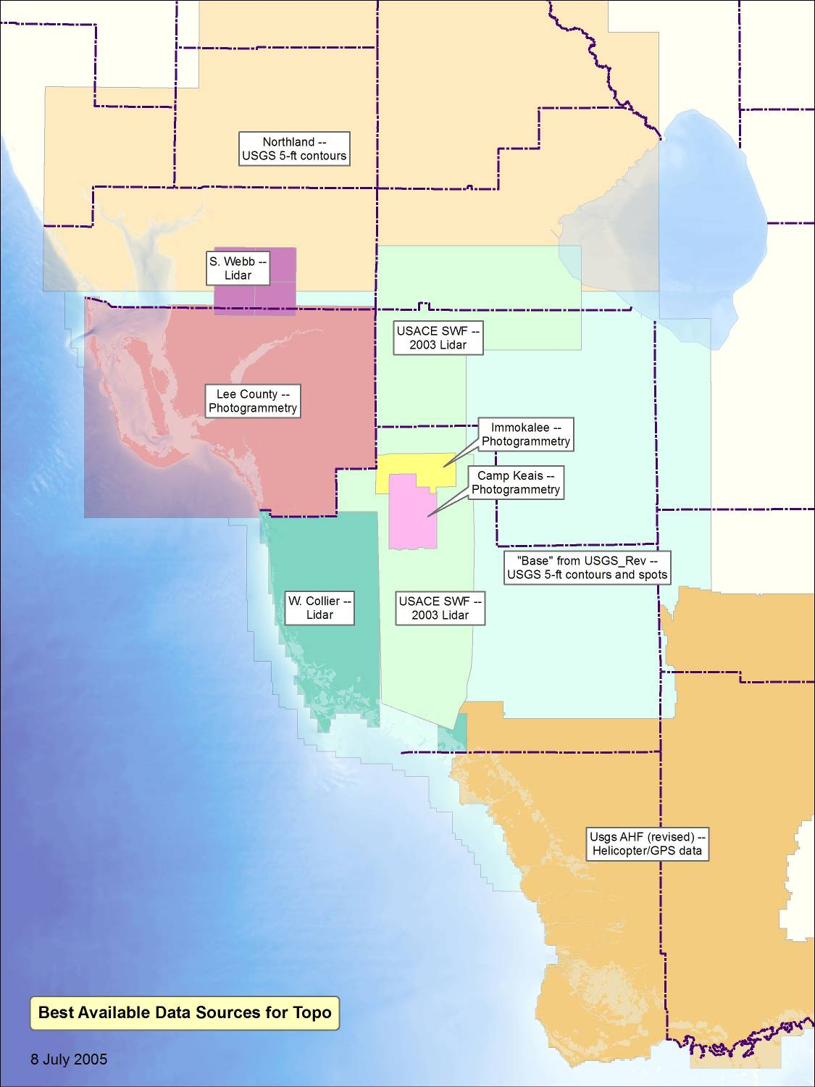
Primary Sources
LiDAR:
- Various sources
Photogrammetry:
- Traditional processing from stereo aerials and ground surveys.
Specialty data:
- Helicopter GPS
Fill in with topo data from USGS 24K quad maps.
- 5-ft contours with spot elevations
USGS NED – not used
2005
Notes:
Here are a few old maps that will serve as a low-tech version of a time slider. Ten years ago we had some LiDAR, but it was of variable quality and very limited extent. For most areas, we had to rely on old or inadequate data.

Slide 17
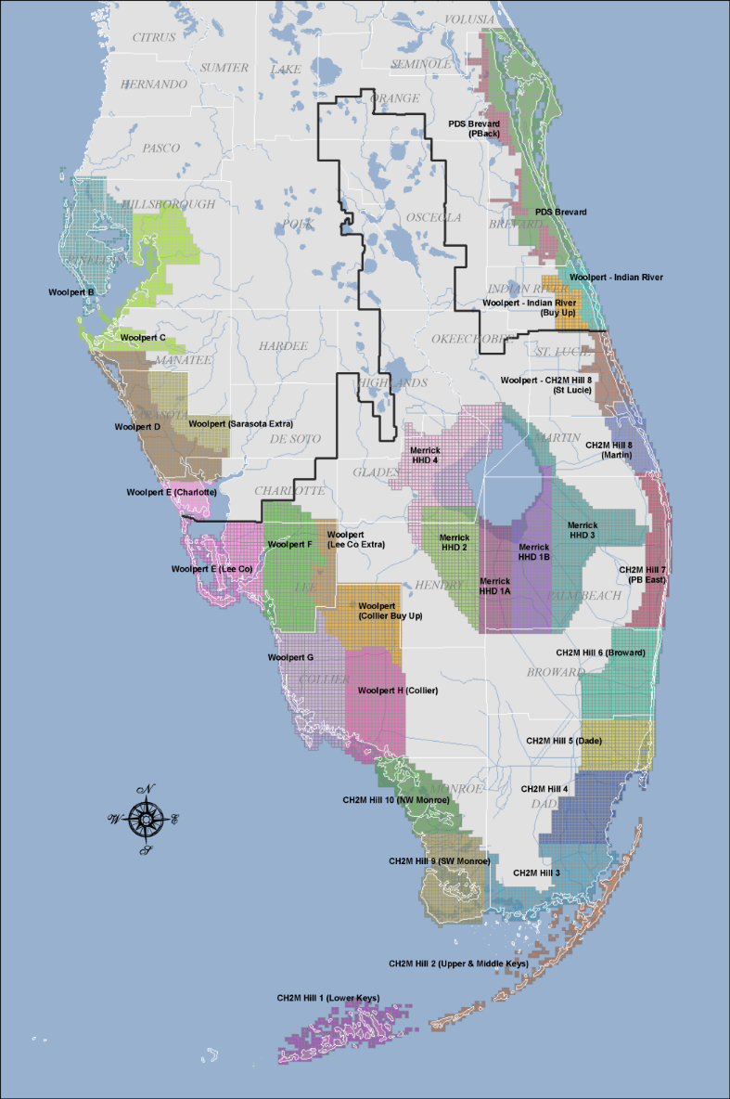
FDEM Coastal LiDAR Project (2007-8)
Statewide tiling system, 5000-ft
One set of specs for all of Florida
Multiple contractors and subs
Multiple deliverables per county
3rd-party contractor for QA/QC and project management
Unintended Consequences
Large amount of concurrent work
QA/QC control was overwhelmed, specs met, but some not satisfactory
Deliverables – LAS and breaklines only, most not processed for DEM
~ 2009
Notes:
2007 marked a milestone in our topographic data. After a series of destructive hurricanes, the Florida Dept. of Emergency Management implemented a statewide program for acquiring LiDAR for the coastal areas. For the most part, uplands and the interior of the state were not included. Also there were problems with post-processing and quality control. Even so, a tremendous amount of useful topo data was created and distributed, and LiDAR was well established as a standard and cost-effective practice.

Slide 18
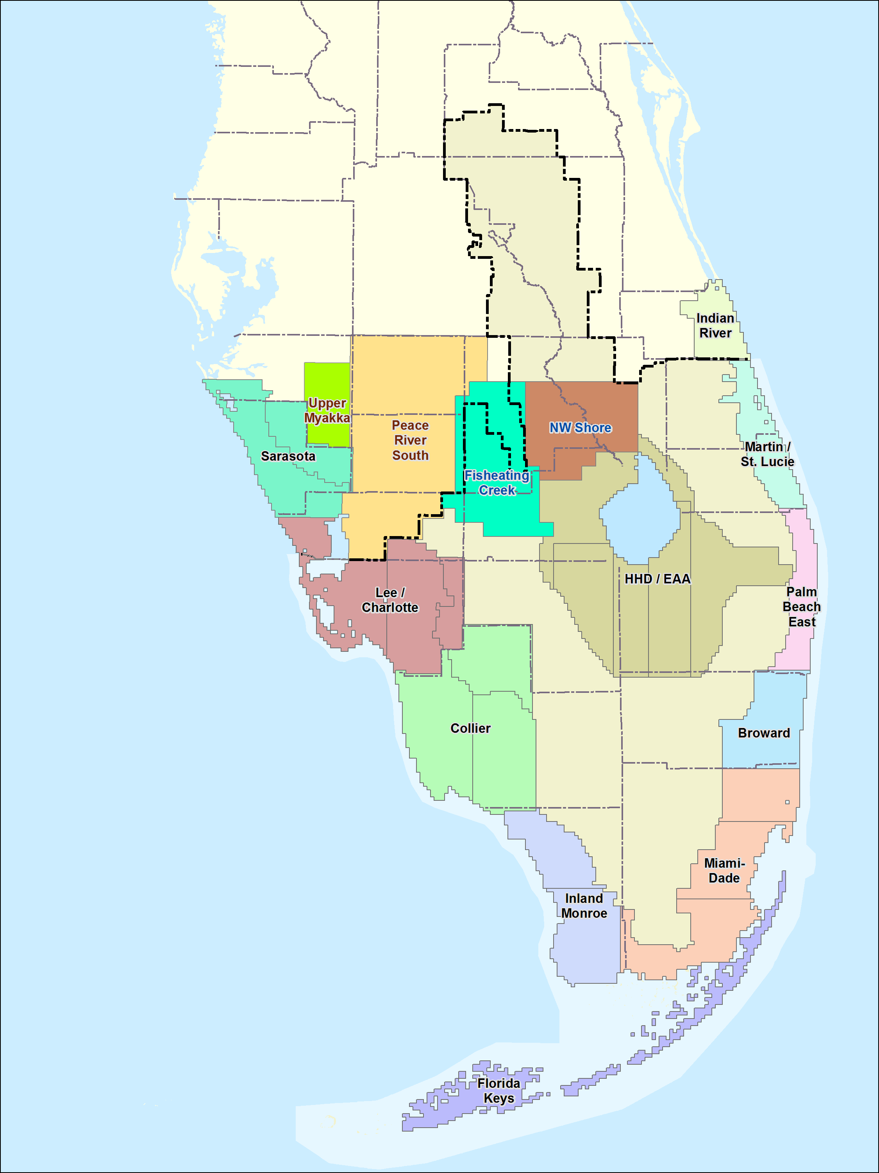
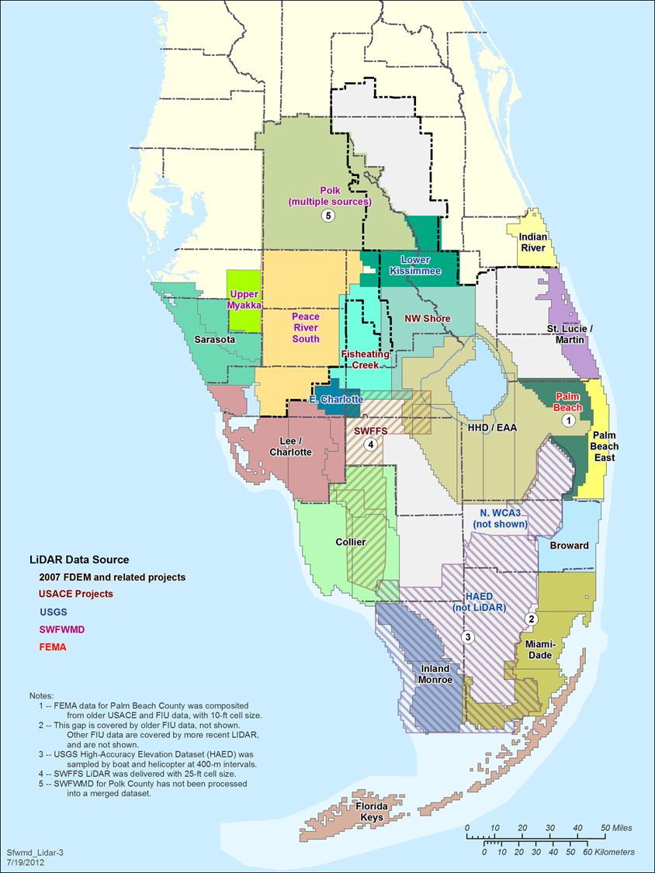
2011
2012
Notes:
In following years we continued to collaborate and collect new topo data, mostly from LiDAR projects. We worked with USGS and USACE, and shared data with other Water Management Districts. We sought out more topo data from county and municipal governments, processing as needed to end up with DEM products that were compatible with our other data.

Slide 19
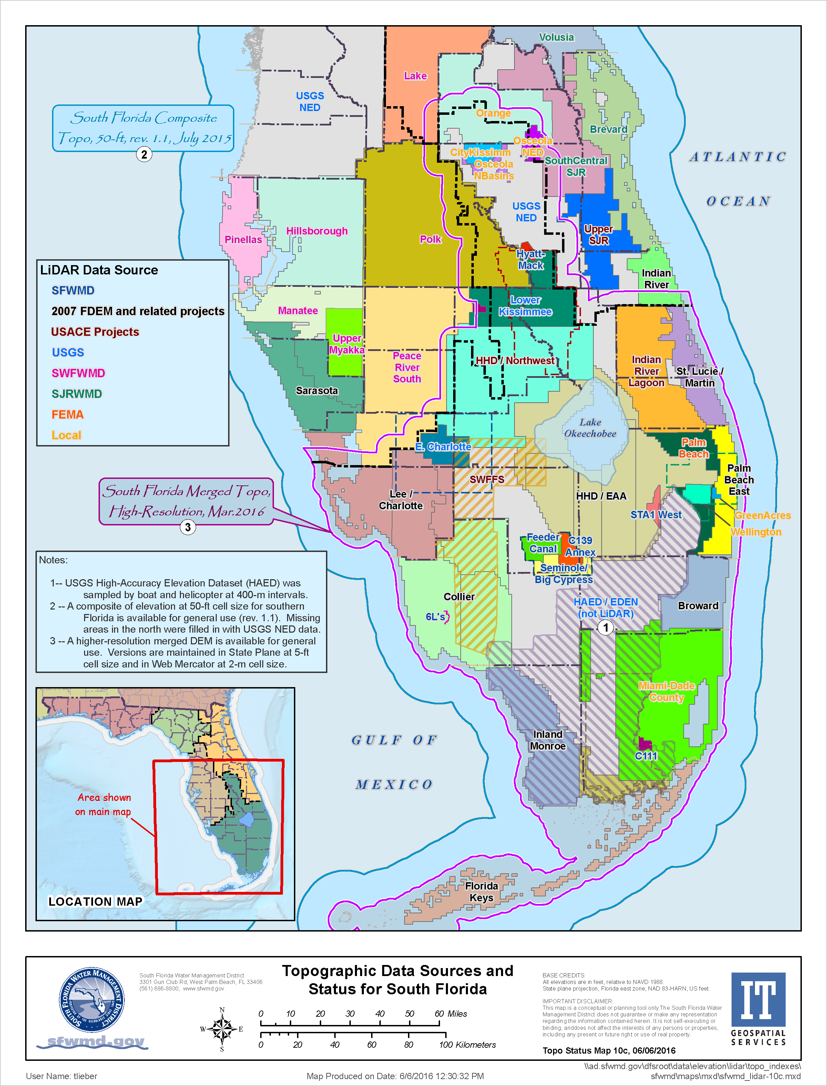
Current Status
Individual DEMs and associated data are maintained in permanent storage
Source LAS files are stored on lower-cost “archive” disk space
About 3 TB stored on network, disks are full
Several large, new DEMs are expected soon (Osceola, Martin, Western Basins)
Typical Methodology
Obtain the full set of deliverables, process to DEM format if needed
Organize ancillary data (breaklines, reports, metadata, etc.) in standardized data structure
Copy DEM to SDE location, create layer files pointing to SDE
Create zip file and link to ArcGIS Online for public download
Add to District-wide merged DEM in both state-plane and Web-Mercator
2016
Notes:
We currently maintain a library of 80 or more DEM datasets. Yet there still significant gaps in our coverage for good, modern topo data.
-- at end… Let’s talk about the process of creating District-wide merged DEMs in a little more detail.

Slide 20
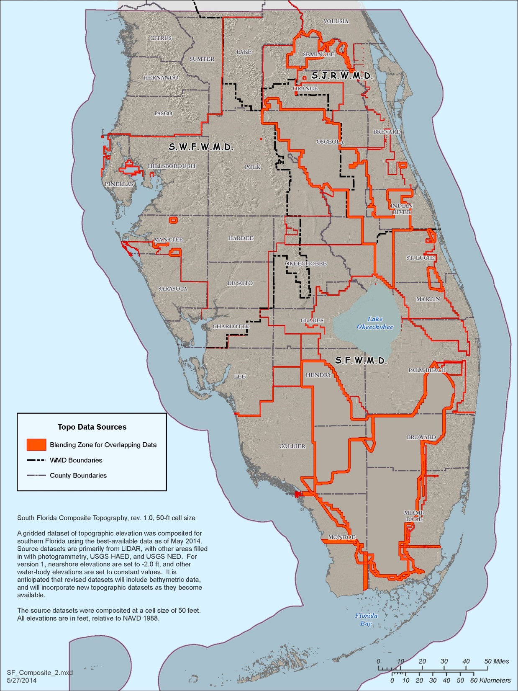
Current District-wide Merged DEMs for southern Florida
Use best-available data (layered on top when merging)
Use standard raster tools to merge data – tedious and slow
May need to start from scratch when creating a new product
Older method included custom “blending” of DEMs along edges to remove discontinuities – too much trouble to do every time
Three different merged DEMs
50-ft DEM first created in 2014, used blending
2-m DEM in Web-Mercator, first created in 2015, no blending
5-ft DEM with all current data, first created in 2016, no blending
All three were created independently and differ slightly in which new data is included
2014
Notes:
Our traditional approach to merging DEM data has involved a lot of custom work. The process was painful enough that revisions with new data weren’t made regularly, and previous merged DEMs were neglected rather than brought up to date.

Slide 21
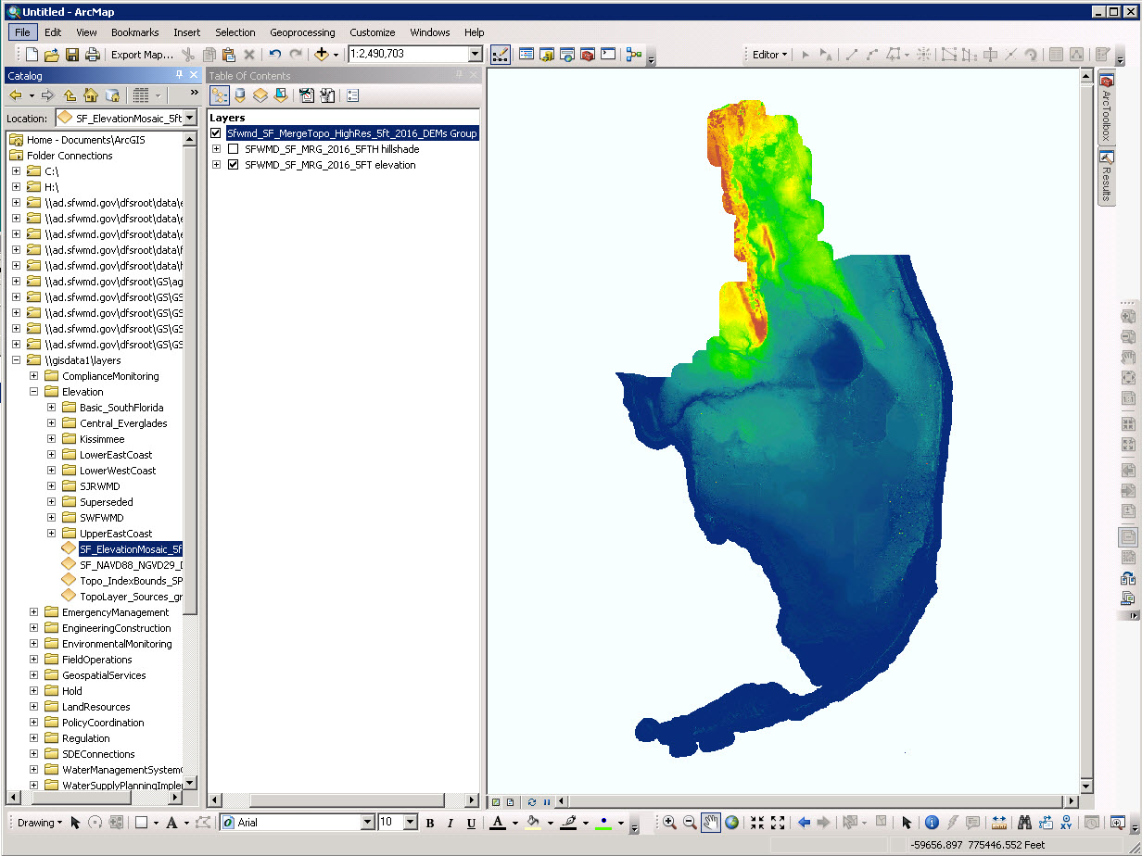
Notes:
Here is our newest merged DEM product, which includes all of our current data and is the standard high-resolution topo source for our desktop users. It is in our local projection (state plane east zone) with a 5-foot cell size.

Slide 22
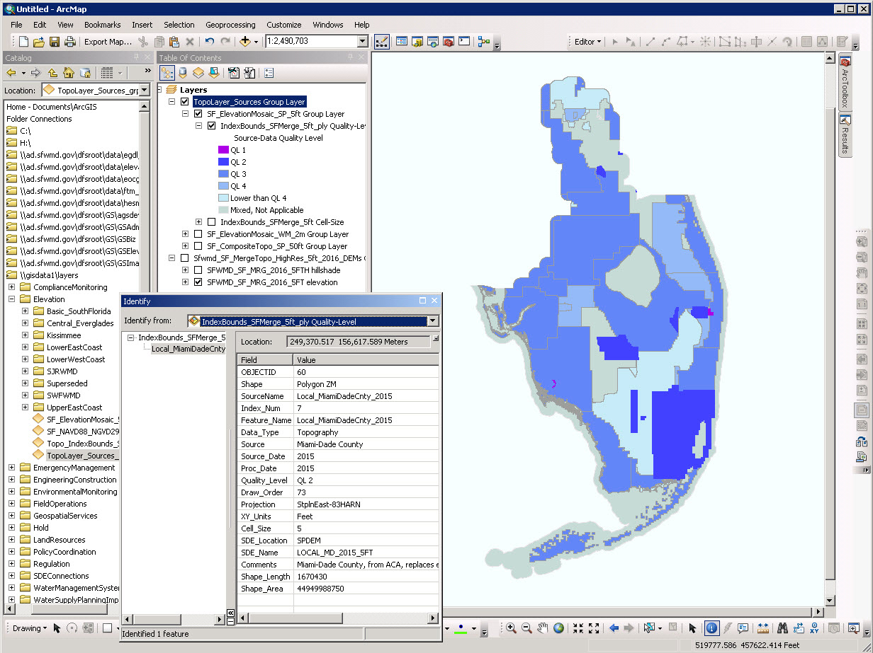
Notes:
As part of our supporting data, we maintain indexes of our DEM boundaries, matched to a master spreadsheet that contains details about the source, location, and quality of the datasets.

Slide 23
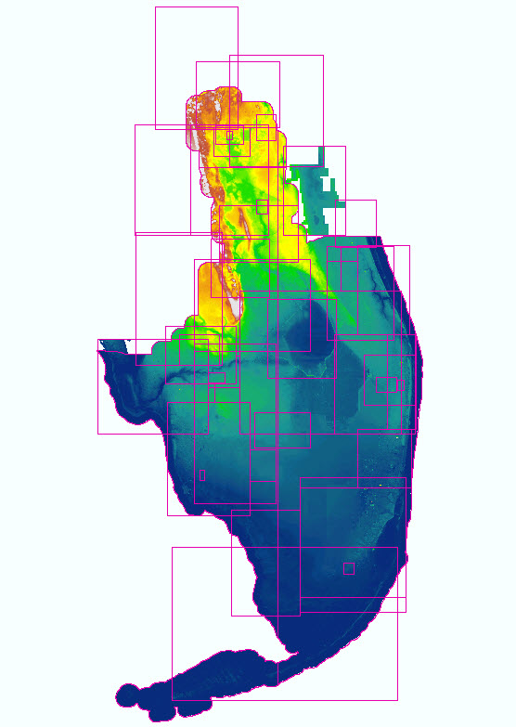
New Approach to Creating District-wide Merged DEMs
Still testing, not yet in production
Create an image mosaic with the best-available DEMs as members
Use the ZOrder to layer the DEMs so the best data shows up on top
In general, a simple overlay – no custom work or blending
Process in local projection (state-plane, east zone)
When new DEMs are available, add to the mosaic, remove superseded DEMs
Applications of the DEM Image Mosaic
Do not use directly as a data product
Only use for organization, updating, and deriving DEM products
Create in-house (state-plane) and out-house (Web-Mercator) from the same mosaic, at the same time
Create subsets of the data for a given map extent, for modeling or analysis or export at any reasonable cell size
2016
Notes:
We’re looking at using the “image mosaic” functionality as a way of creating and managing our merged DEMs. Since DEMs are a raster format, they can be added into image mosaics. Dave had done some work on this concept several years ago, but at the time we only found it useful for display.

Slide 24
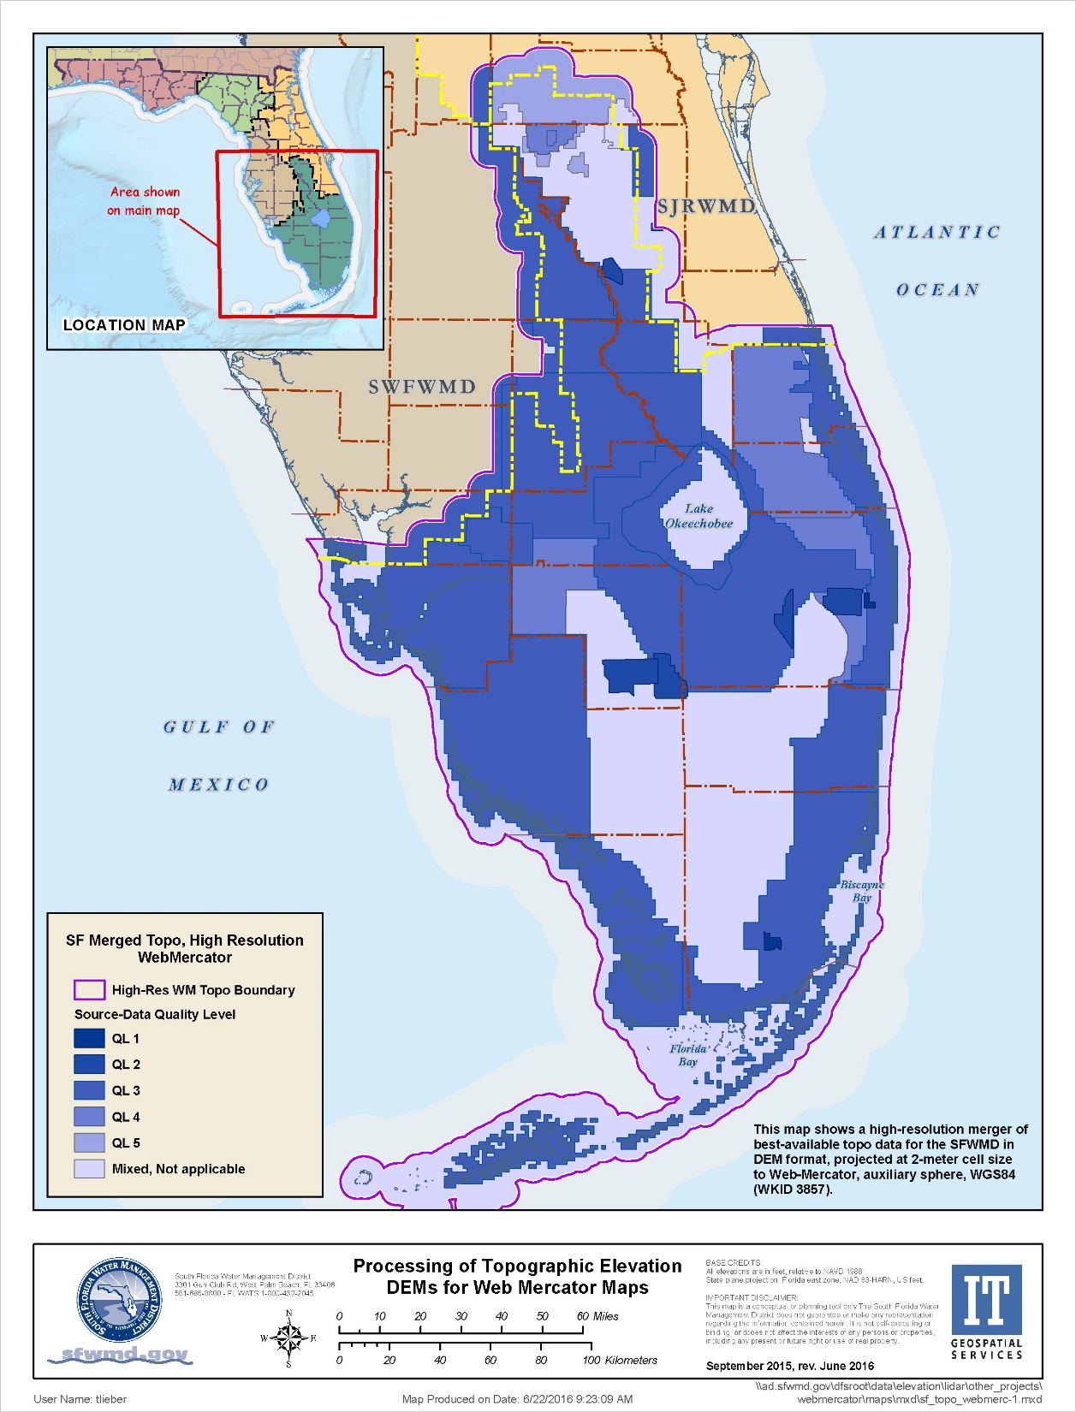
DEMs for Web-based Apps
District-wide merged DEM is produced in Web-Mercator at 2-meter cell size
Published as the primary dataset provided by web-based access to the public
Already used for several custom District applications
Future versions will match with the state-plane merged DEM
A limited number of other DEMs will be produced in Web-Mercator
Public Access to Source DEMs and Related Data
Individual DEMs and supporting data (breaklines, etc., but not LAS) are zipped and will be available for download by ftp
Zipped files also may be downloaded from the District’s ArcGIS Online site (in progress)
2016

Slide 25
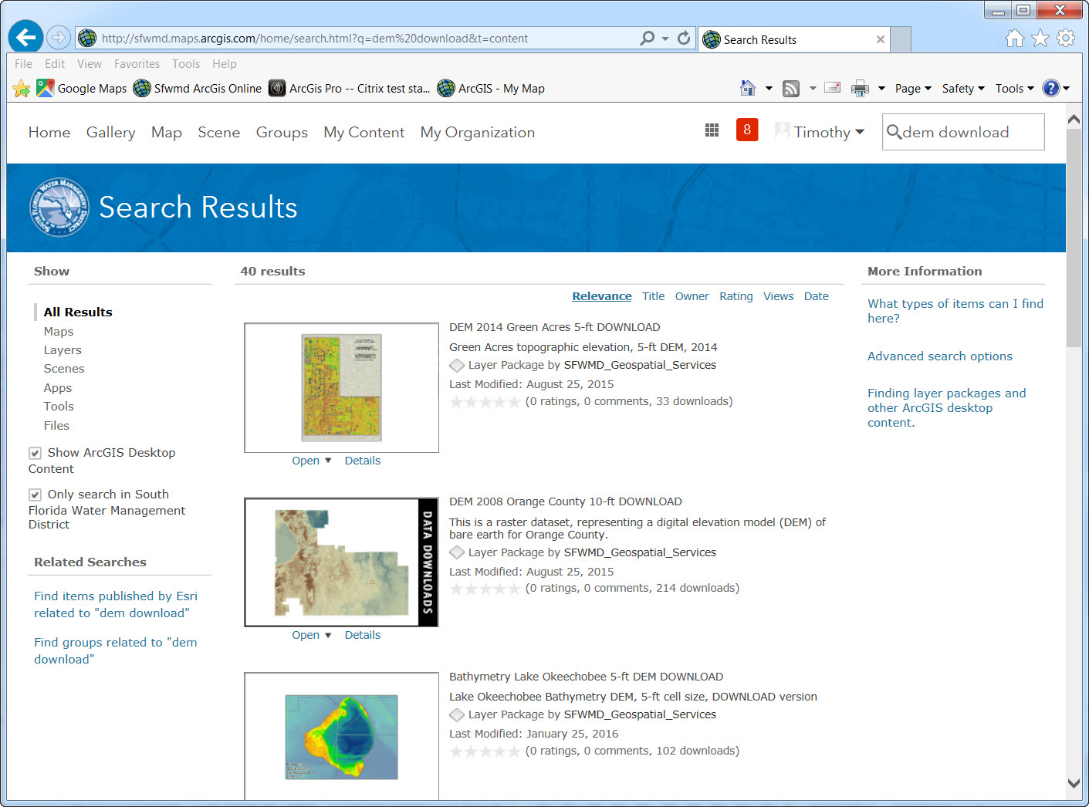
Notes:
Here is an example of our topo DEMs posted on ArcGIS Online. Revision to all of our AGOL entries for DEMs is underway, with the plan of providing links to zipped files on our ftp site for public download of the data.

Slide 26
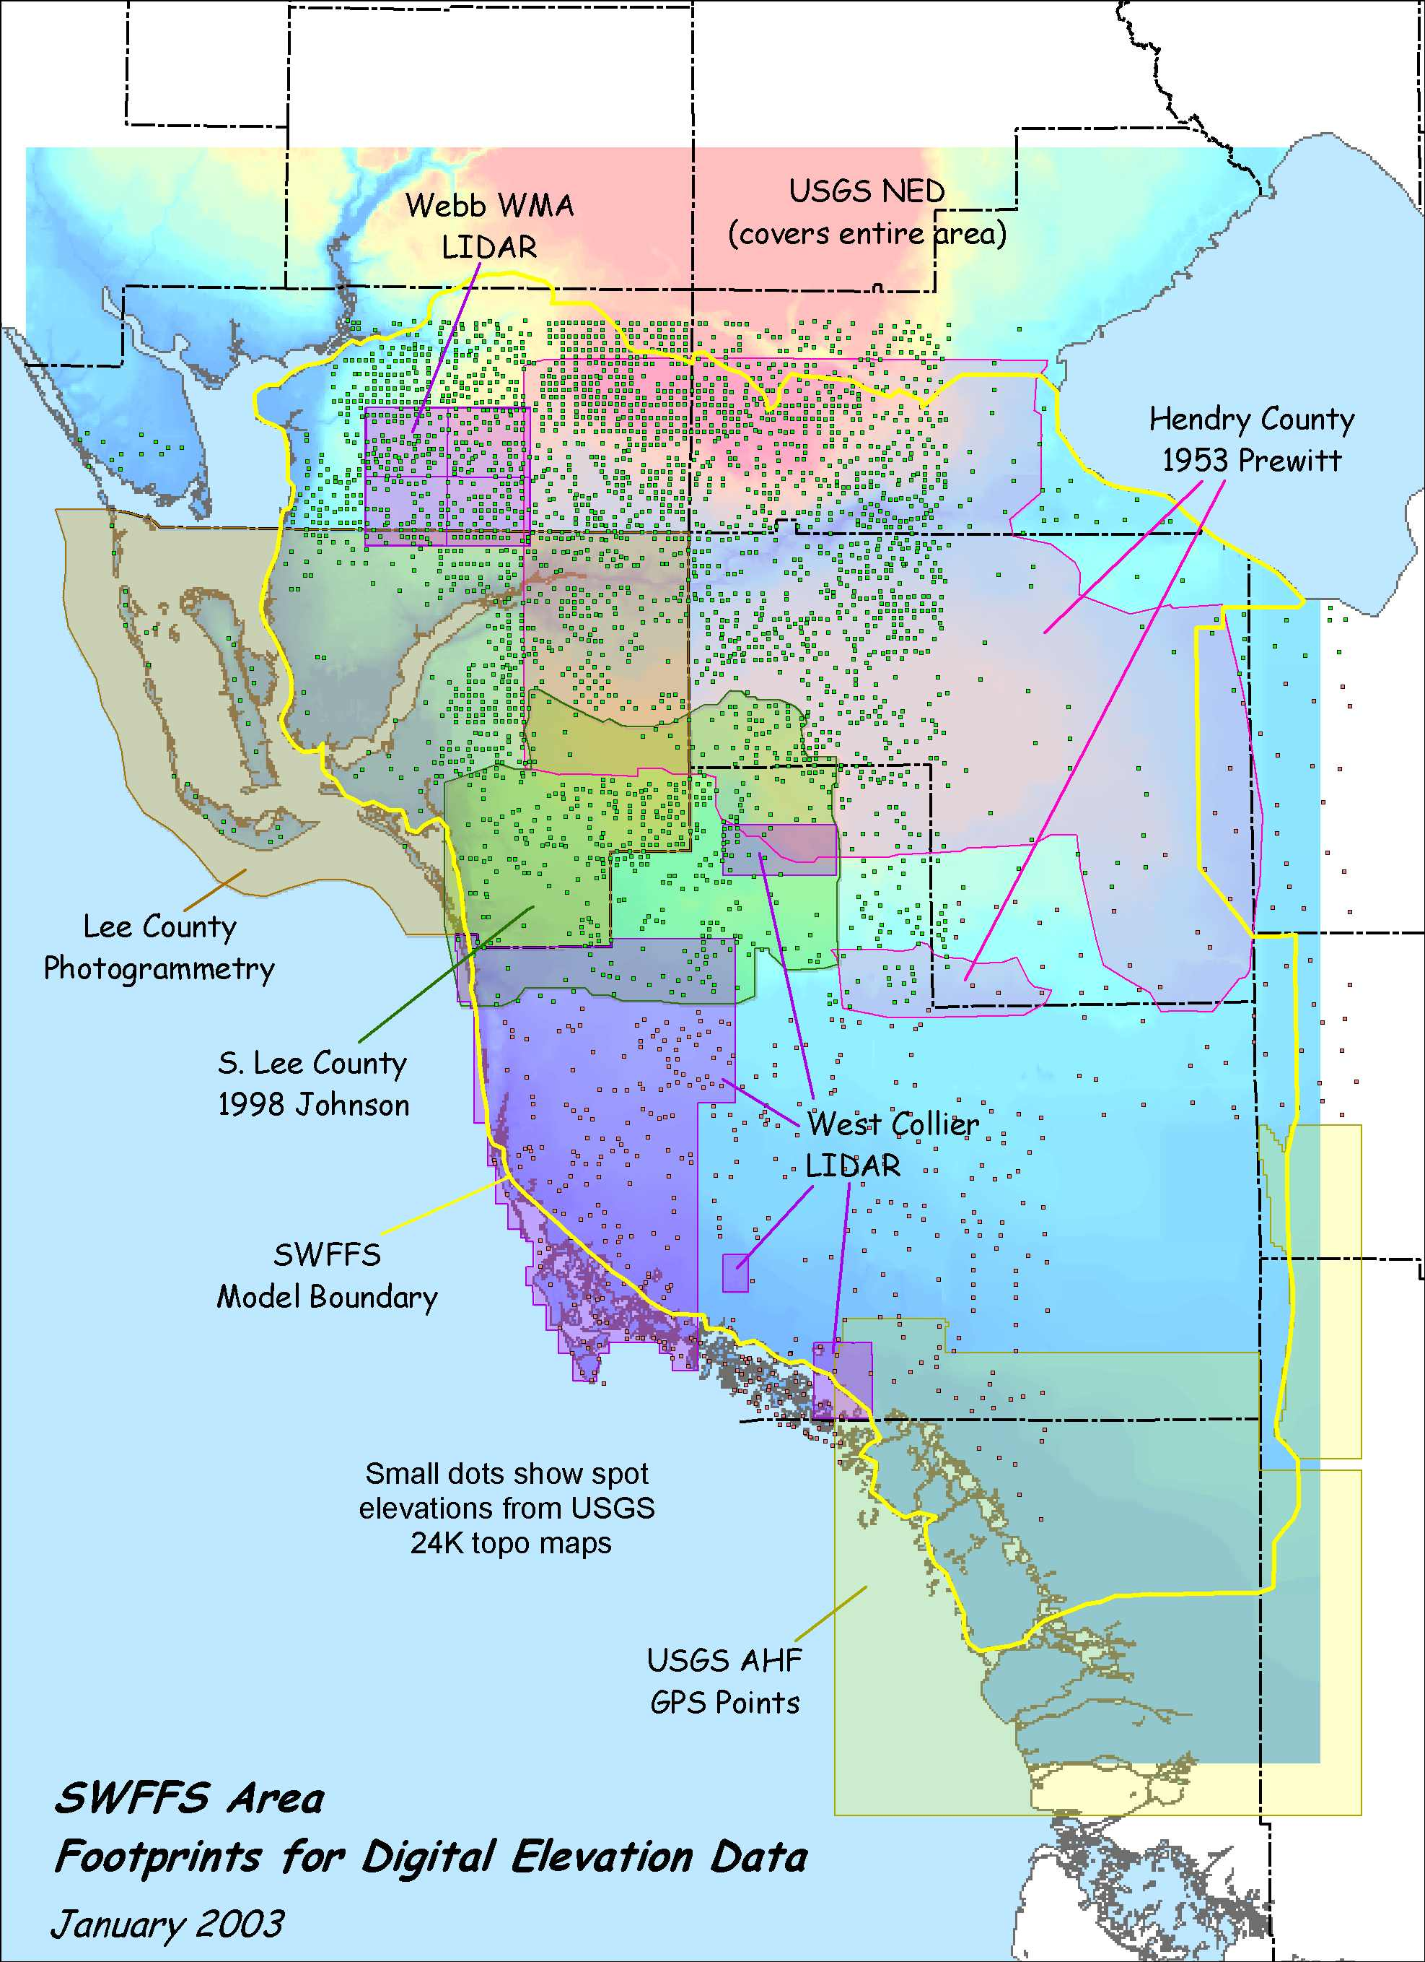
Whither from here…
Continue to nibble away at the gaps in the data, improve on older data
Support county efforts within the USGS 3DEP framework – currently Osceola, Martin, Palm Beach
Hopeful for a statewide LiDAR project with multiple partners
Pay attention to new technologies as potential game changers – single-photon, Geiger mode, drones, etc.
Keep an open mind about Open Data for rasters
Keep plugging for more disk space
Continue to adapt to new possibilities for technology and service
Total Transformation !
2003
Notes:
This is my oldest map that shows the process of collecting and merging topo data from various sources in DEM format for southern Florida.

Slide 27
Managing Large Raster Collections of Aerial Imagery and Topographic DEMs – A Case Study for South Florida
?
?
?
?
ArcGIS Online at
sfwmd.maps.arcgis.com
David Kirouac, dkirouac@sfwmd.gov, 561-682-6984
Tim Liebermann, tlieber@sfwmd.gov, 239-338-2929 x7788
Notes:
Any questions?

