Slide 1
Remote Sensing Image Classification
in Bid Assessment
George Sprehn and Nathalie Smith
6TH Annual
Southwest Florida GIS Symposium
Minnesota Twins Player Development Academy
Lee County, Florida
October 27, 2016
Notes:
Title slide. George introduction, then introduces Nathalie.

Slide 2
INTRODUCTION
Who are we and what do we do?
Remove invasive or unwanted vegetation
Grow and install native plant species
Operate three mitigation banks in Florida
Consult with land managers and regulatory agencies to obtain approvals/permits
Image source: EB
Notes:
We are an ecosystem restoration and environmental consulting company.

Slide 3
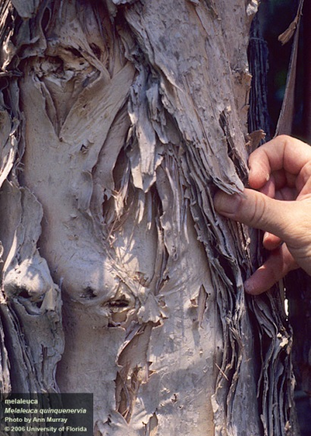
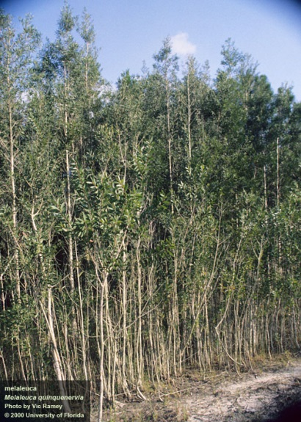
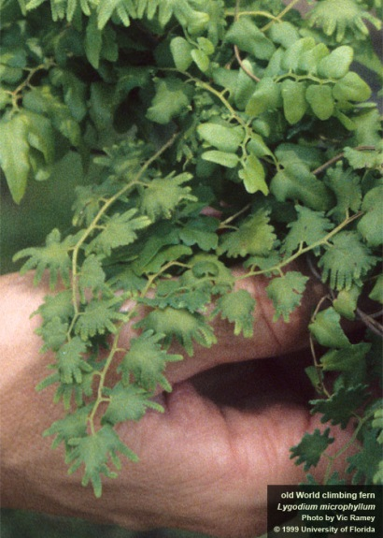
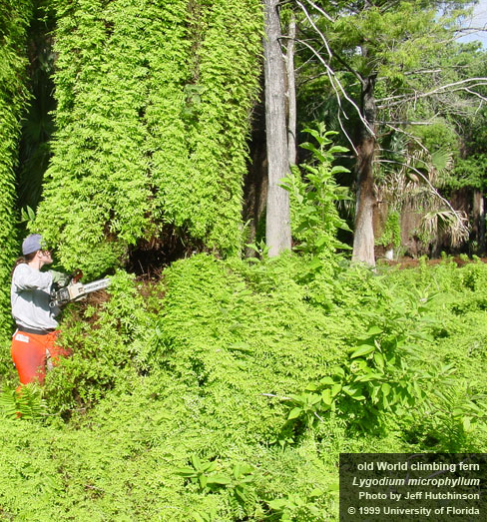
PROBLEM
Invasive plants
Have the ability to thrive and spread aggressively outside their native range
Economic impacts
Melaleuca
(Melaleuca quinquenervia))
Lygodium
(Lygodium microphyllum)
Images source: 1999, UF
Notes:
Invasive species are non-native species that have been introduced into the local landscape. Nuisance species have the ability to thrive, spread and outcompete native vegetation.
Two examples are melaleuca and Lygodium
Our job is to remove/manage these species.
Invasive species have directly contributed to the decline of 42% of the threatened and endagngered species in the US. The annual cost to the US economy is estimated at $120 billion a year (with over 100 million acres (app. Size of Cali) suffering from invasive plant infestations. (http://www.nature.org/ourinitiatives/habitats/forests/explore/invasives-101.xml)

Slide 4
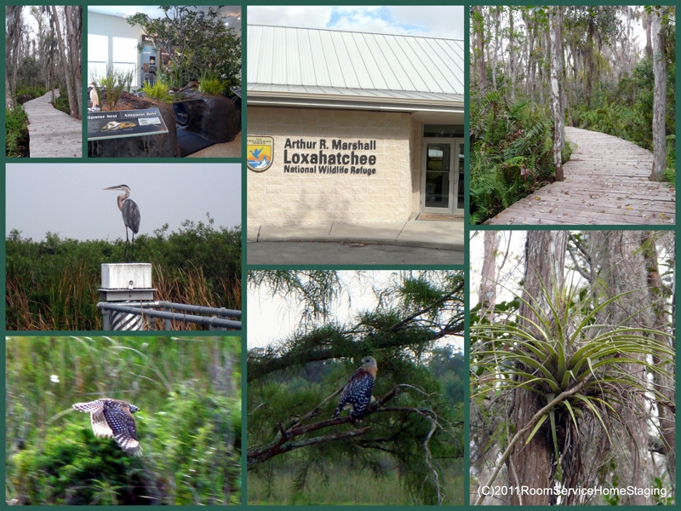
PROBLEM
Remote Locations
A.R.M. Loxahatchee National Wildlife Refuge
Notes:
In order to complete our work we must access remote regions (case study: Lox)
Challenges of working in these environments include….

Slide 5
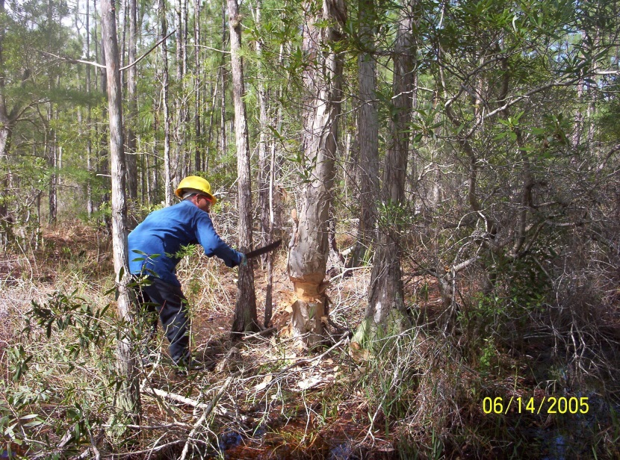
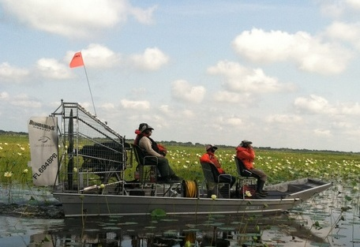
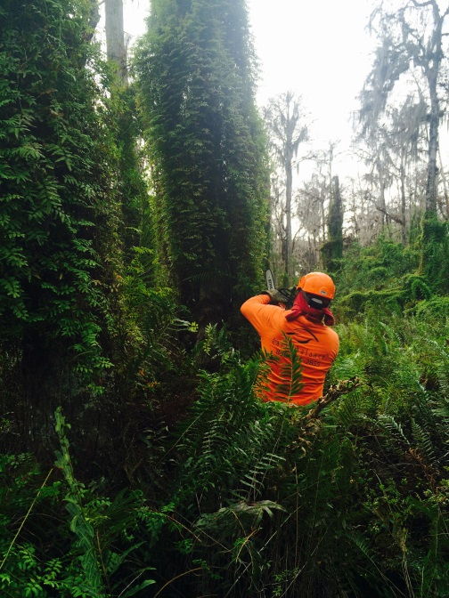
OPERATIONS
Treatment Methods
Girdling
Crew access
Poodle cut
Images source: EB
Notes:
In order to complete our work we must access remote regions (case study: Lox)
Challenges of working in these environments include….

Slide 6
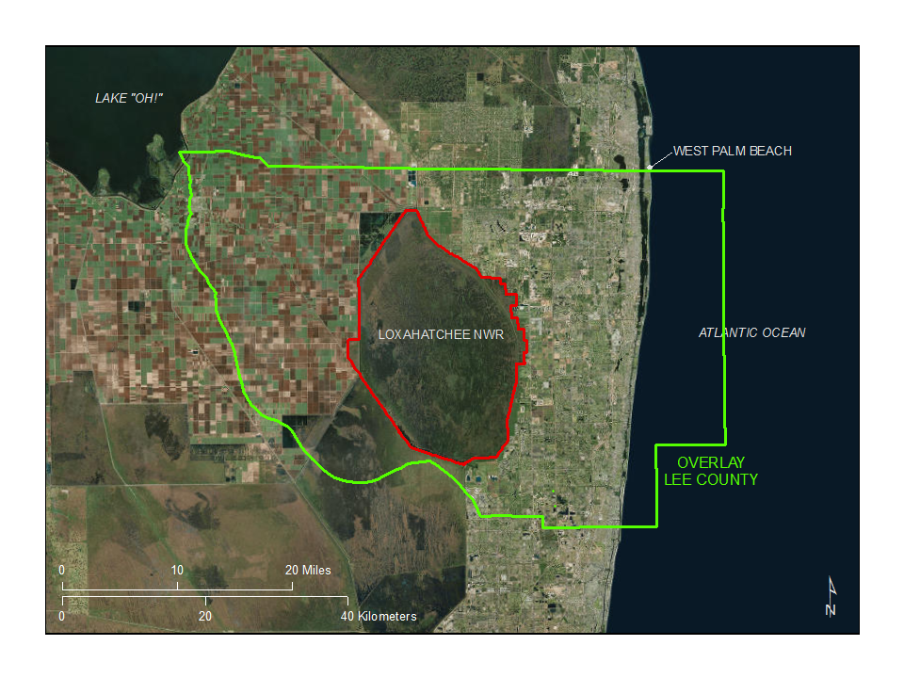
BID DEVELOPMENT
Bidding development process
How can we improve our bidding capability on large remote tracts of land?
Notes:
How do we accurately bid on a region that is so remote and difficult to access?
George will be discussing what remote sensing image classification is and how it MAY benefit contractors who need to estimate vegetation density in the bidding process.
Pass to George…

Slide 7
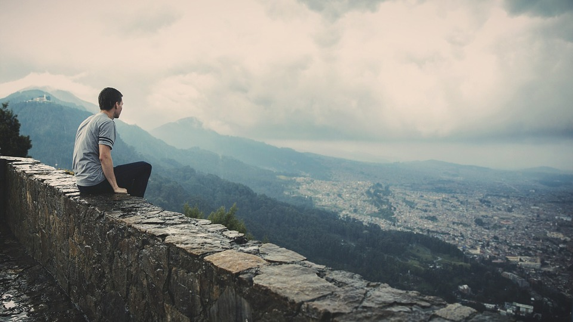
REMOTE SENSING
Distanced: Not in physical contact
A Measurement
Recorded
Analysis
Image source: pixabay
(Jensen, 2005)
Notes:
Definition. WE are remote sensing.

Slide 8
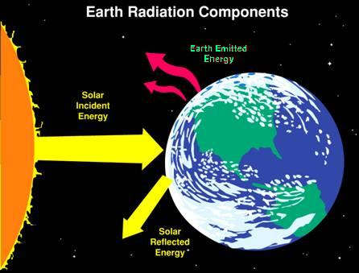
ELECTROMAGNETIC RADIATION
MOLECULAR ACTIVITY CEASES
“0” K = -273 °C = -440 °F
Image sources
Earth Radiation: mynasadata.larc.nasa.gov
Bill Nye: Washington Post, Courtesy of Bill Nye
Notes:
The Science Guy explains wave theory. Long wave and short wave. Car example.

Slide 9
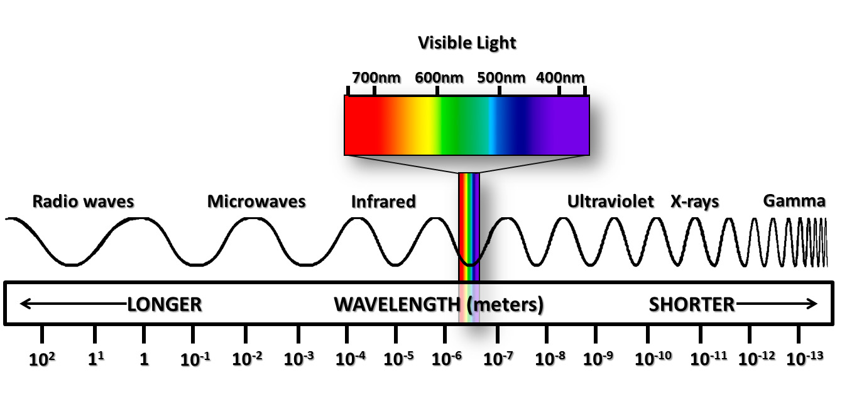
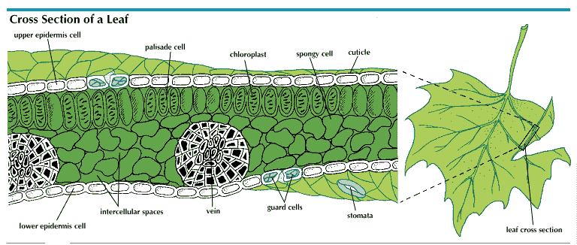
ELECTROMAGNETIC SPECTRUM
Image source: www.ces.fau.edu
Image source: 2015, Rodriguez, B
Notes:
There is more than meets the eye. Vegetation responses.

Slide 10
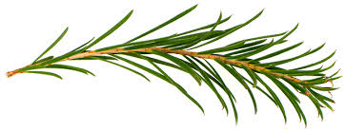
CRITICAL VARIABLES
SUN’S SURFACE TEMPERATURE
EARTH’S ATMOSPHERE
OBJECTS’S SURFACE
ANALYSIS
INSTRUMENT
EARTH’S ATMOSPHERE
OBJECTS’S COMPOSITION
REFLECTANCE ANGLE
Image source: UFEI
Notes:
Consider the many layers of influence to image analysis.

Slide 11
THE REMOTE SENSING PROCESS
Statement of the Problem
Data Collection
Data-to-Information Conversion
Information Presentation
Scientific Method
(Jensen, 2005)
Notes:
High school science fair project. Remote locations. Remote sensing. Photo Interpretation. Results.

Slide 12
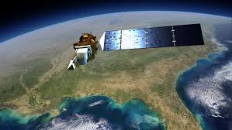
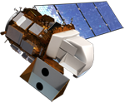
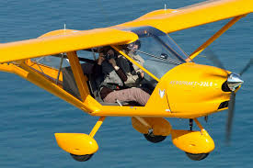
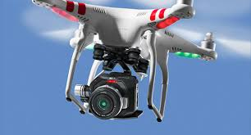
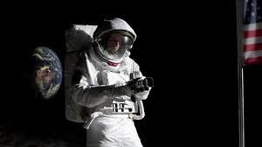
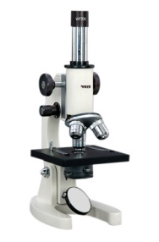
PLATFORMS
ORBITAL PLATFORM
Image source: Jensen, 2007
Image source: NASA
Image source: NASA
NON-ORBITAL PLATFORM
Image source: FOXBATPILOT
Image source: DRONEBLOG
Hmmm: BOTH
Image source: history-of-the-microscope.org
Image source: GETTY IMAGES
Notes:
Common data collection methods.

Slide 13
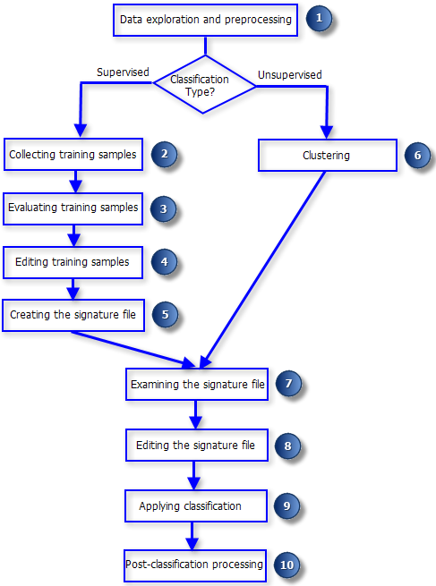
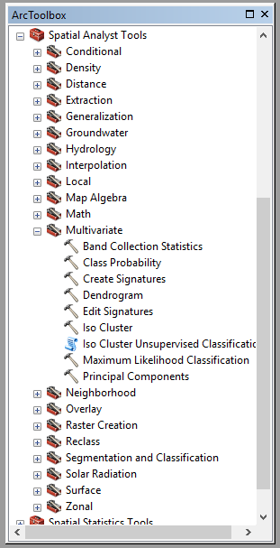
WORKFLOW
Image source: www.esri.com
Notes:
The GIS image classification workflow. Spatial Analyst Extension. Multivariate Toolbox. Image Classification toolbar.

Slide 14
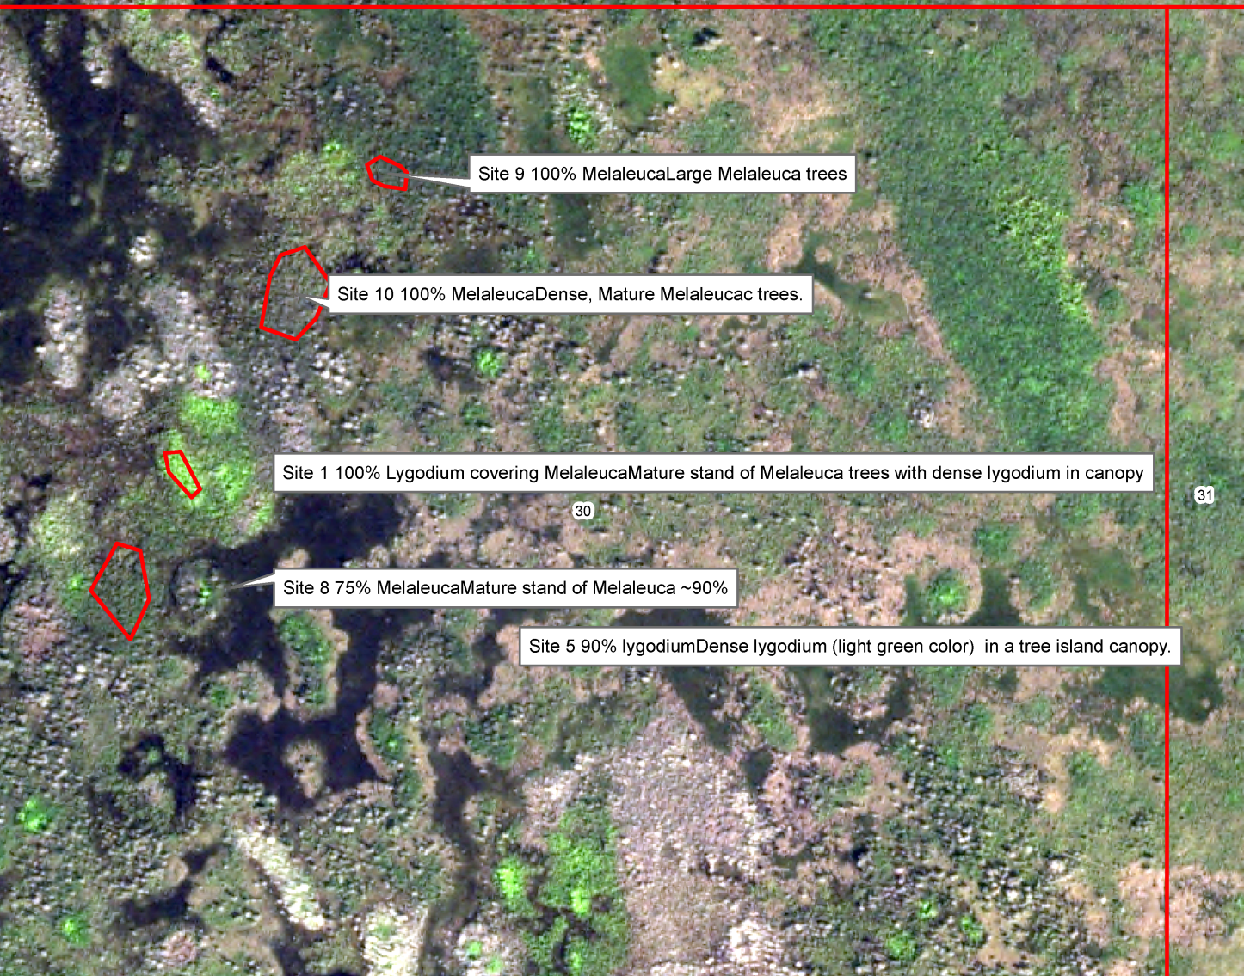
DATA EXPLORATION
Photo Interpretation (PI)
Notes:
Expert knowledge, in situ observations, ground-truth data

Slide 15
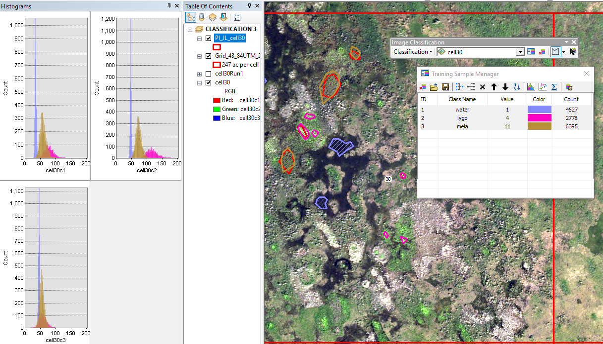
COLLECT TRAINING SAMPLES
Create a Signature File *.gsg
Notes:
Demonstrates the training sample process.

Slide 16
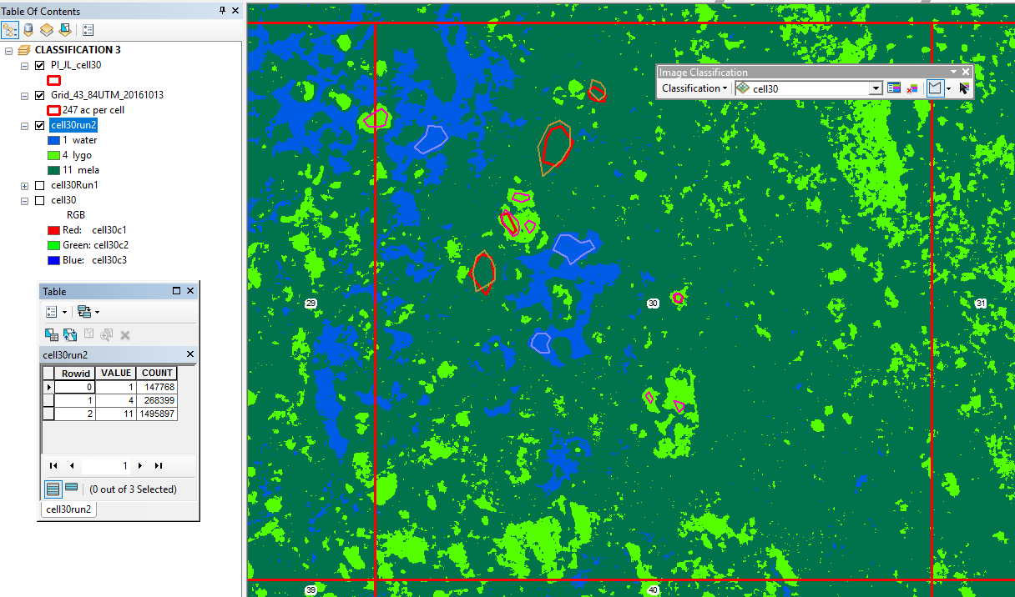
RESULTS
Post processing clean up
Ground-truth accuracy assessment
Pixel area (m²) x #pixels / 4047 = ac.
Notes:
Filtering, smoothing, generalizing. Statistics. Bid acres.

Slide 17
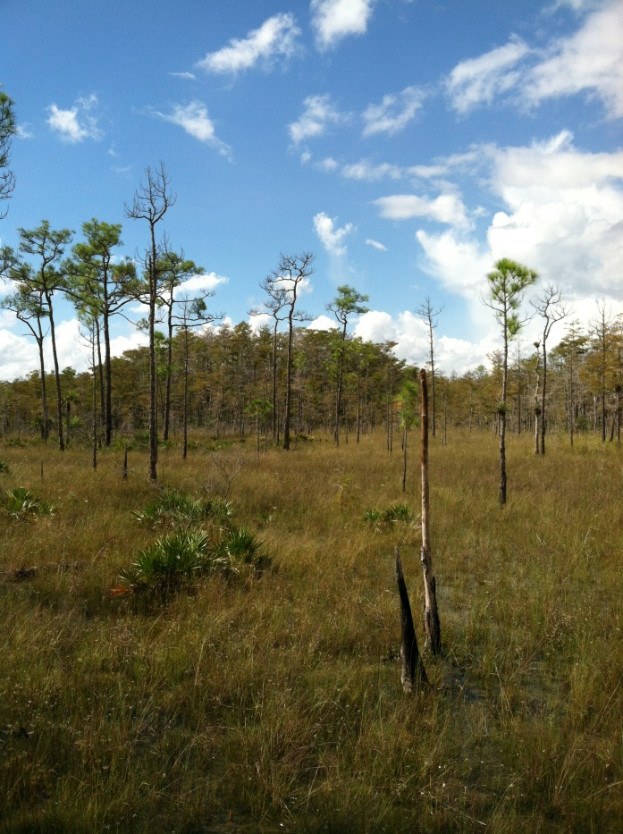
CONCLUSION
Can supplement the bidding process
Understand the many variables
Further study
Q & A
Image source: 2015,Laroque, J.
Notes:
Photo Interpretation better than classification, labor intensive. Electromagnetic variables. Automate script workflows. Alternative uses.

