Slide 1
Creating Custom GIS Web Applications: Making Crucial Data Readily Available
Susan Blake – Infrastructure Information Coordinator, City of Sarasota Utilities Department
Cameron Amrine – GIS Analyst, Stantec
November 5, 2015

Slide 2
Where to Start
Who are the users?
Familiarity with GIS/computers
Data and functionality
Who is maintaining it?

Slide 3
Web Application Choices
ArcGIS Online
Single purpose maps
Limited amount of features
Little customization
Custom Written using JavaScript API
High customization
Expensive
Open Source
Customizable
Cost effective
Great support community

Slide 4
Configurable Map Viewer (CMV)
Developed by ESRI employees
Community submitted widgets and updates
Utilizes ArcGIS for Server, ESRI JavaScript API
Template code provided
Assumes some knowledge of JavaScript, ArcGIS for Server
Meant to be customized by the user
https://github.com/cmv/cmv-app

Slide 5
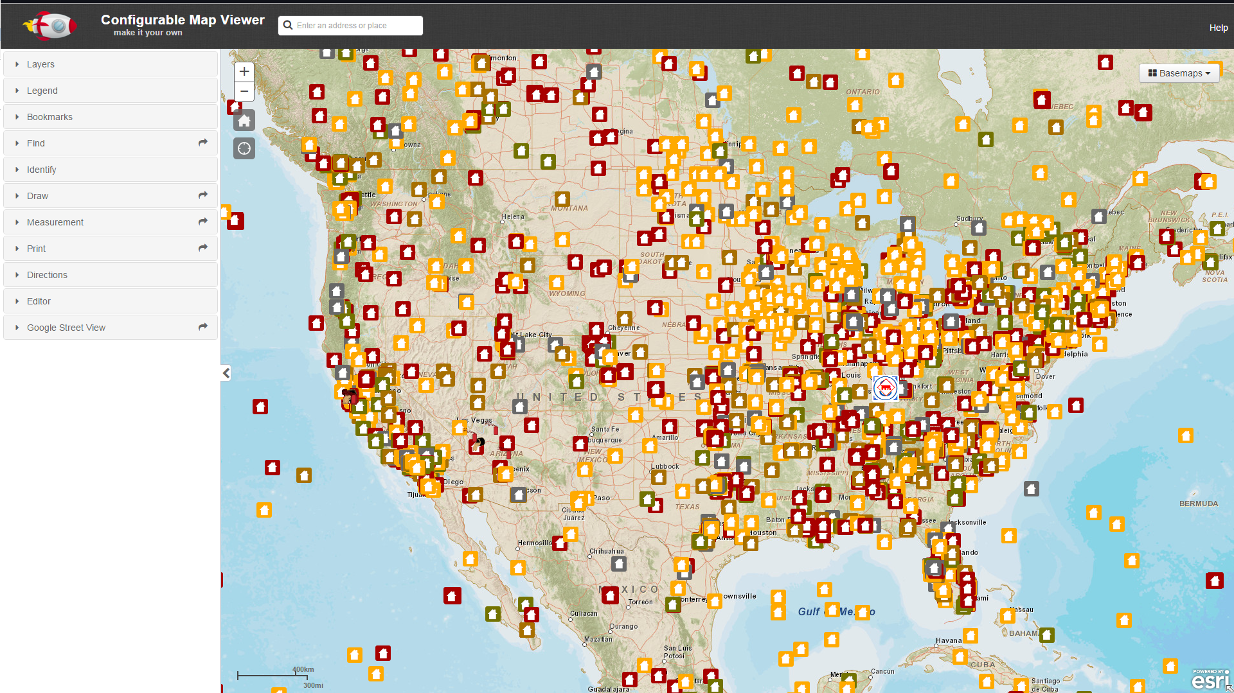
Configurable Map Viewer (CMV)

Slide 6
Configurable Map Viewer (CMV)
Contains an assortment of interconnected files that retrieve data and provide formatting
JavaScript
CSS
HTML
Provides framework to customize appearance/functionality
Titles/labels
Menu styles/colors
Add/remove widgets

Slide 7
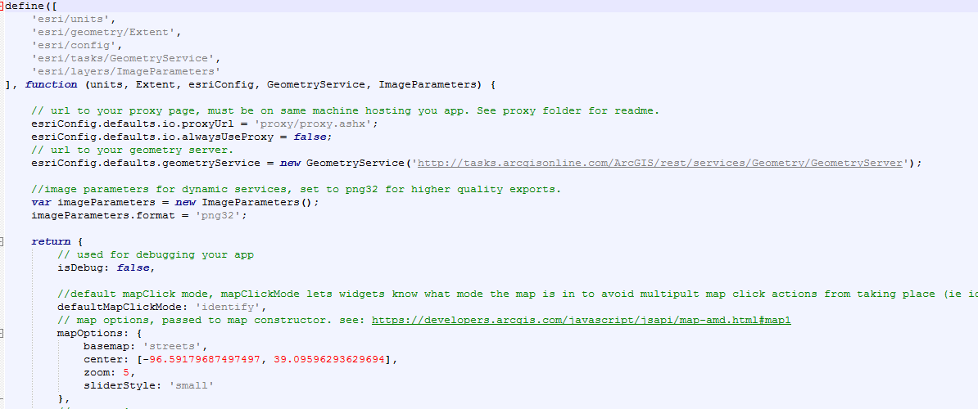
Configurable Map Viewer (CMV)

Slide 8
City of Sarasota Utilities Web Application
Make GIS data readily available to non-GIS staff
In office and in the field
Needs to be:
Easy to use
Lots of functionality
Accurate
Held stake holder meetings through the development process

Slide 9
City of Sarasota Utilities Web Application
Utility networks included:
Potable Water
Sewer (with direction of flow arrows)
Reuse
Stormwater (with direction of flow arrows)
Base information
Parcels, roads, 2 ft. contours
Functionality Added
Import item was a disclaimer prior to accessing information that it was use at your own risk, no liability to the City for anything incorrect.
Query asset attribute tables
Export selections to excel
Print to PDF
Uses custom print templates
Google Street View

Slide 10
City of Sarasota Utilities Web Application
Live Demo

Slide 11
What’s Next?
Release the app to the public (minus a few layers)
Bring in other City departments
Neighborhoods (zoning, neighborhood designations and associations)
Building Permits (active and proposed construction)
Parking (Public timed, vs permit), ticket info
Additional functionality/modify widgets
Add forms to be completed and the ability to email them
Example sewer spills to DEP
Additional layers
Evacuation zones, Pre-Annexation

Slide 12
Questions?

