Slide 1
Lee County Port Authority
Geographic Information System

Slide 2
Welcome
Ian McKay
Project Coordinator (Noise/Airspace)
Department of Planning and Environmental Compliance
Office: 239.590.4609
Email: icmckay@flylcpa.com

Slide 3
How GIS Fits Into the Airport Industry
The National Airspace System requires a massive upgrade
Airports will be required to provide GIS data to the FAA via AGIS
Electronic Airport Layout Plans
Surface Analysis and Visualization
Airport Master Record data
Obstacle data
As of yet, the FAA is not mandating compliance, but will soon

Slide 4
ArcIMS
LCPA pursued an enterprise solution using ArcIMS
It suffered from several hurdles:
It became outdated
LCPA did not posses in-house capability to maintain it
There wasn’t enough buy-in from the whole organization
We took a different approach and started smaller

Slide 5
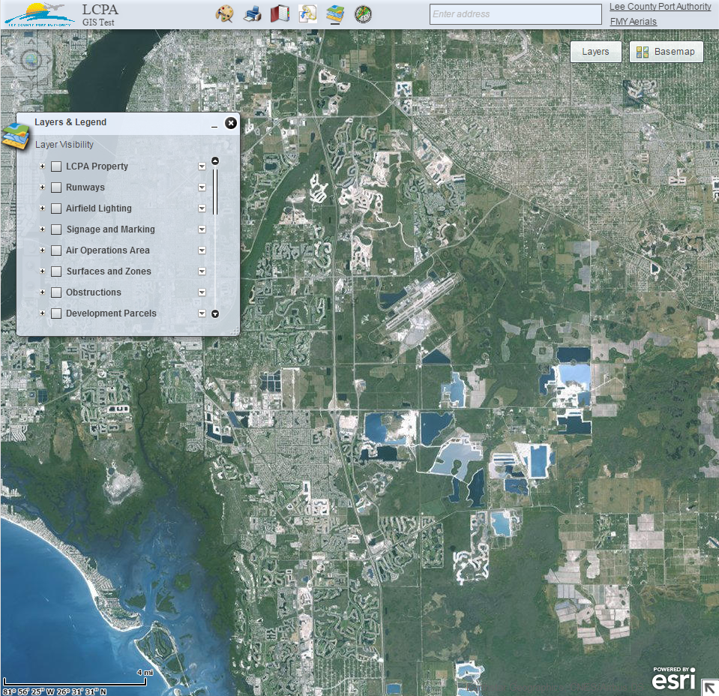
ArcGIS Viewer for Flex
LCPA coordinated with Lee County
A network of three servers host project files, the geodatabase, and the Flex Viewer
We began to generate data and add existing data from CAD files
It’s only available on the internal network and cannot be accessed through the internet

Slide 6
Data Available in the Geodatabase
There are nearly 100 feature classes in the geodatabase including:
Airfield signage and markings
Airport Operations Area
Airspace surfaces and zone
Airspace Obstructions
Tall Structure Permits
Development parcels
Utilities
Wildlife observations
Bird strike data

Slide 7
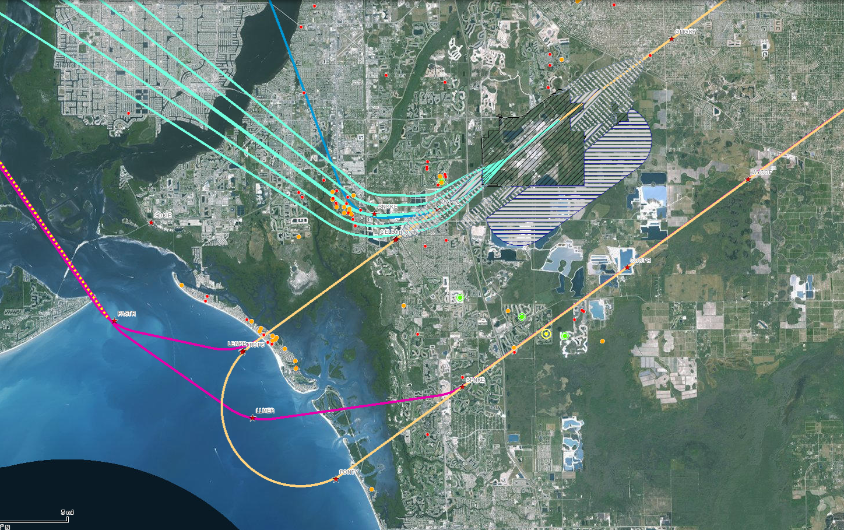

Slide 8
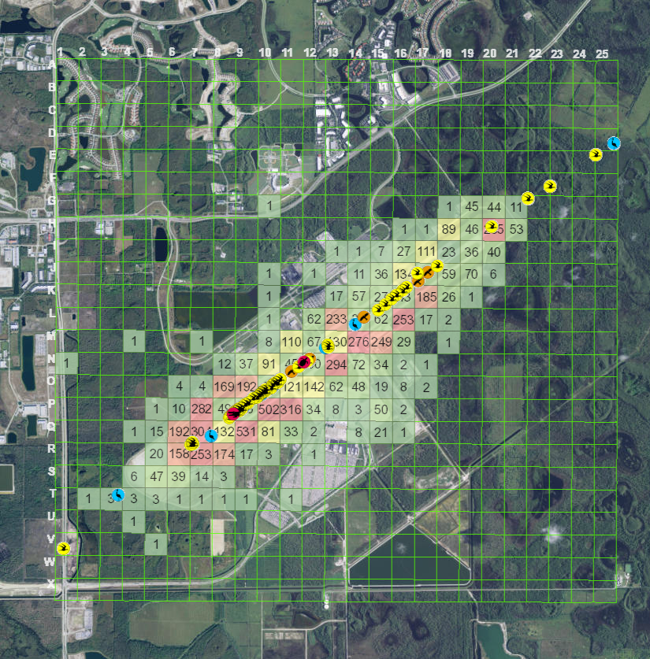

Slide 9
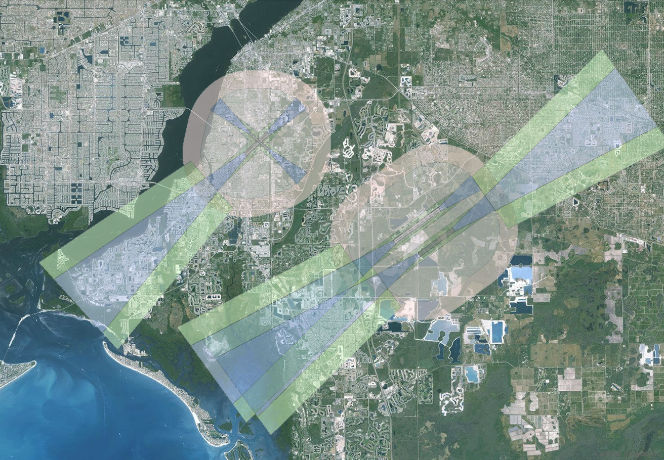

Slide 10
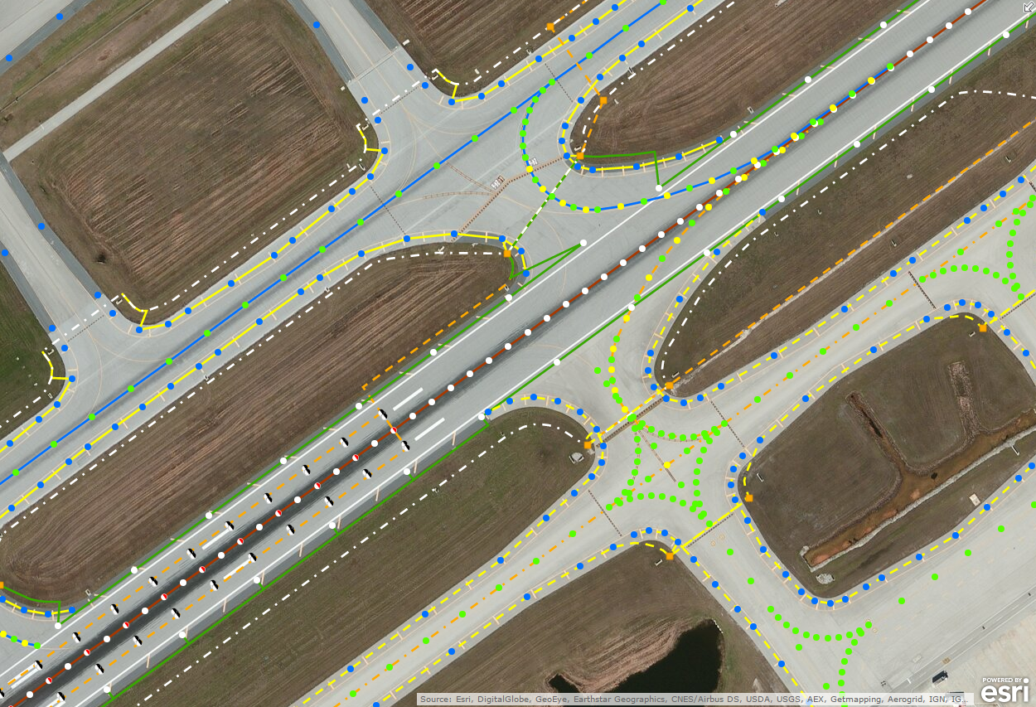

Slide 11
What We Look Forward to in the Future
Hire a GIS Coordinator to champion the program
Integrate GIS with our:
Work order management system
Safety Self Inspection program
Emergency dispatch
FAA AGIS
Continue garnering the necessary support through phased and controlled implementation
There are limitless possibilities for GIS at airports

Slide 12
Thank You

