Slide 1
A basic overview of a really fantastic free tool no one is using.
Presented by:
Manuel Perez, Senior GIS Analyst
Stantec
Shellie Watts, GIS Coordinator
- City of Fort Myers

Slide 2
What is it?
ArcGIS for AutoCAD is a free, plug-in application for AutoCAD that allows you to access and create GIS data by connecting to services from ArcGIS for Server and ArcGIS Online.
Within the AutoCAD environment, you gain easy access to enterprise GIS maps, map services, image services, and feature services.
It will make less work for you.

Slide 3
Why is it so cool?
Streamline information sharing between GIS and CAD groups.
View live, rich cartographic GIS maps in AutoCAD (AND EDIT IT)!!
Include the results of GIS analysis in AutoCAD designs.
Add imagery to your AutoCAD drawing (save storage space).
Create, manipulate, and define how CAD data is organized and attributed as GIS content so it can be used in ArcGIS for Desktop or AutoCAD.
No longer have to continually export shapefiles and dwg’s to AutoCad users. Labels come through. No longer have static view of the data (Roads/Parcles).

Slide 4
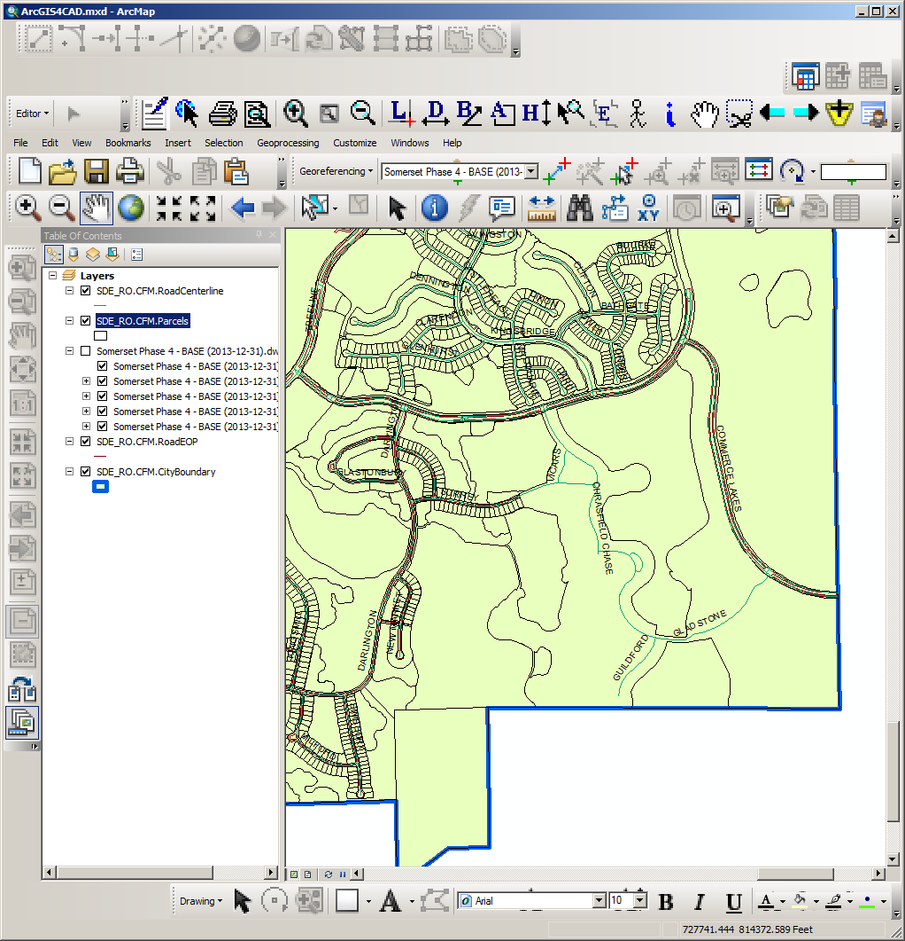
From the GIS end… What Cad file looks like in Gis

Slide 5
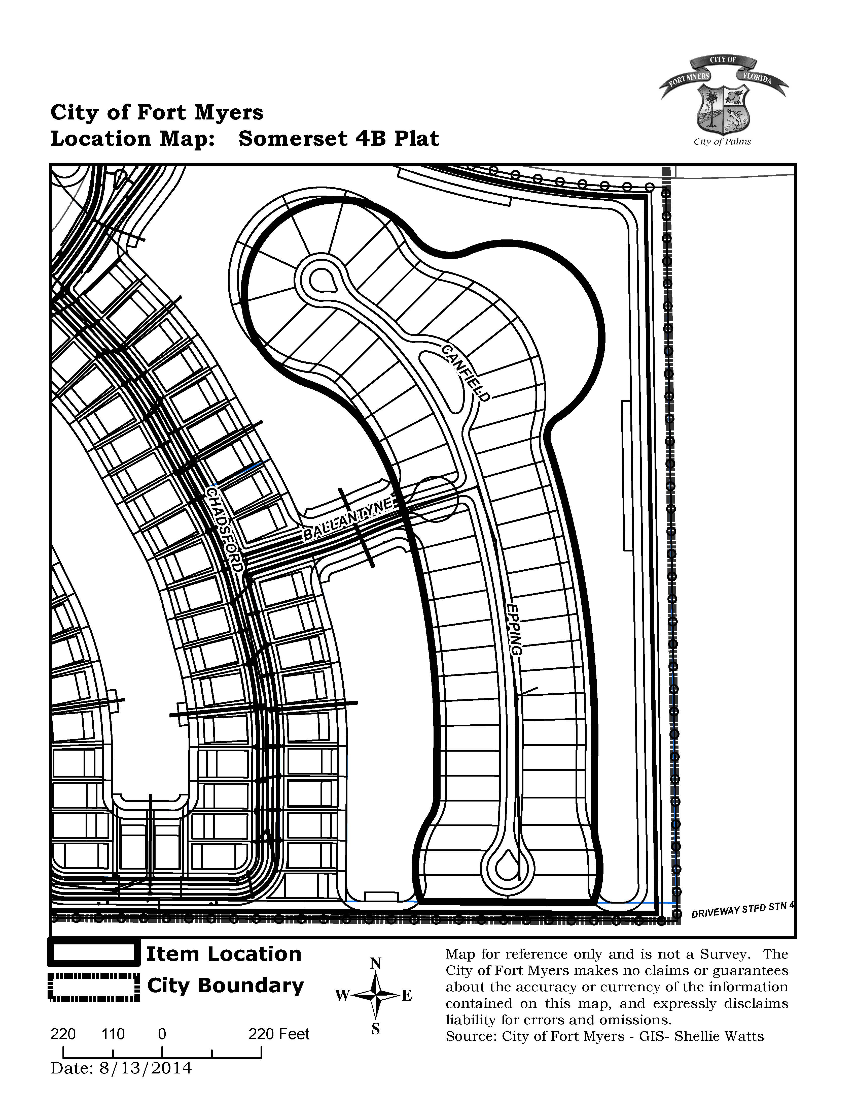
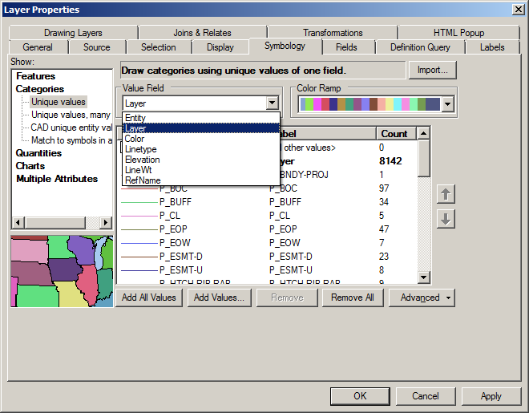
Time Killer

Slide 6
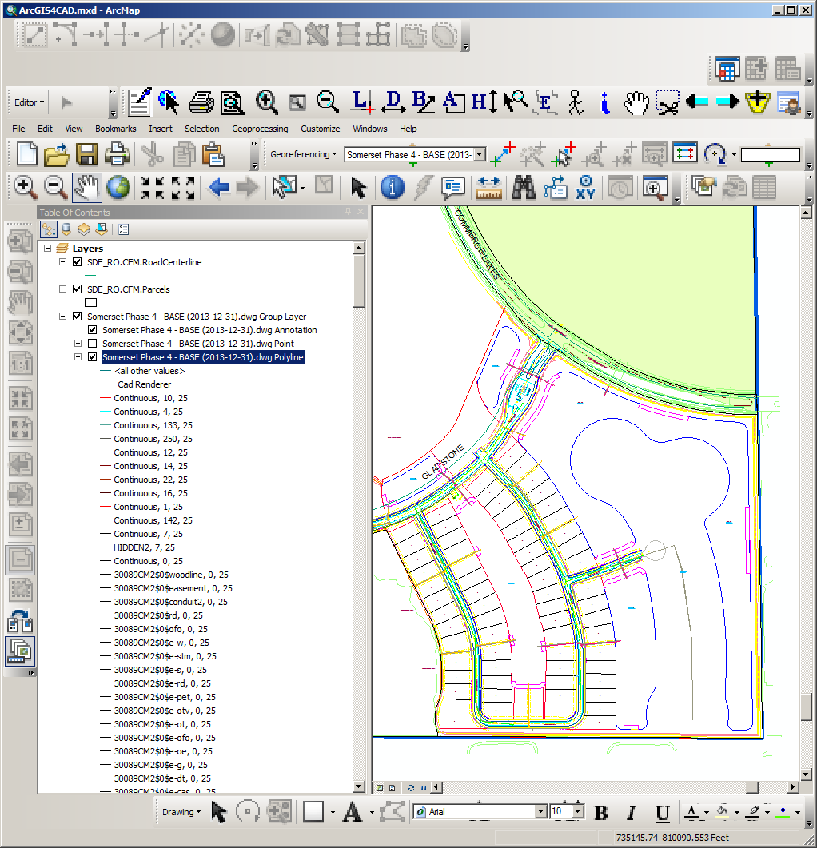
CAD vs. GIS

Slide 7
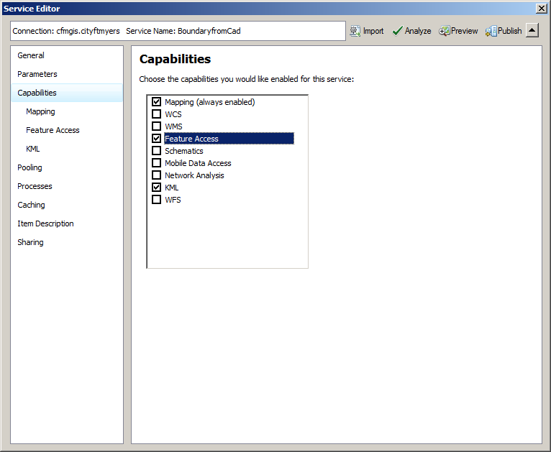
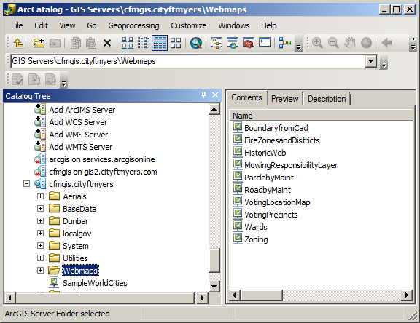
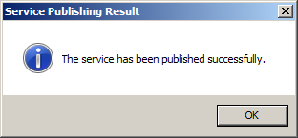
How does it work ?
Publish a .mxd to an ArcGIS Server – or ask someone you know.
If you want to be able to edit it, be to check “Feature Access” under capabilities.

Slide 8
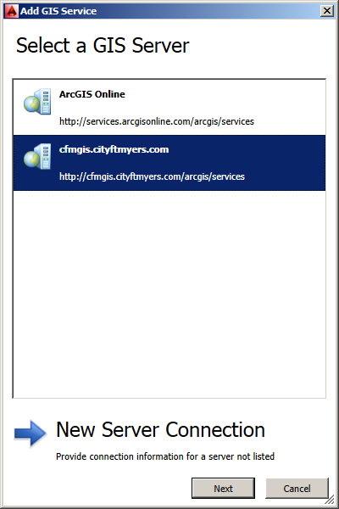
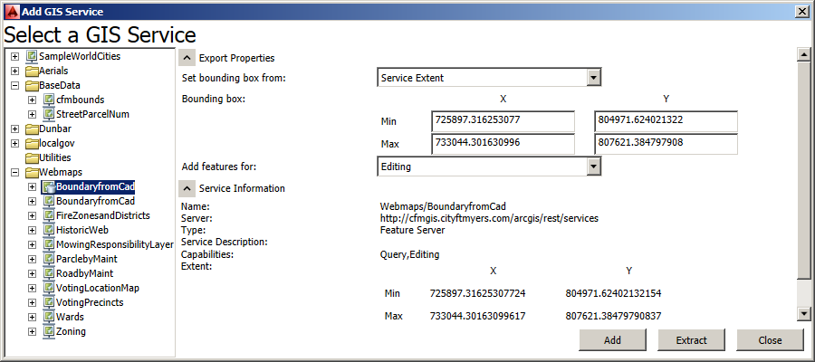

Slide 9
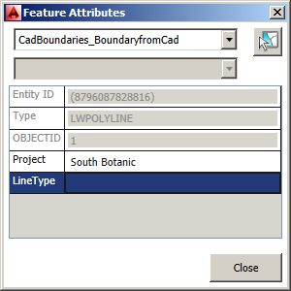

Slide 10
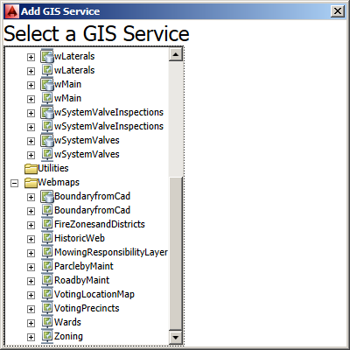
I was able to add data and bring it into a CAD DWG edit it and push to GIS formate.

Slide 11
Workflows to support – GIS to CAD and CAD to GIS

Slide 12
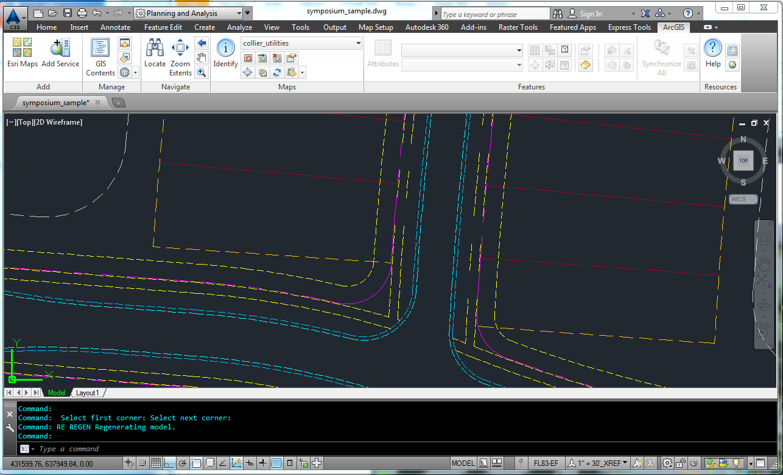
Why it is useful for your organization

Slide 13
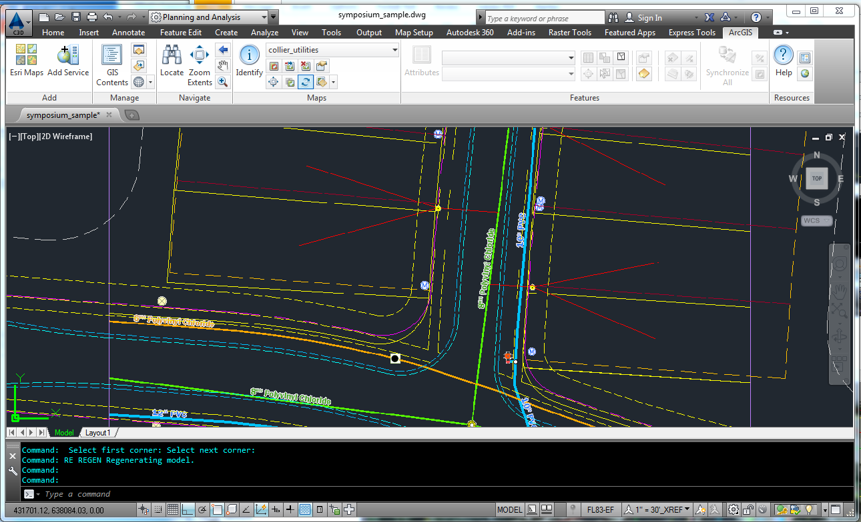
Why it is useful for your organization

Slide 14
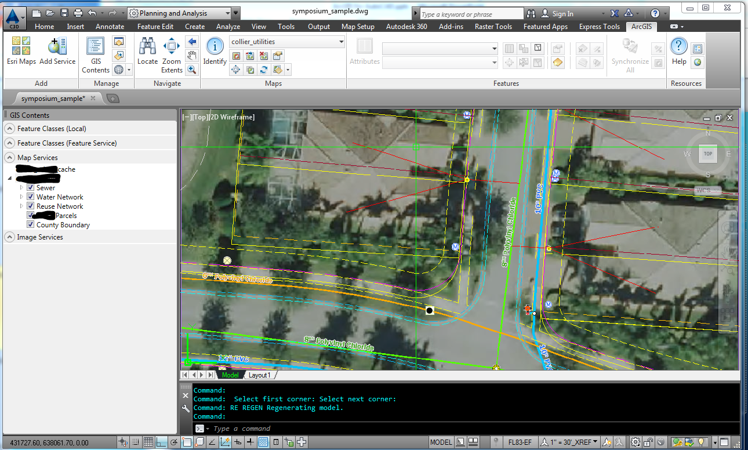
Why it is useful for your organization

Slide 15
Requirements – all the moving parts
Requires either ArcGIS Server (any) or ArcGIS Online (Don’t have to roll your own – you can use publicly available servers such as City of Ft Myers)
ACAD 2013-2015, any flavor (Civil, Map, etc). Mac users are out of luck.
Personnel – Someone who can publish services and is knowledgeable concerning ArcGIS Server

Slide 16
Limitations
NOT A CONVERSION TOOL – Designed to consume ArcGIS Services
The plugin is free – the server isn’t
Performance and speed dependent on server config, connection speed, etc
It crashes!!!!

Slide 17
Where to learn more
http://giscadblog.blogspot.com – Don Keuhne’s blog (ESRI Product Owner)
GISCADChannel – Youtube channel run by Don
ESRI UC Presentations – just google “esri video arcgis for autocad”.

Slide 18
Questions?
We thank you for your time today!

