Slide 1
Lee County GIS ”Soup To Nuts” (Building a GIS to Spatially Enable a Community)
Amy Hoyt, GISP
GIS Manager Lee County Government ahoyt@leegov.com

Slide 2
What is a GIS?

Slide 3
“Soup to Nuts”
People
Hardware
Software
Data
Data/Maps/Analyses
Map Services
ArcGIS Online for Organizations
Web Maps
Web Apps
Soup
Nuts

Slide 4
GIS Staff & County Departments
4 GIS Staff
– Manager, System Administrator, Data Steward, GIS Analyst
Provide daily county-wide GIS support and training for 21 departments
Administration ITG
Building Inspections Parks & Recreation*
Code Enforcement Permitting
County Lands Planning*
Development Review* Public Resources*
DOT – Eng/Operations/Traffic* Public Safety*/EOC
Economic Development Solid Waste
Environmental Sciences* Sustainability
Human Services* Utilities*
Lee Tran* Zoning*
Natural Resources – Env Lab/Marine Sciences/Surface Water*
* GIS expertise embedded in department

Slide 5
GIS Partners & Community
Work closely with/provide data to stakeholders:
City of Bonita Springs LCEC
City of Cape Coral RPC/MPO
City of Fort Myers* Port Authority*
City of Sanibel Property Appraiser*
Town of Fort Myers Beach Sheriff’s Office*
Fire Districts FGCU
* Connected directly to our GIS
Southwest Florida GIS User Group – 7 SW Counties
GIS Symposium – Rookery Bay

Slide 6
Hardware (Partnership w/IT)
Servers
2 Virtual SQL 2012 Servers – EOC - failover capability
1 Virtual SQL 2012 Server – DR (Miami)
Flat File Storage Array - EOC
1 VM Web/Application Server – EOC
2 Citrix Servers – EOC - Remote ArcGIS Access
1 Citrix Server – DR - Remote ArcGIS Access
Desktops
Dell Workstations, Dell Laptops
Plotters
1 HP5000 (60”), 14 HP1055/800 (36”) – county-wide
Mobile Devices
Dell Tablets, iPad, Trimble GeoXT, GPS Cameras, USB GPS

Slide 7
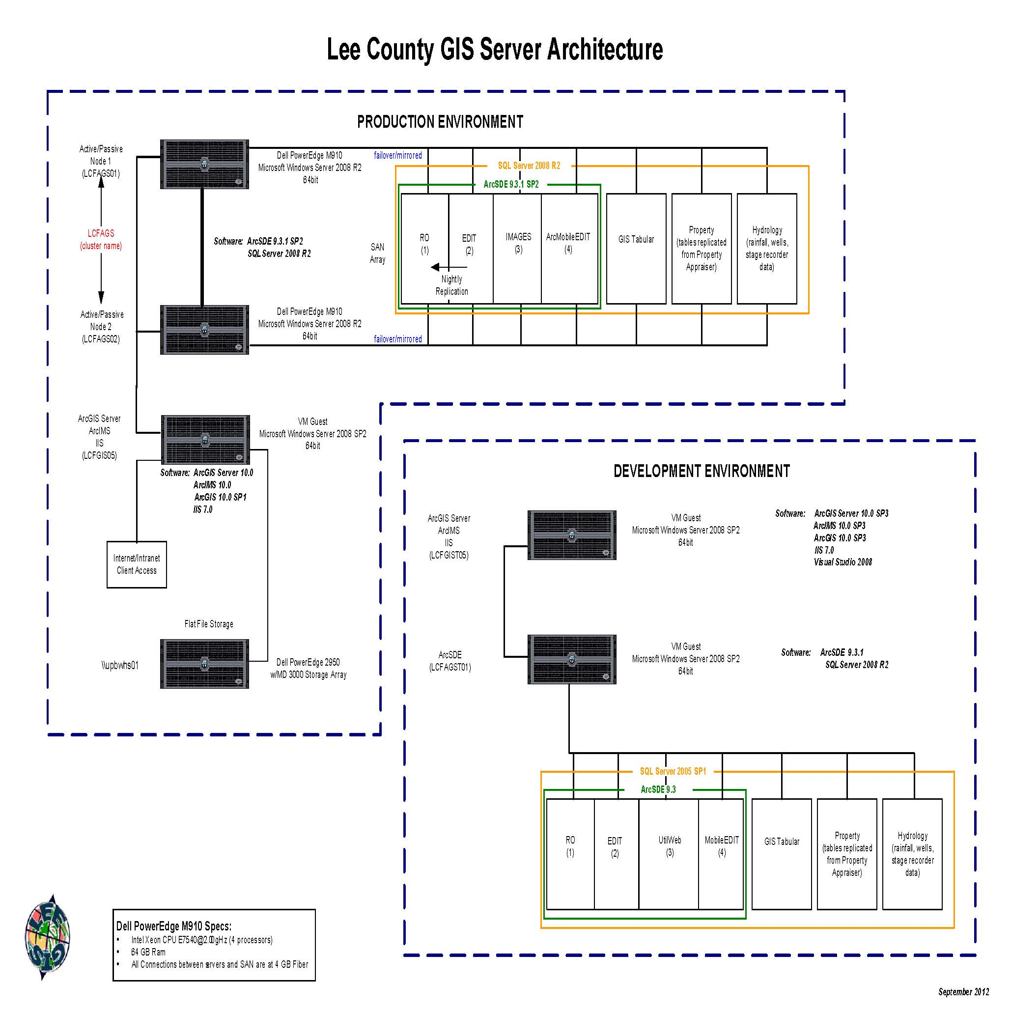
Hardware

Slide 8
Software
ESRI (Environmental Systems Research Institute)
ArcGIS Desktop: create data, maps, perform analyses, publish data to the web (accessed through local installs and Citrix – central license server)
ArcGIS Desktop Extensions: 3D Analyst, GeoStats, LP360, Maplex, Network Analyst, Publisher, Spatial Analyst
ArcSDE: database engine
ArcGIS Server: serves data to web
ArcGIS Online for Organizations: provides GIS access on all devices
Microsoft
SQL Server: database

Slide 9
What is GIS Data?
Layers of Information
Points - hydrants, traffic signs, permitted wells
Lines - roads, pressurized mains, contours
Polygons – flood zone, properties, zoning
Imagery - aerial photos, scanned images
Attributes - street name,
flood zone,
install date,
elevation

Slide 10
GIS Data
Points, Lines, Areas: over 700 data layers

Slide 11
GIS Data
Imagery ~ 4 TB
1998, 2002, 2005, 2007, 2008, 2010, 2011, 2012, 2013, 2014 :
6 “ Digital Orthophotography
Georectified (lines up with county GIS data)
1953, 1986:
Scanned Images
Georectified (lines up with county GIS data)
1968, 1972, 1975, 1979, 1986, 1990, 1996:
Scanned Images
Not Georectified
1966 – 2008 (~ every 2 yrs):
Scanned Section Images
Not Georectified

Slide 12
Scanned Historic Aerials
April 1993

Slide 13
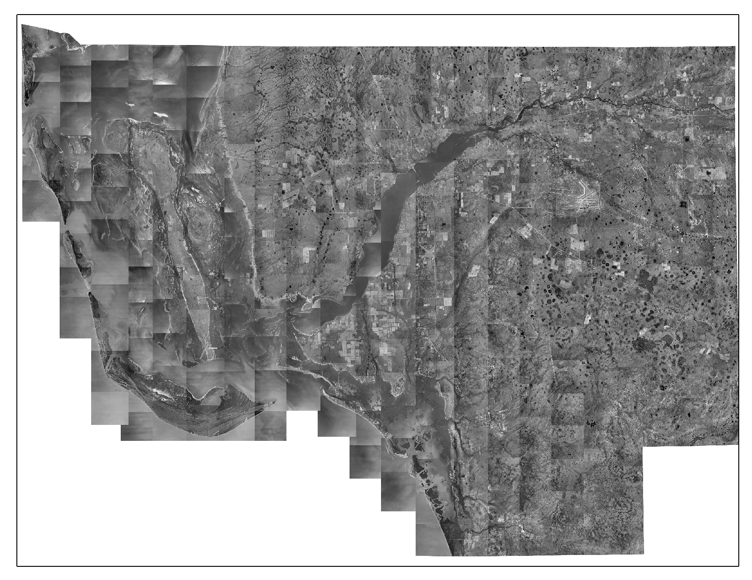
1953 Aerials: scanned historic aerials (300 photos)

Slide 14
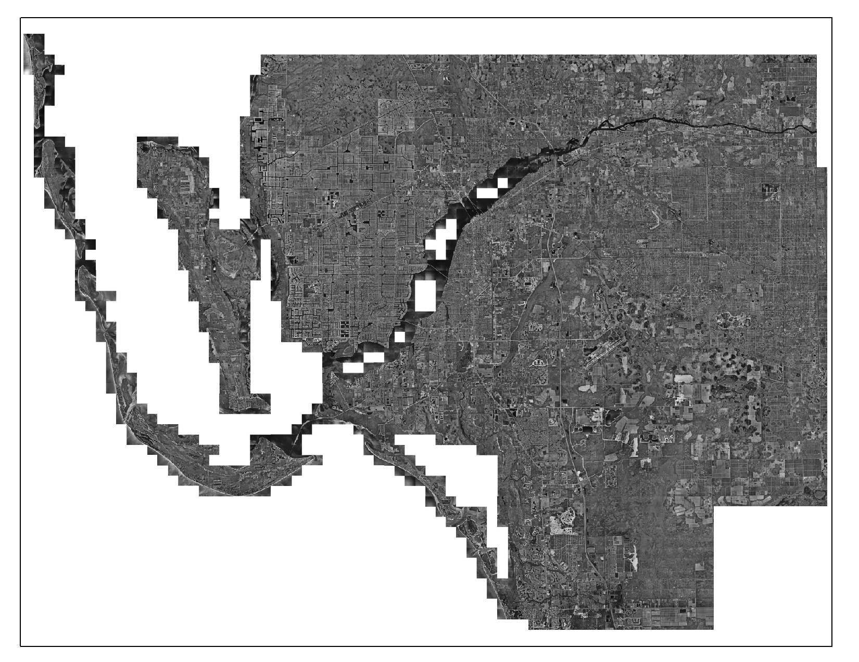
1998 Aerials: ½’ pixel resolution

Slide 15
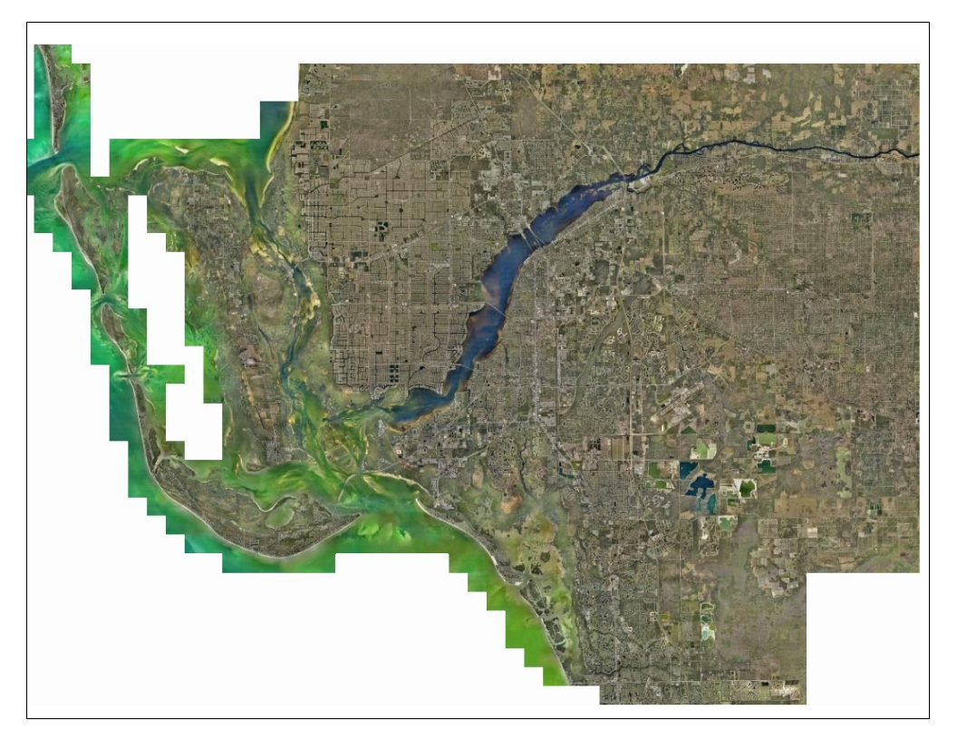
2014 Aerials: 4” pixel resolution

Slide 16
GIS Data
Elevation Data - LiDAR (Light Detection and Ranging) collected for Surge Zone and Evacuation Zone updates.
All Classifications Ground and Water

Slide 17
GIS Data
1’ and 2’ Contours
Spot Elevations
3 billion points county-wide

Slide 18
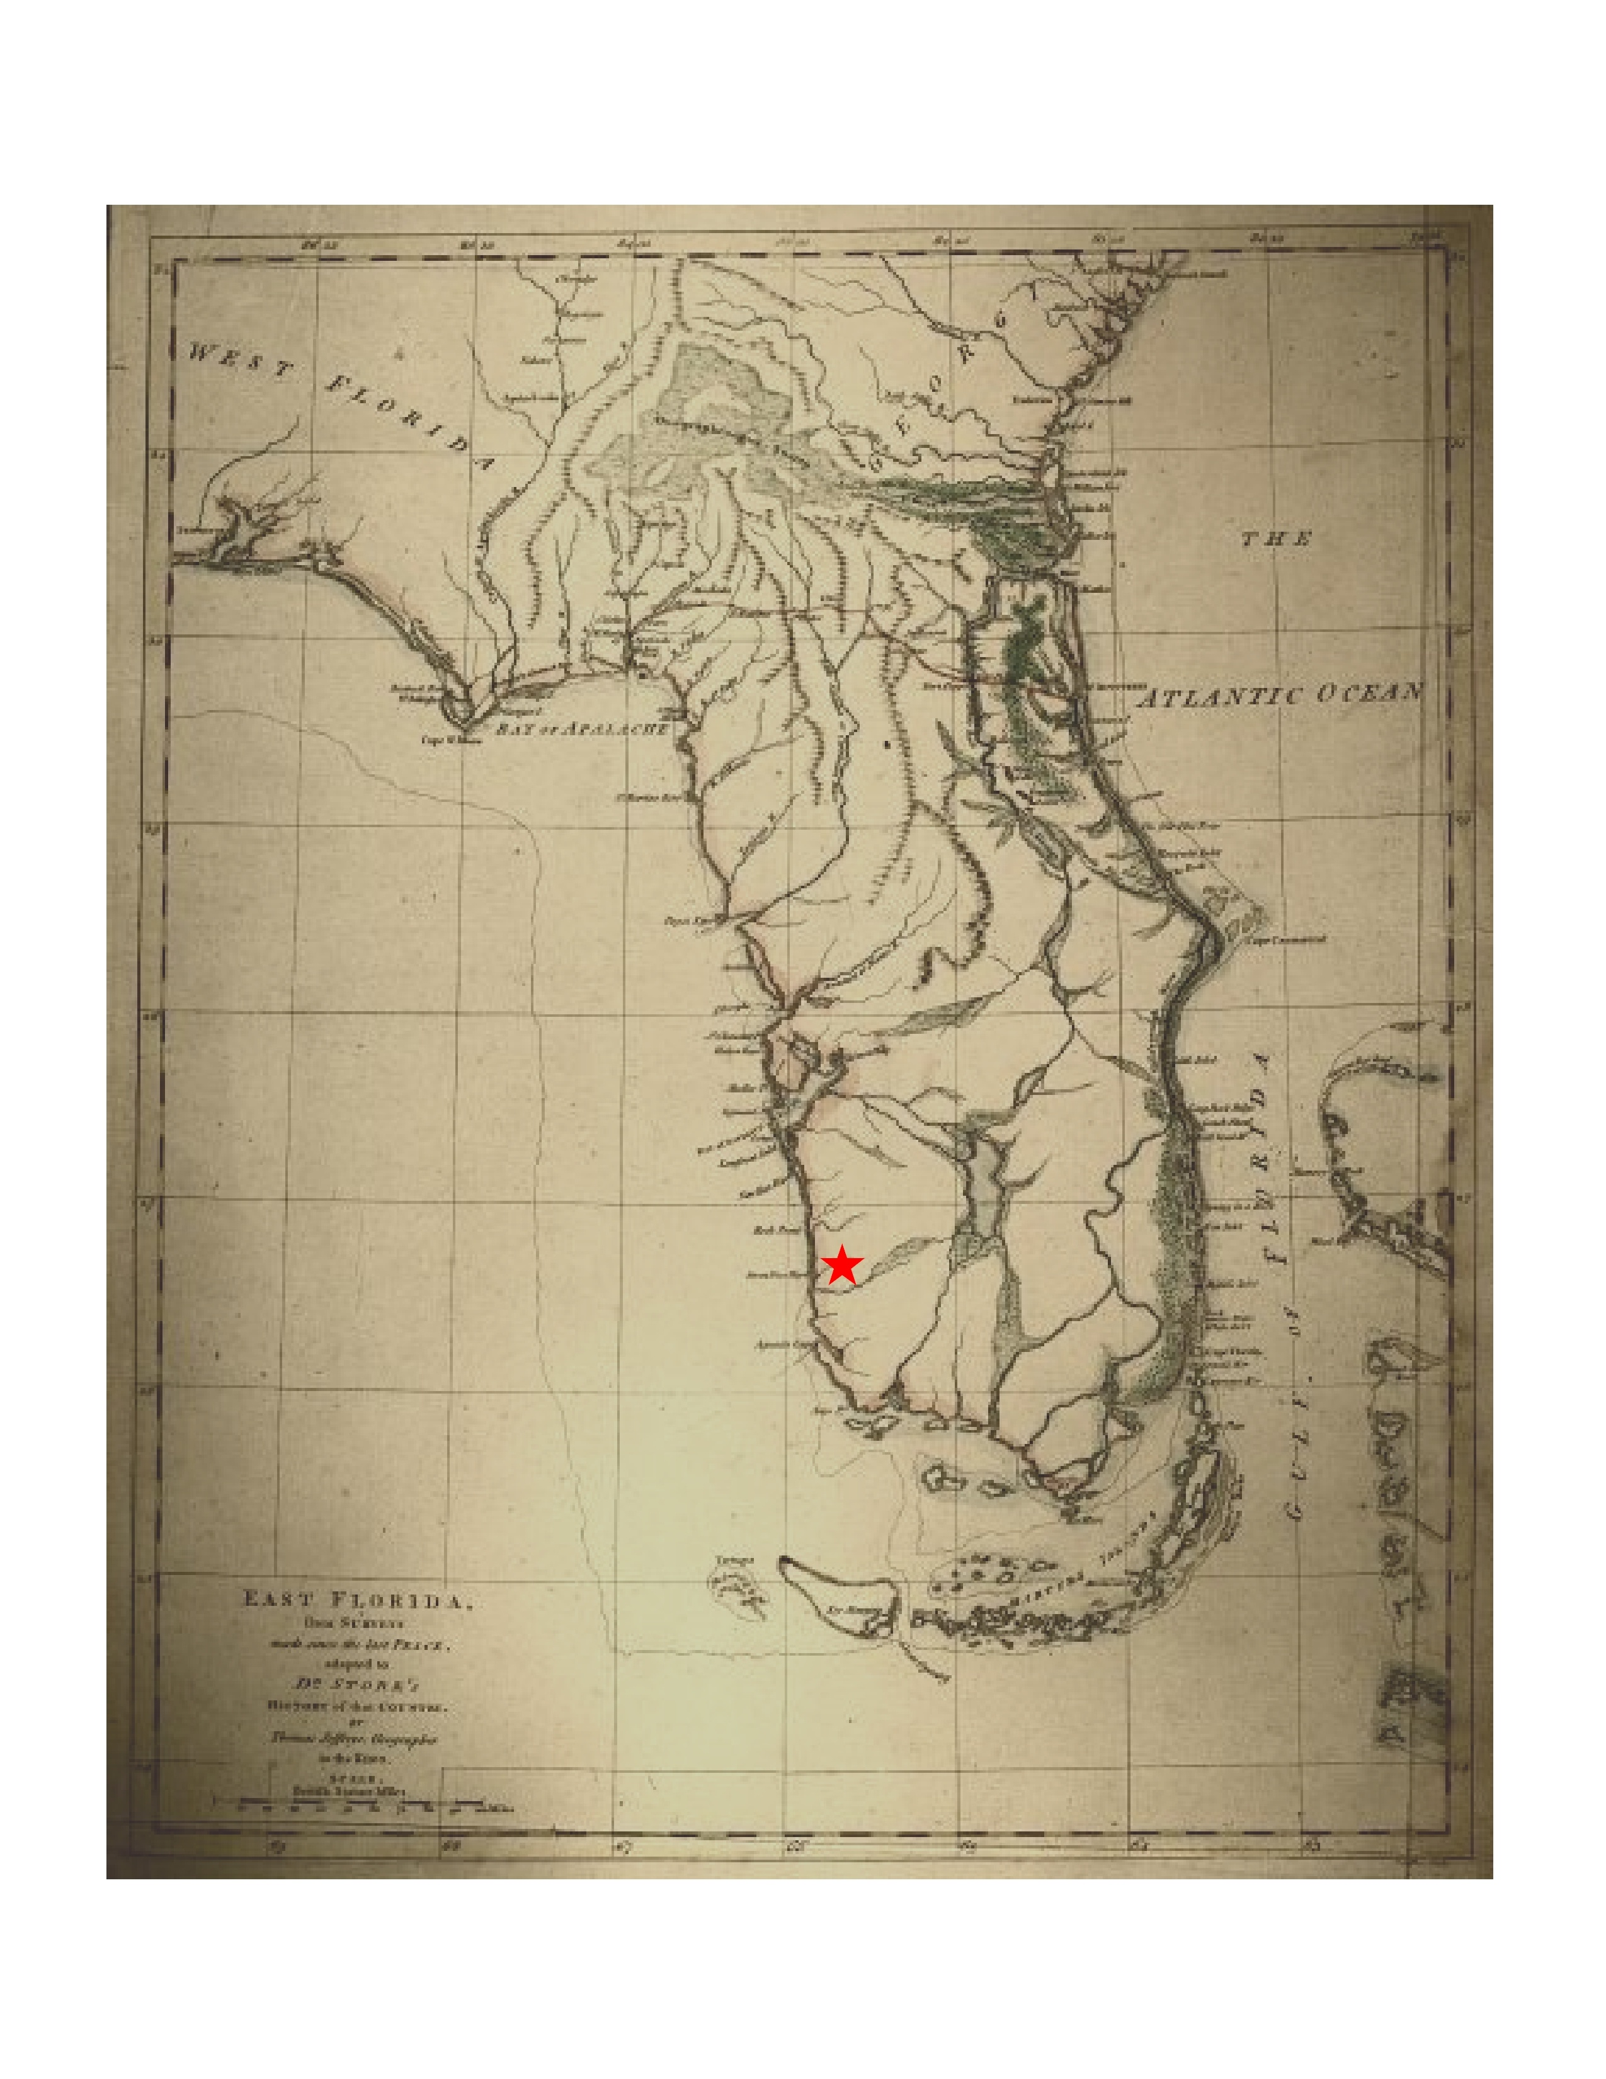
Data/Maps/Analyses

Slide 19
Water Distribution Map Book – 477 maps

Slide 20
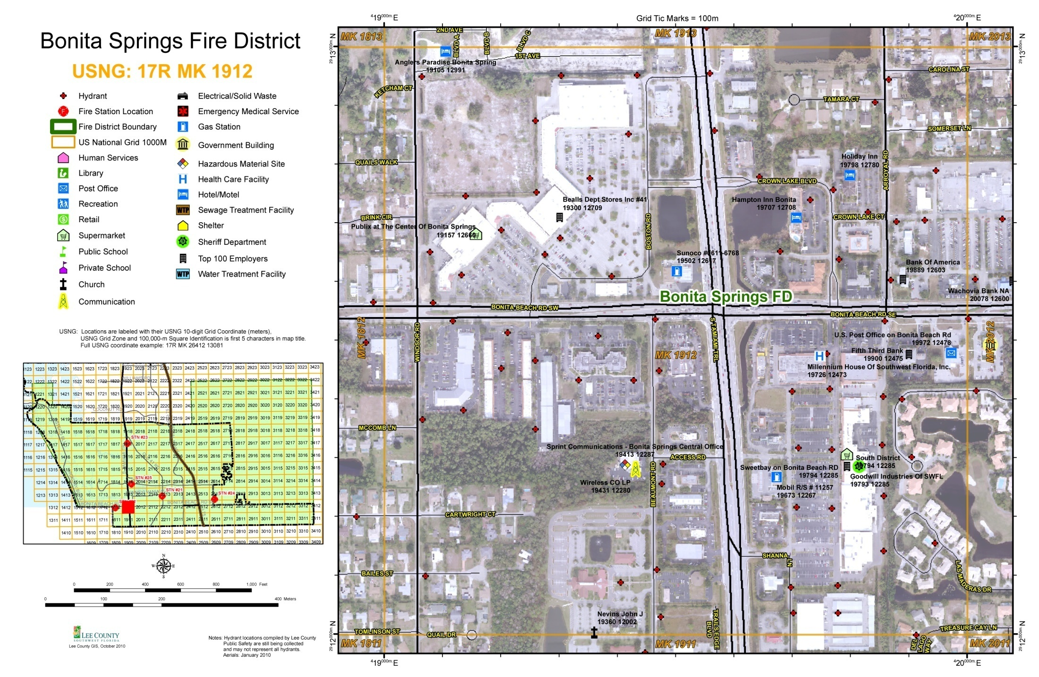
Fire District Hydrant Map Books

Slide 21
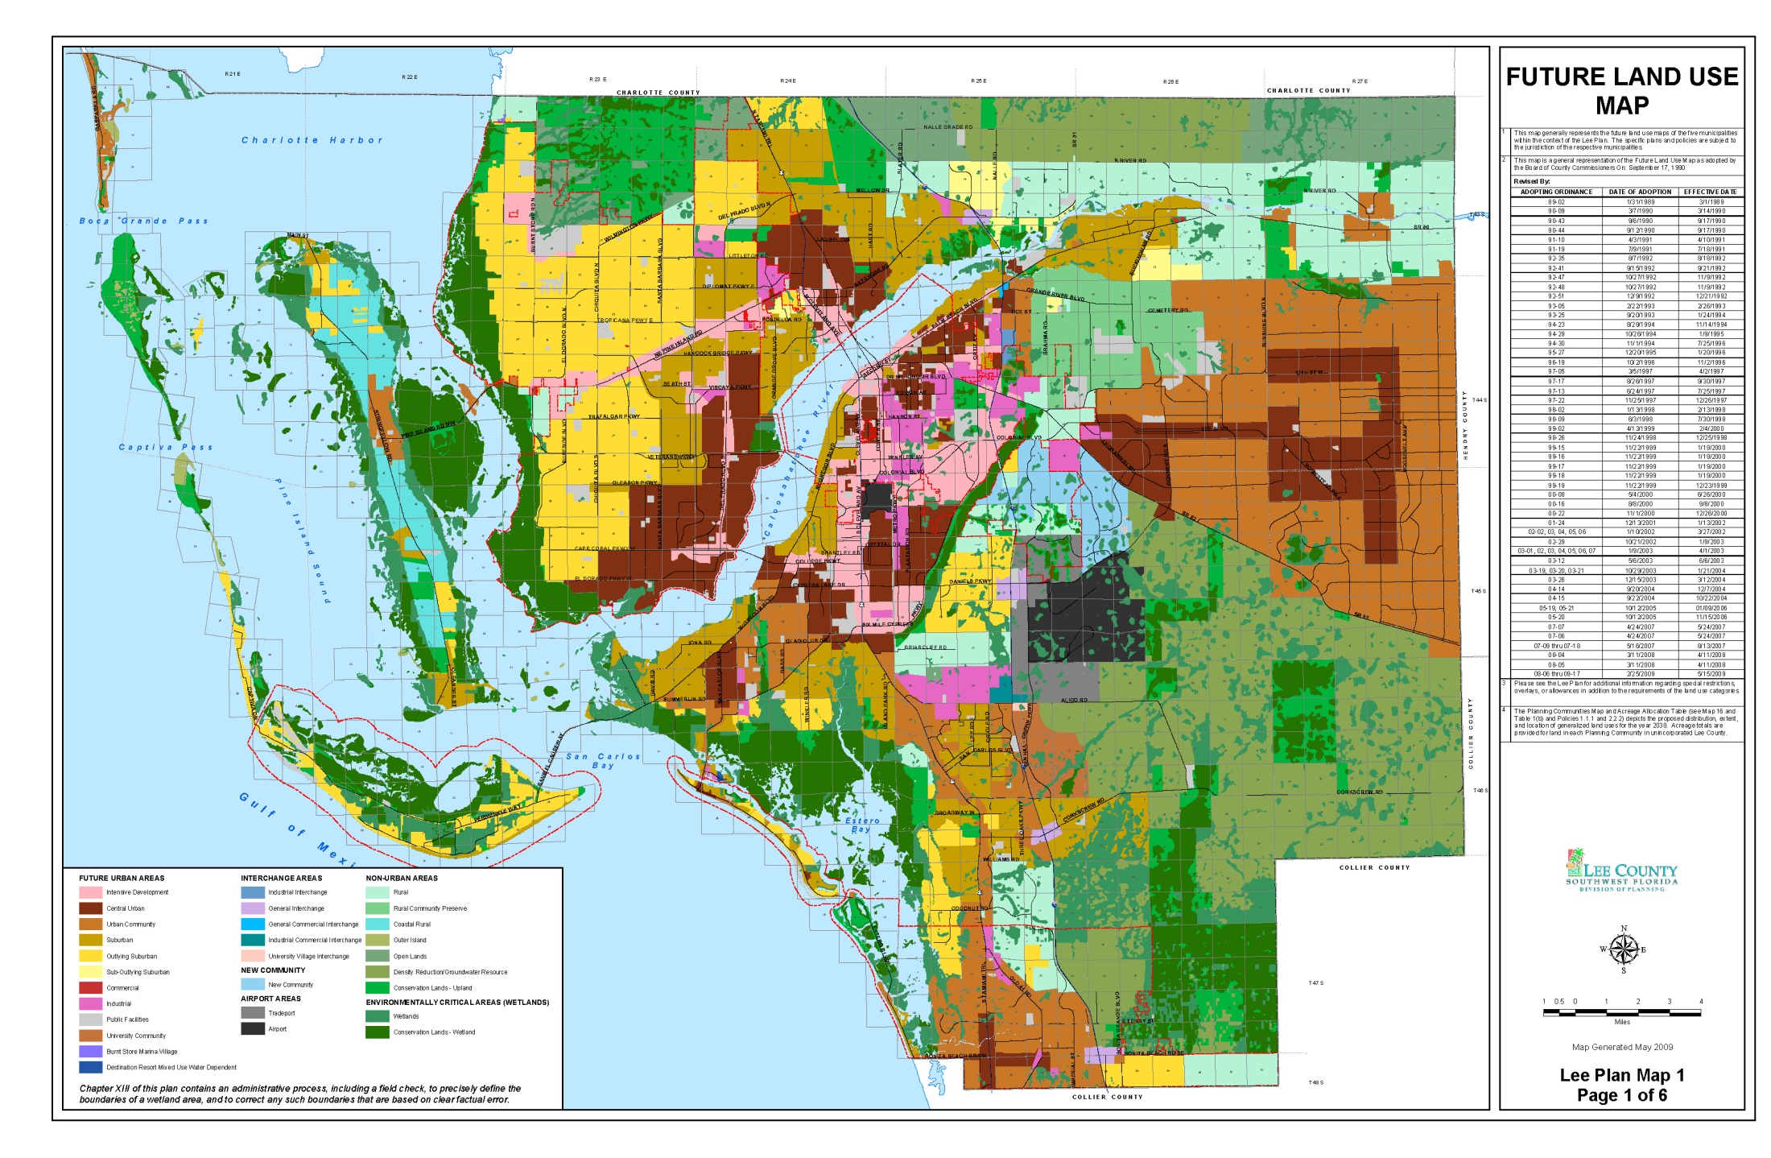
Lee Plan Map Series – 38 maps

Slide 22
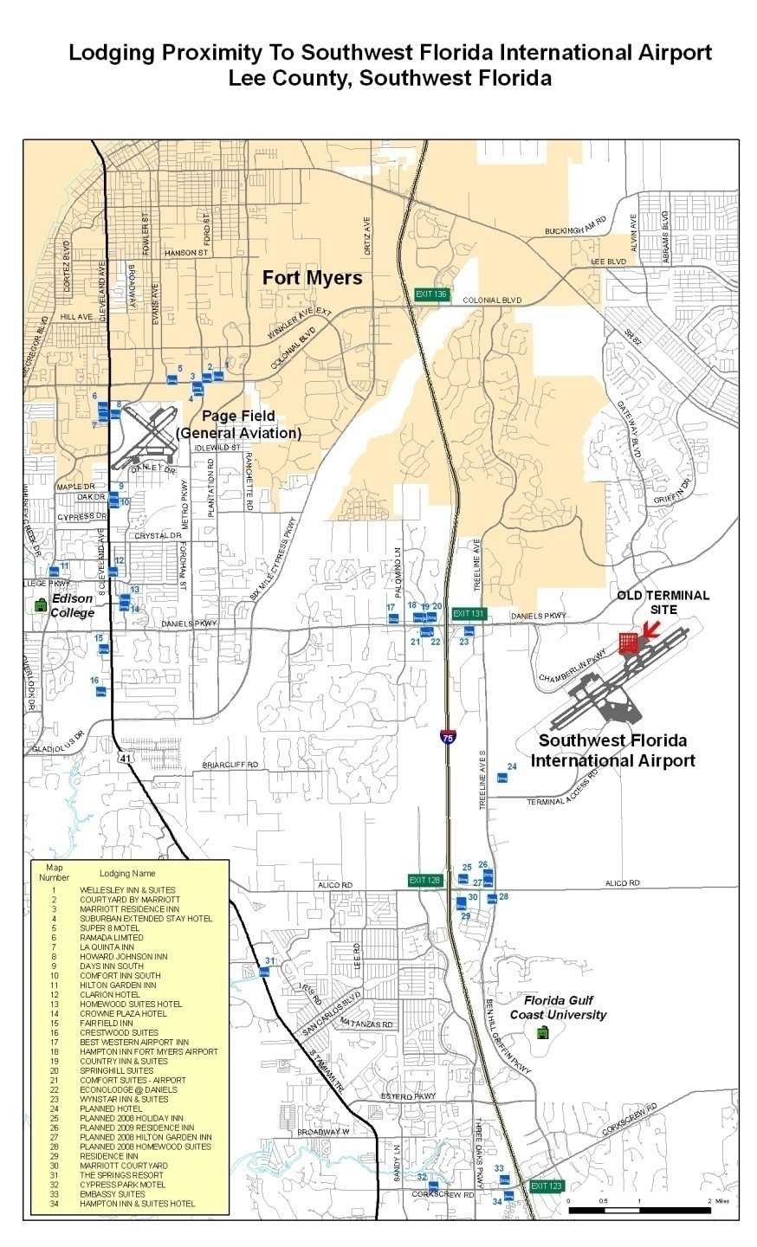
Economic Development

Slide 23
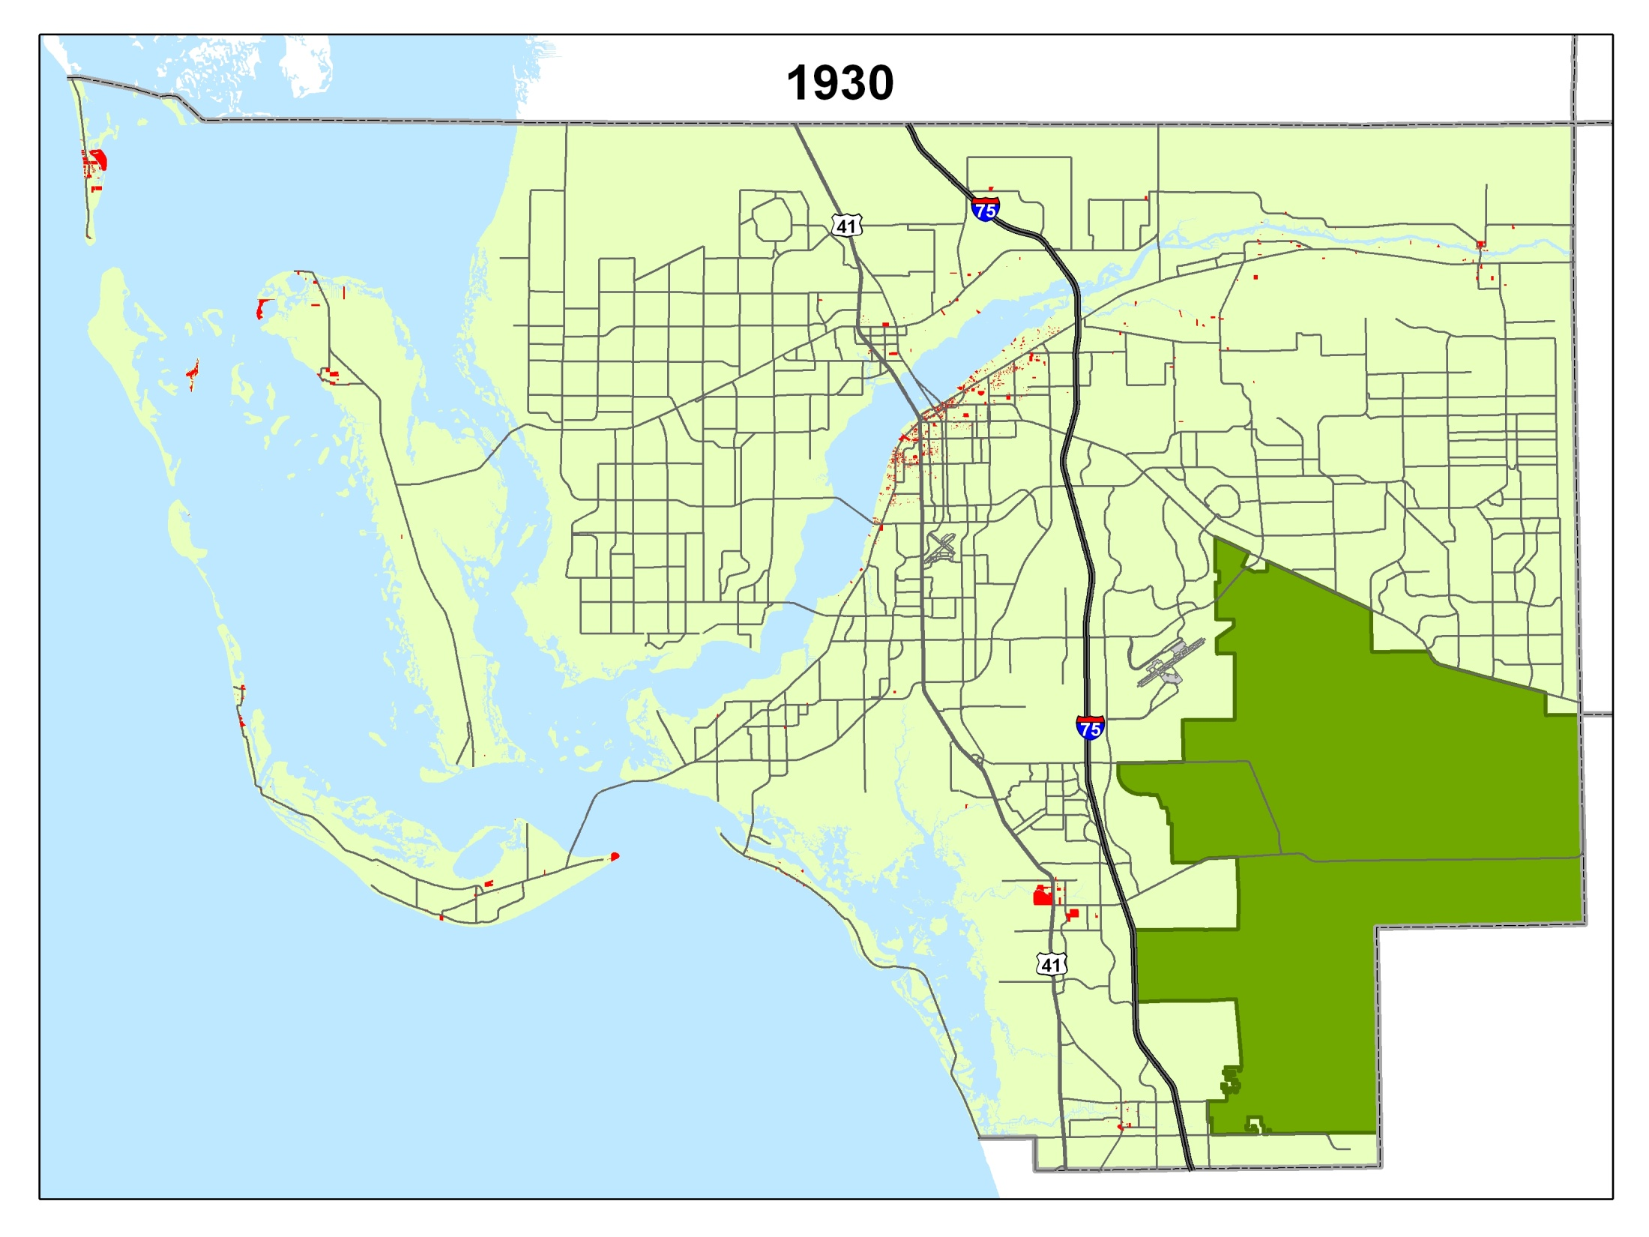
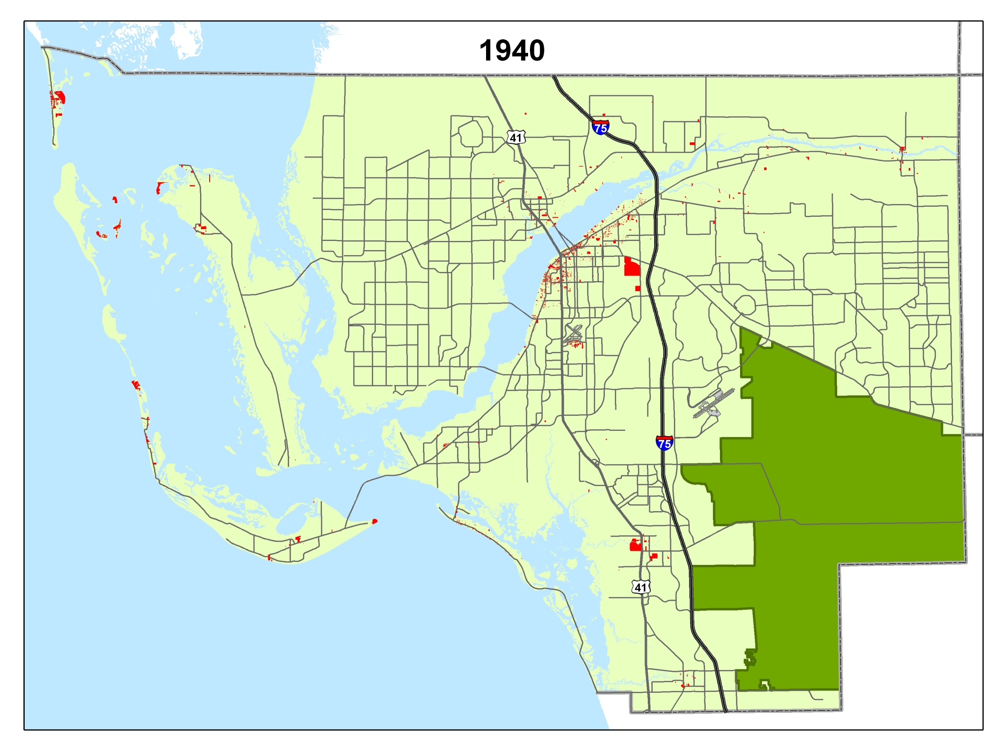
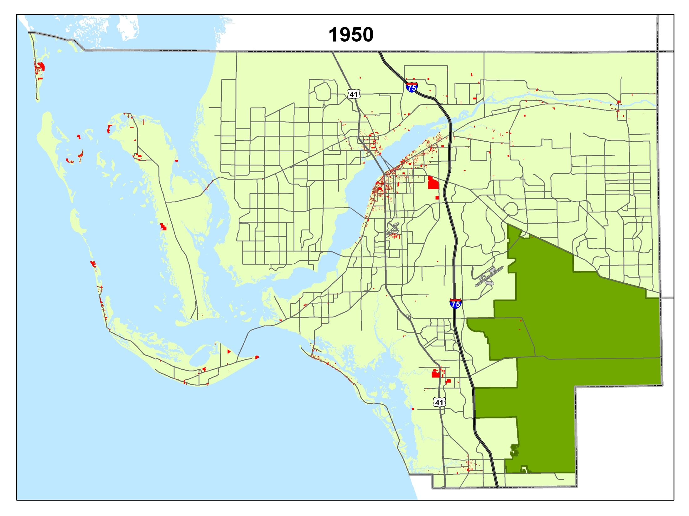
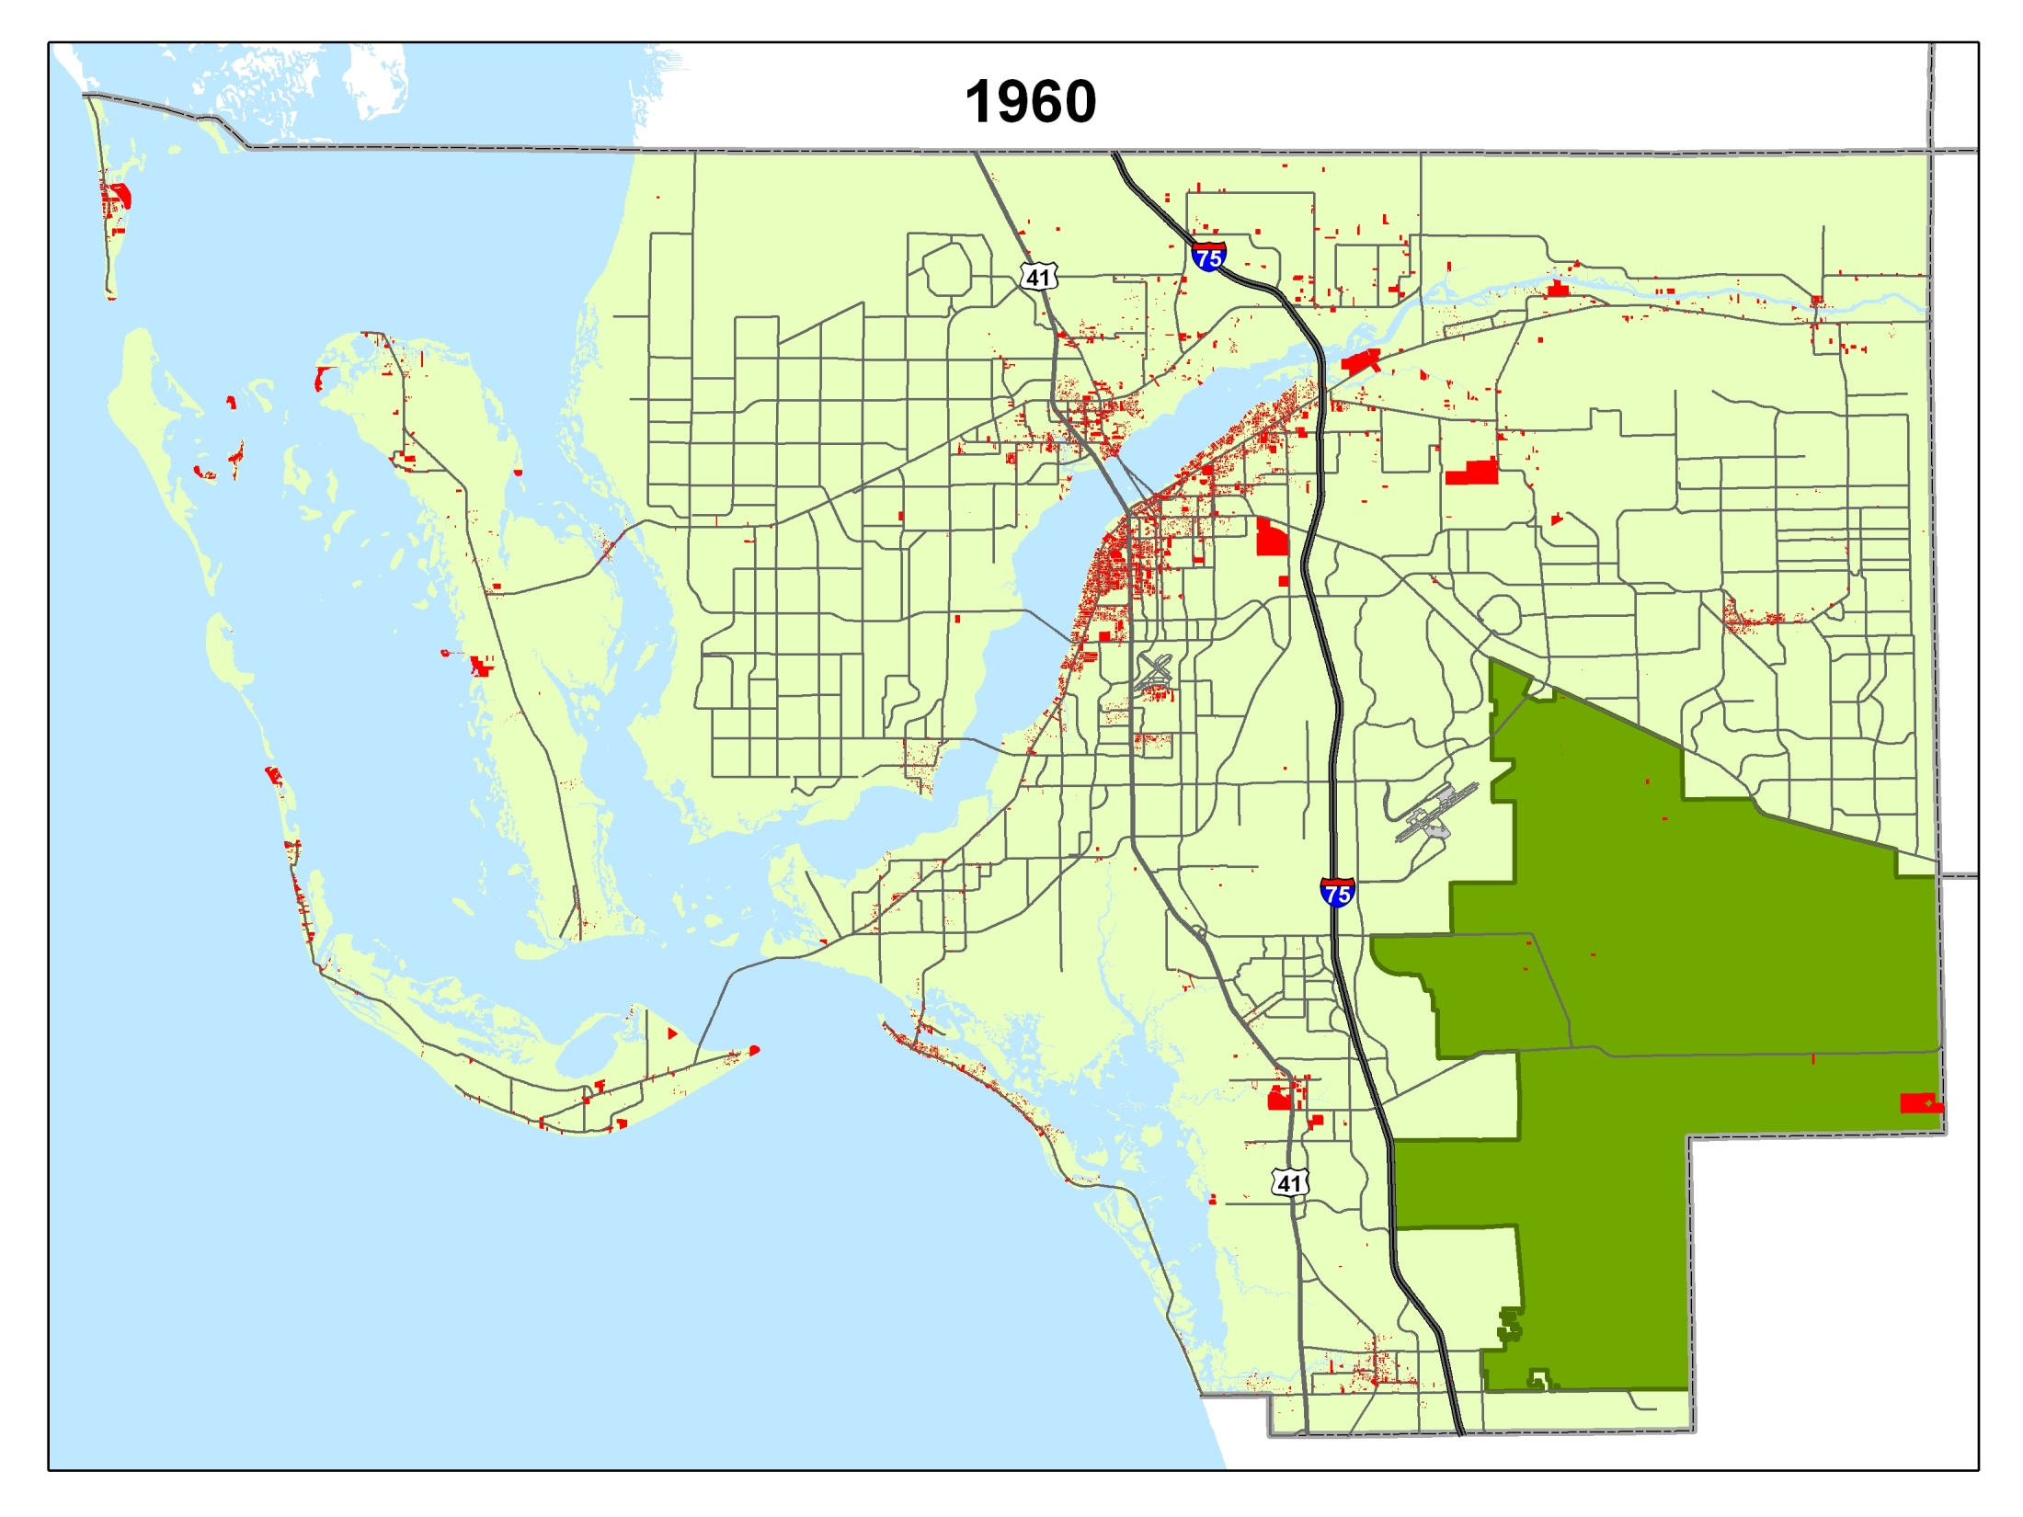
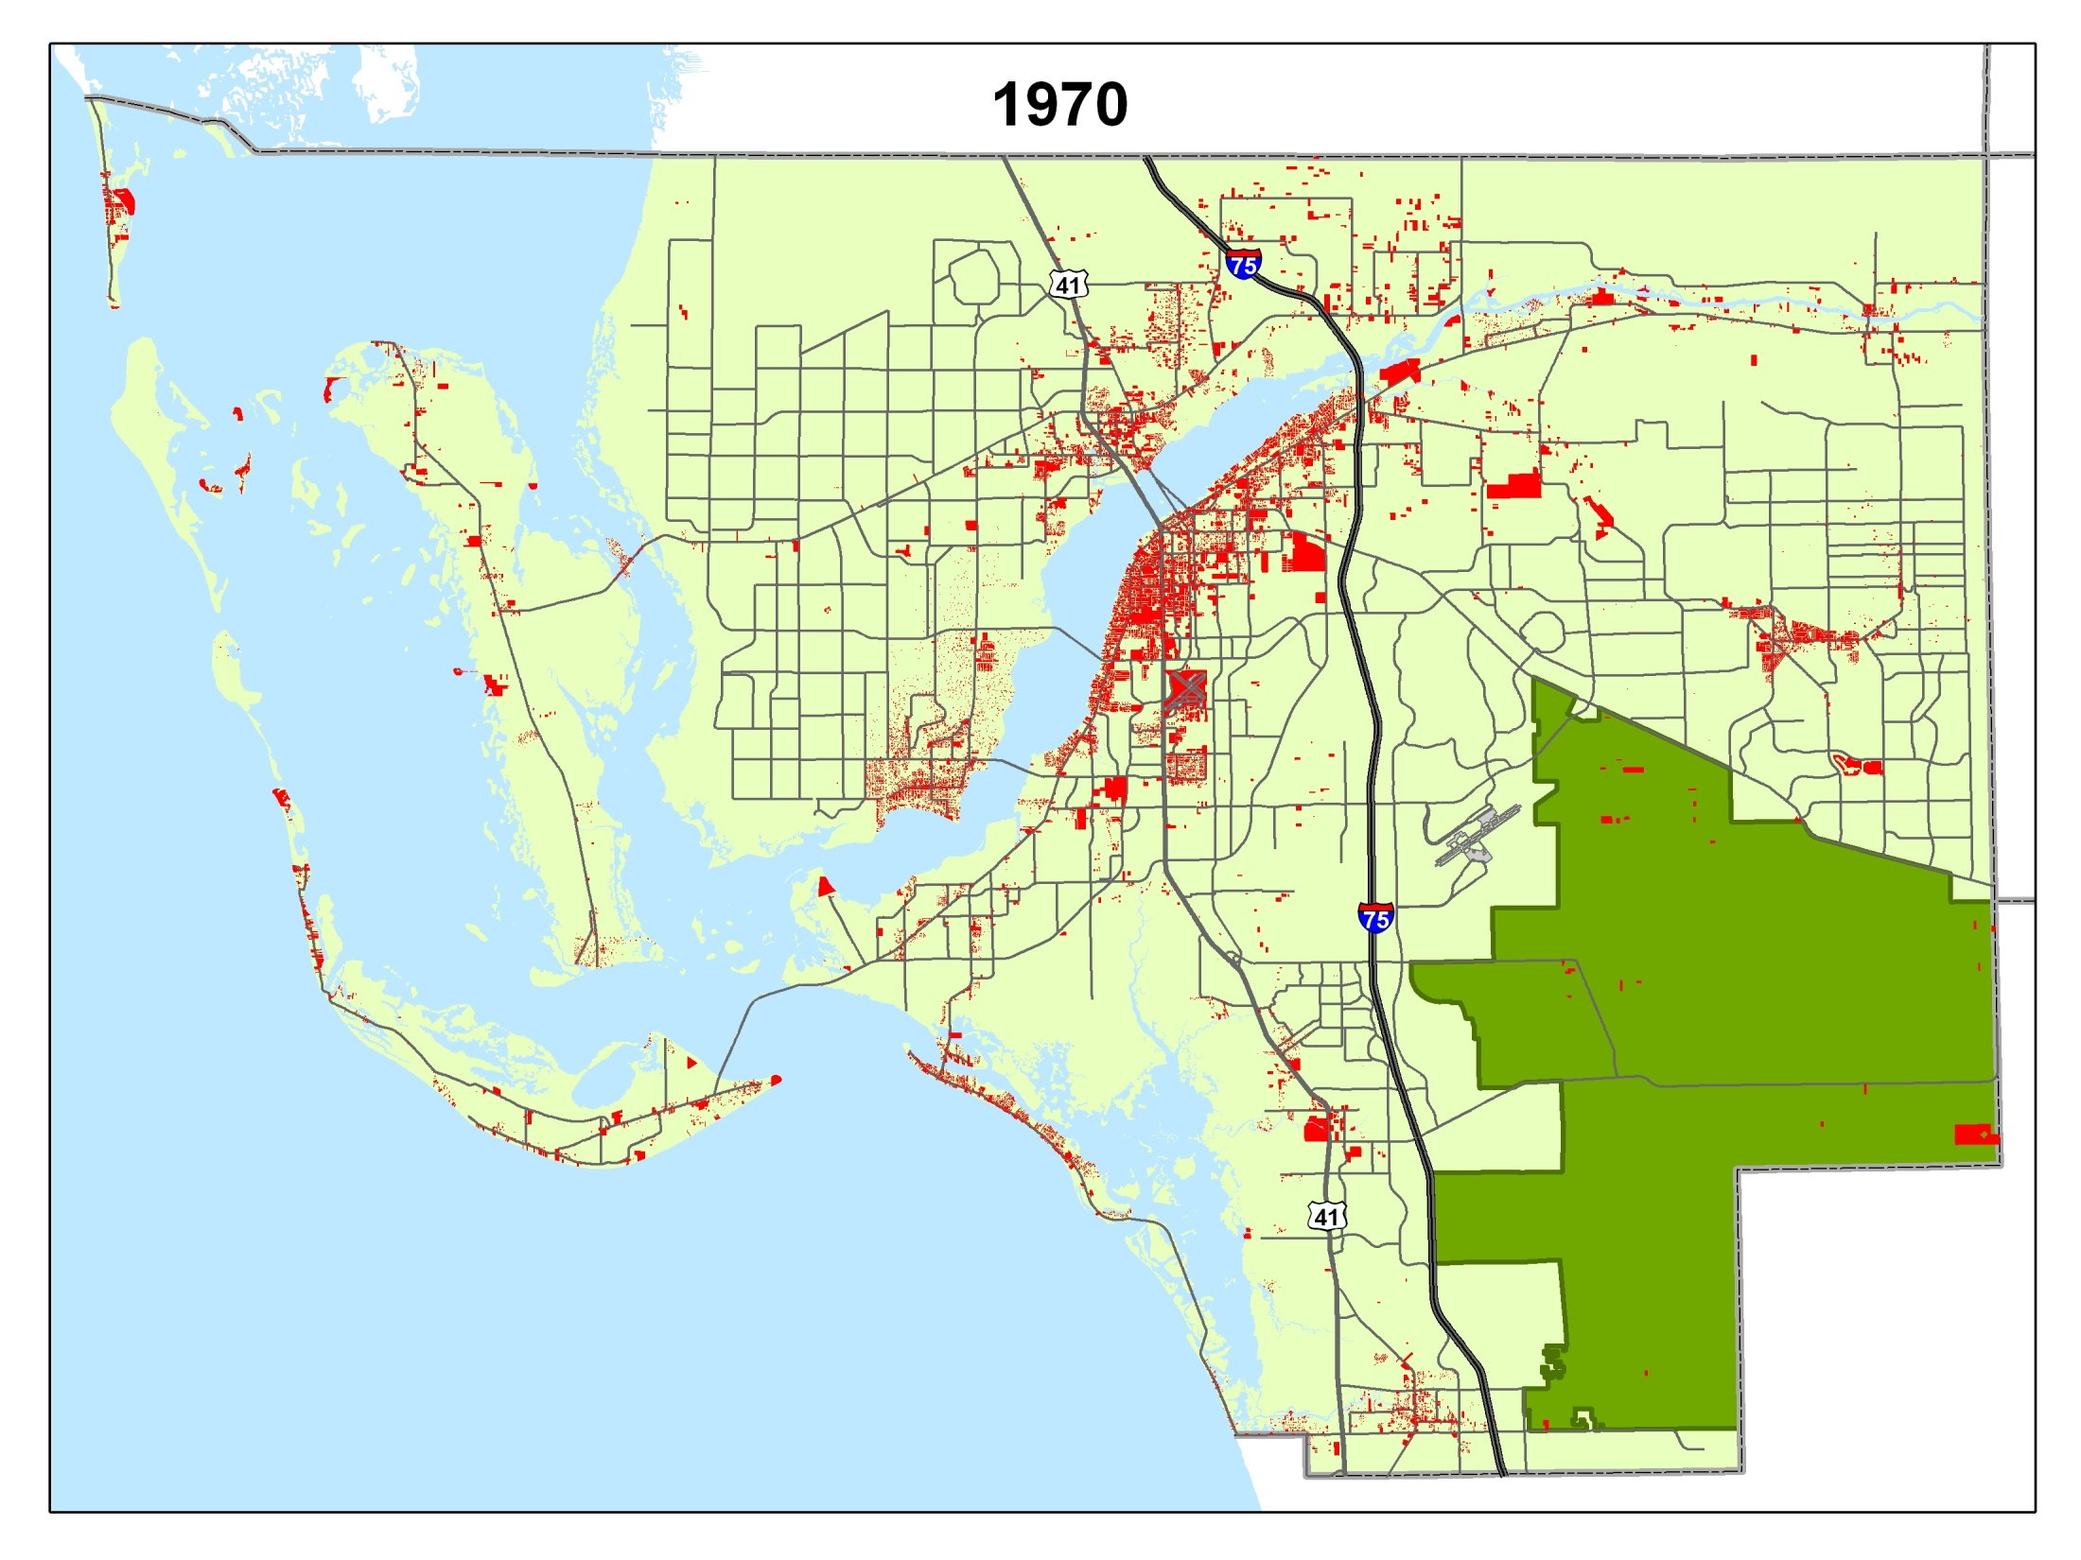
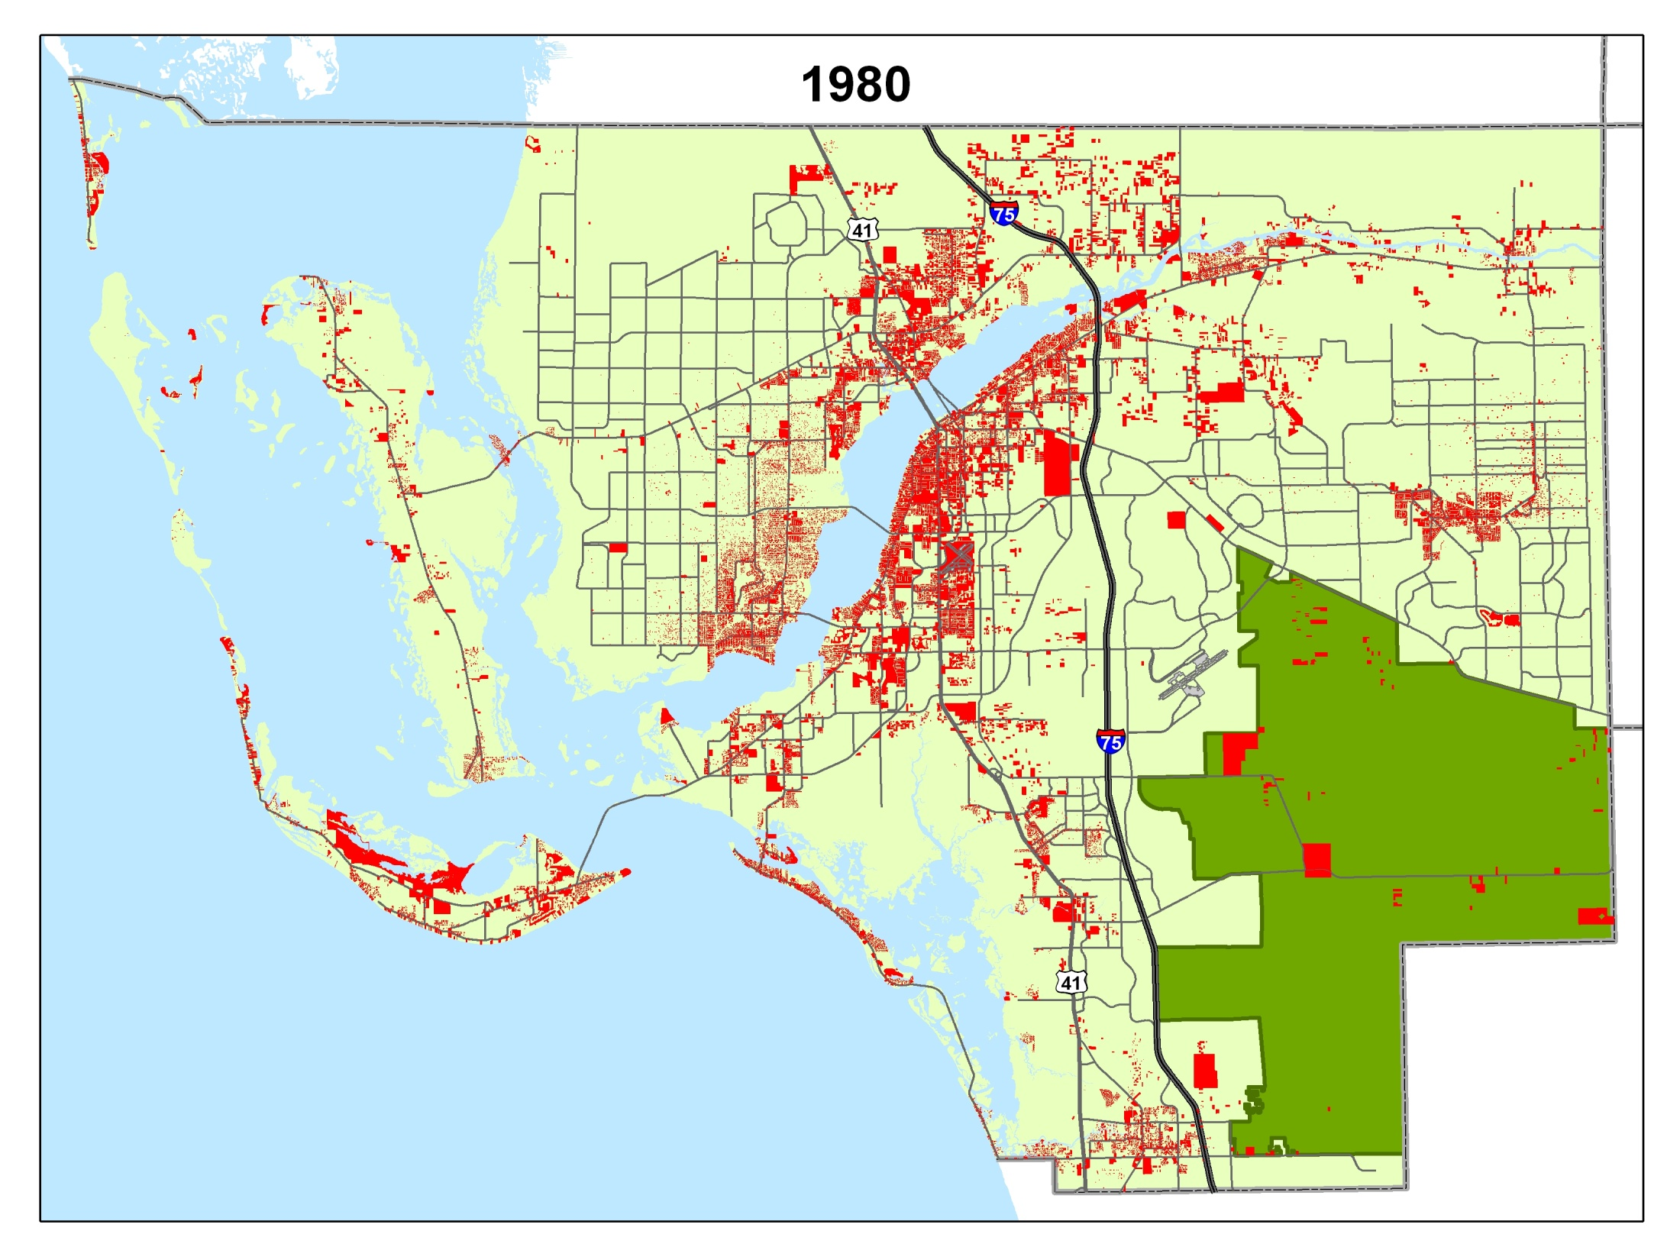
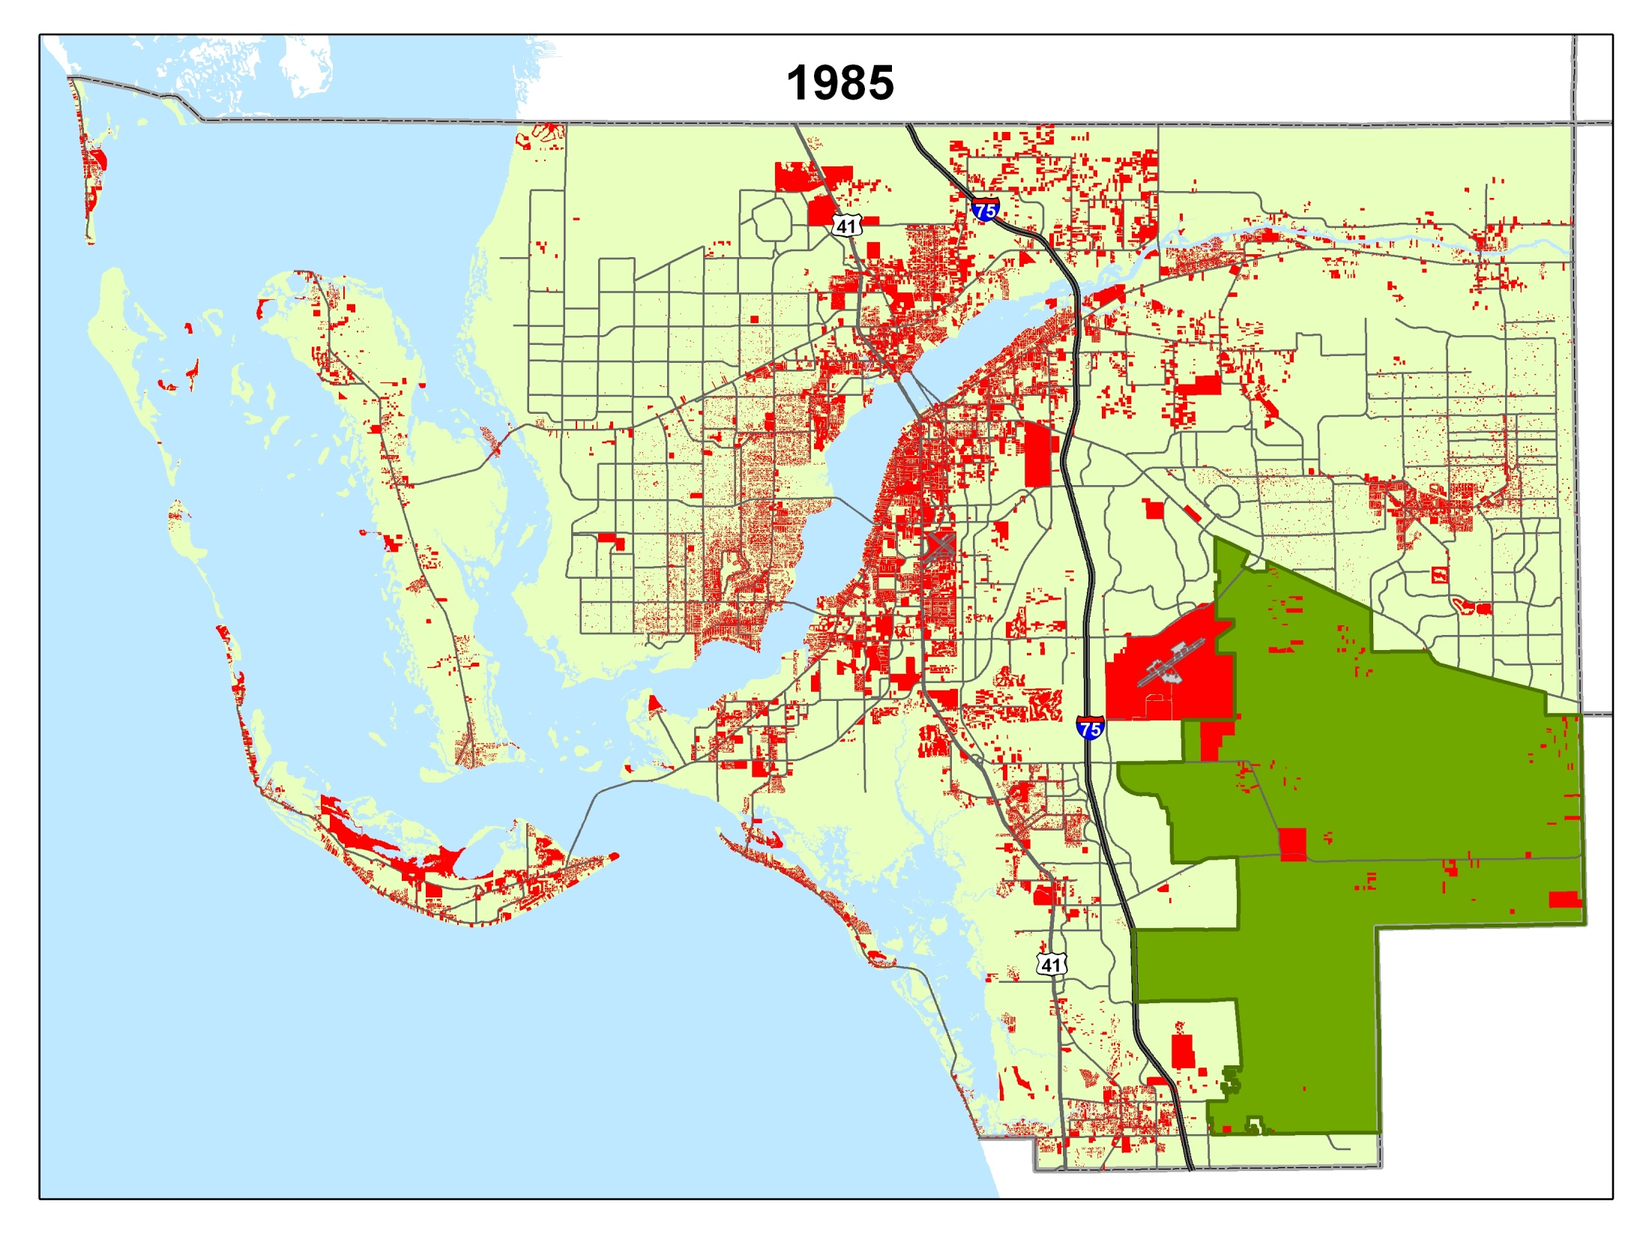
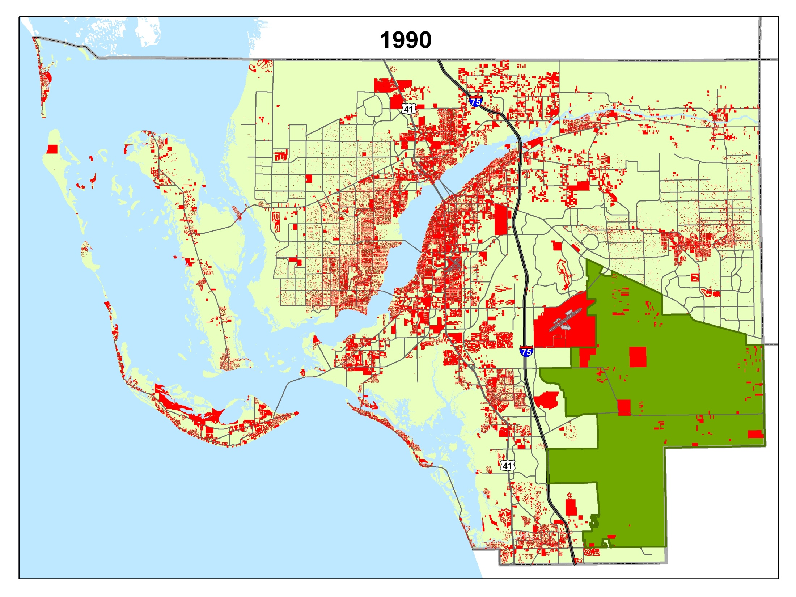
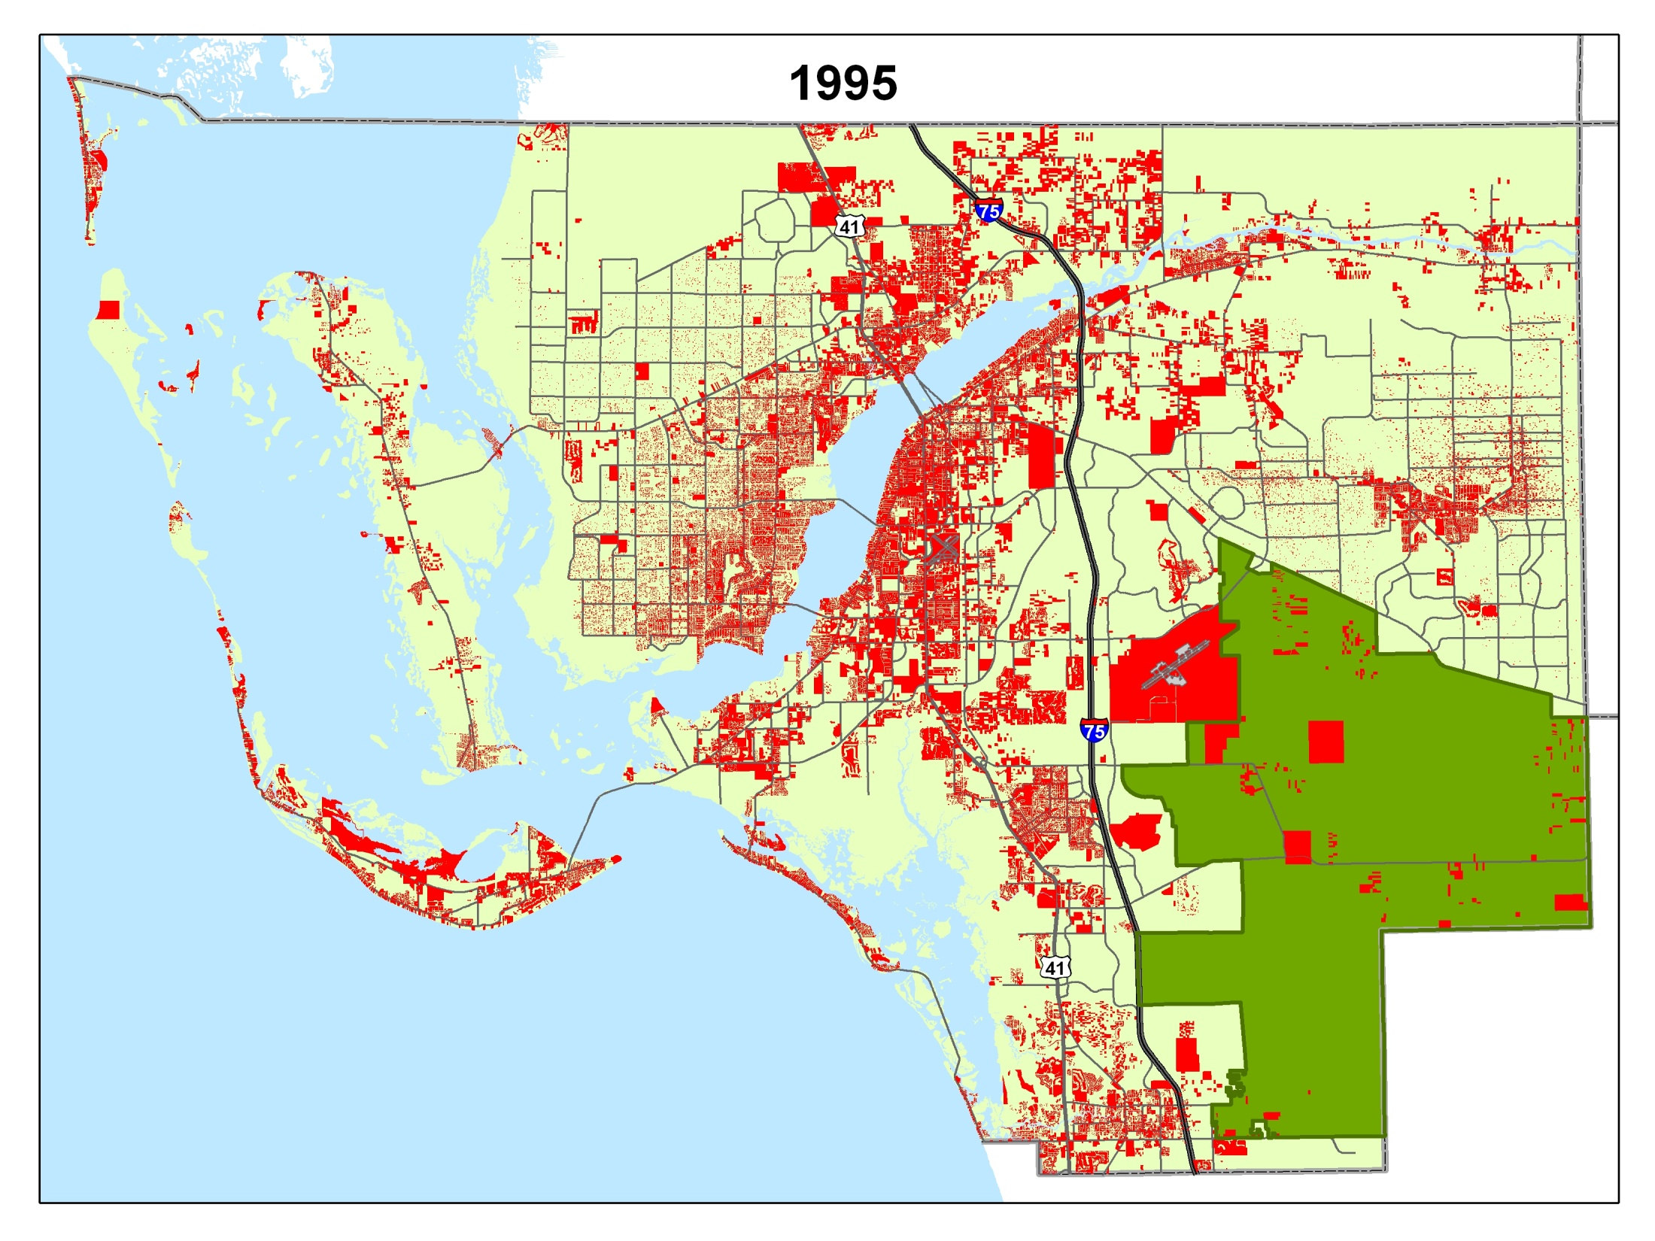
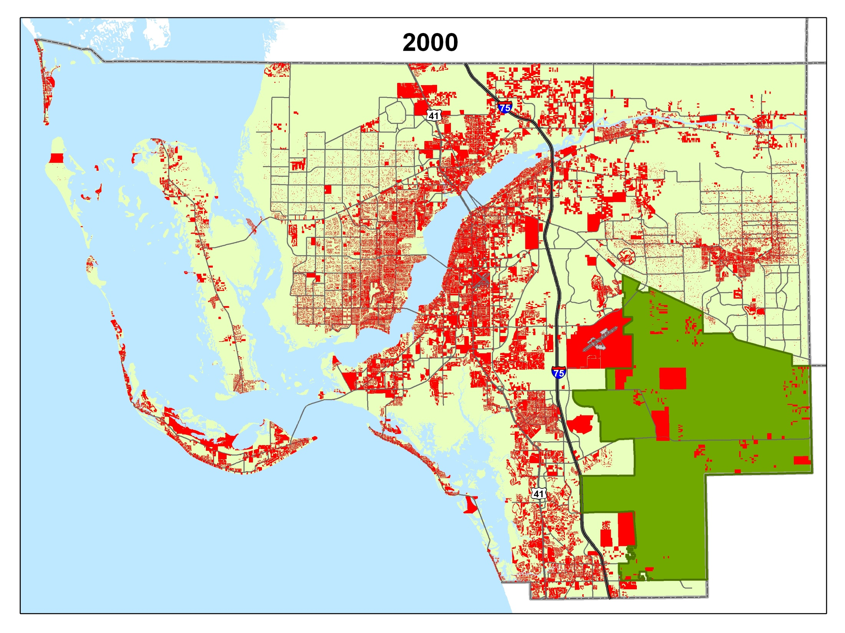
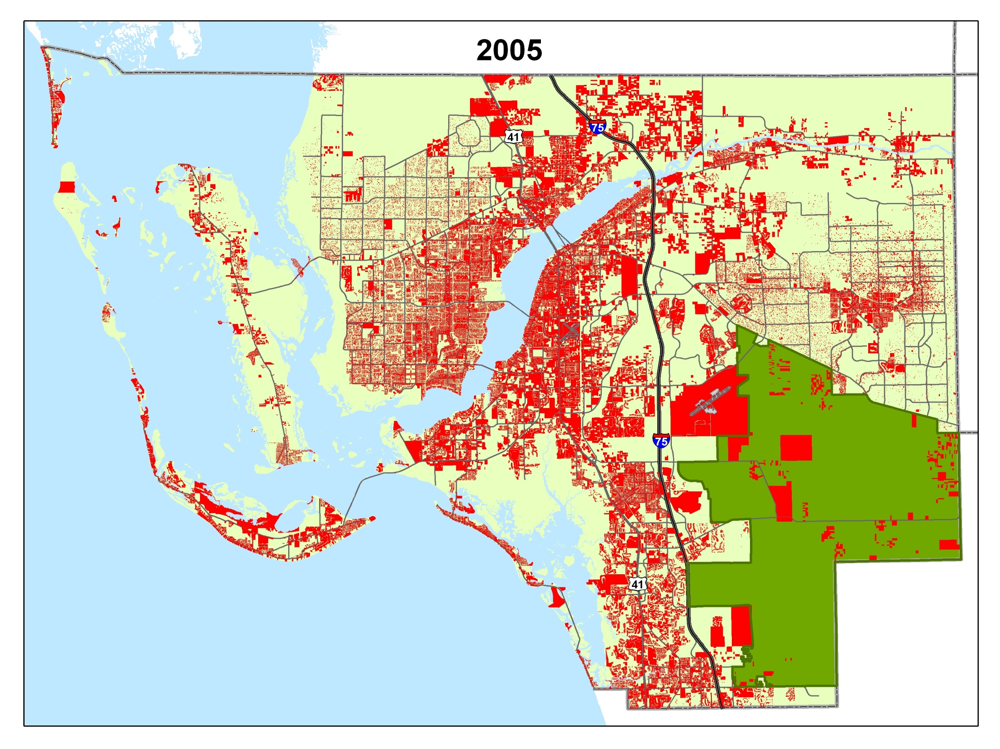
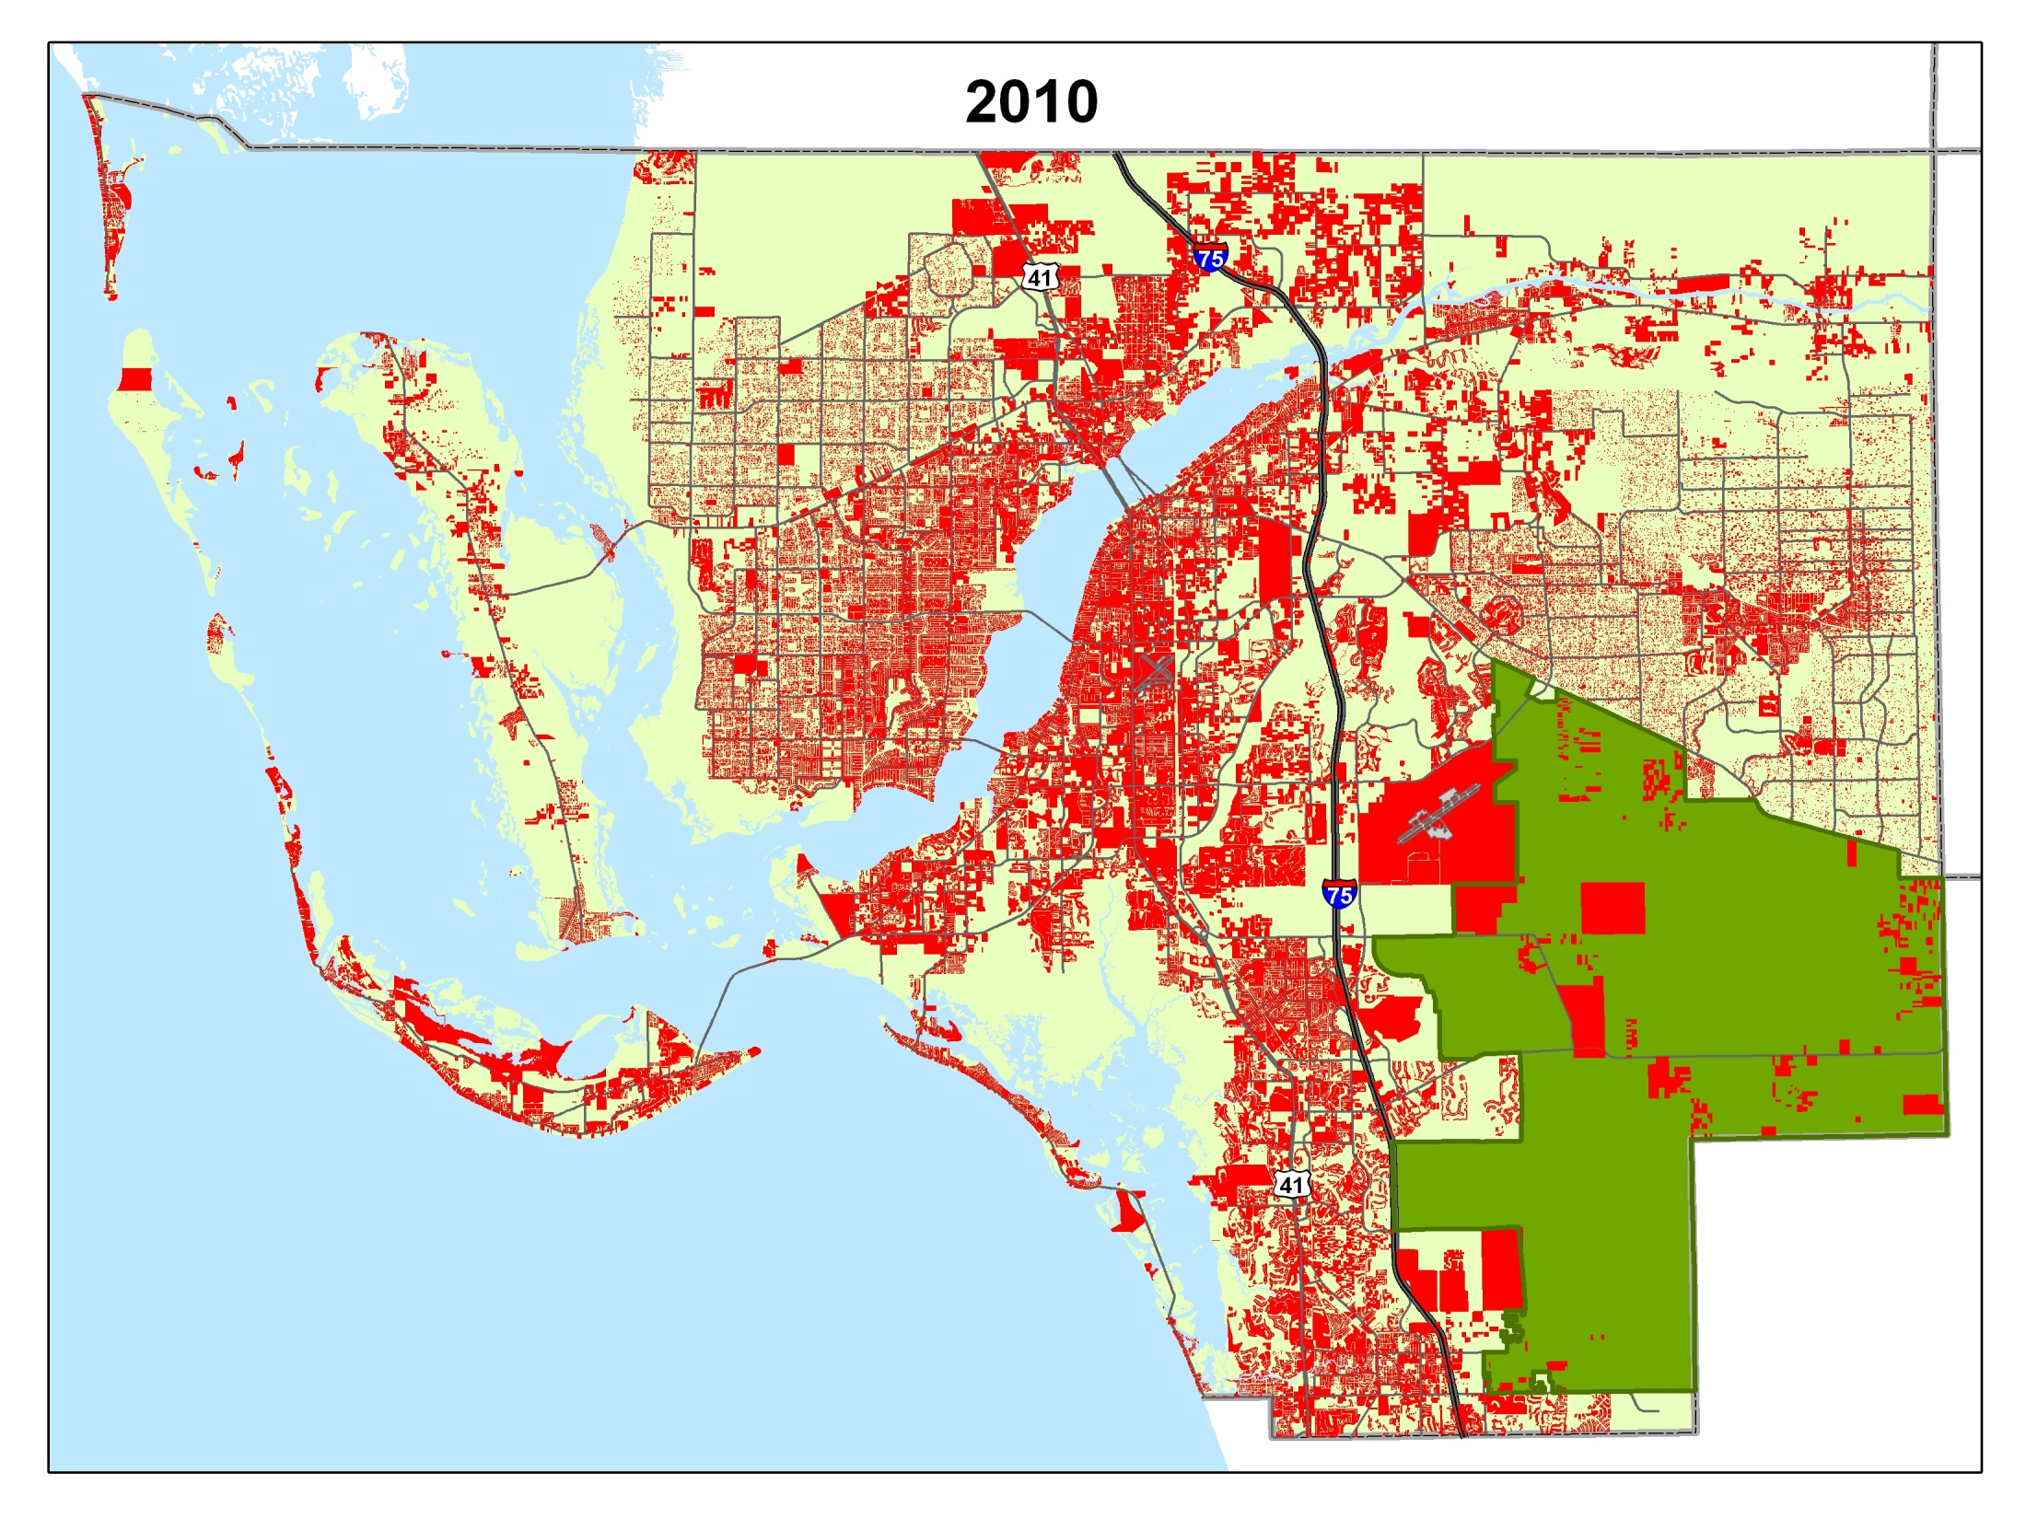
Parcels with Structures

Slide 24
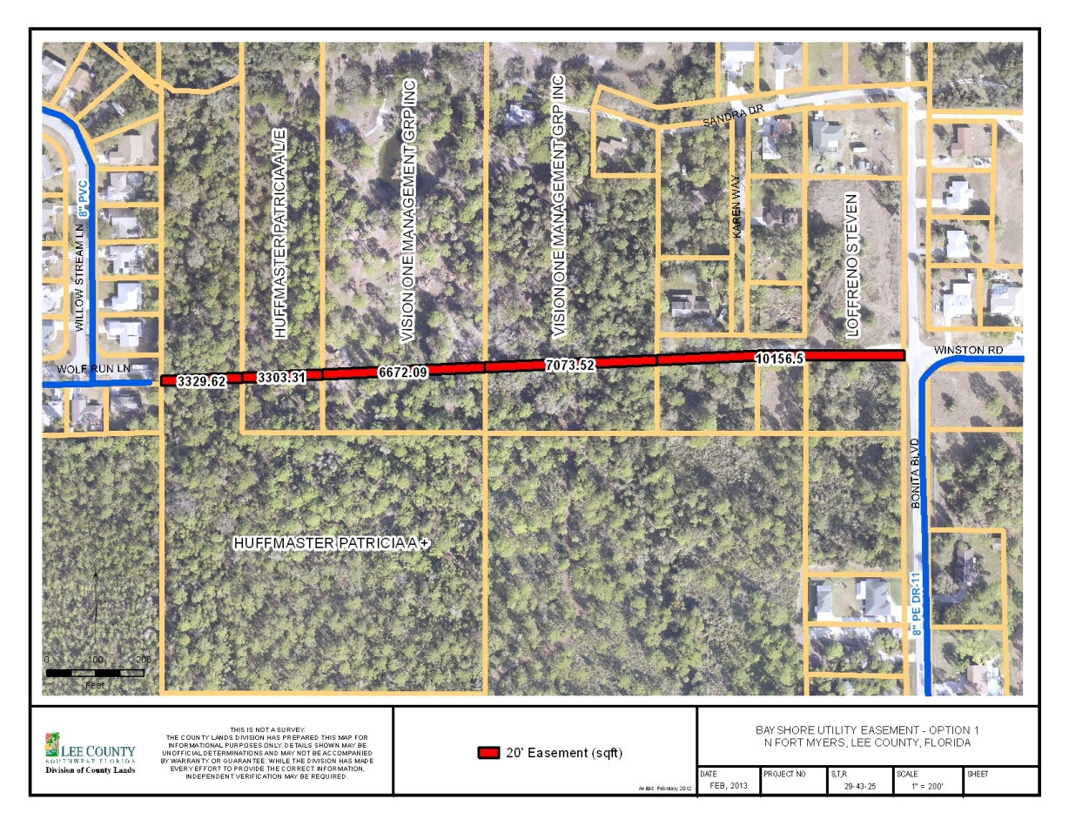
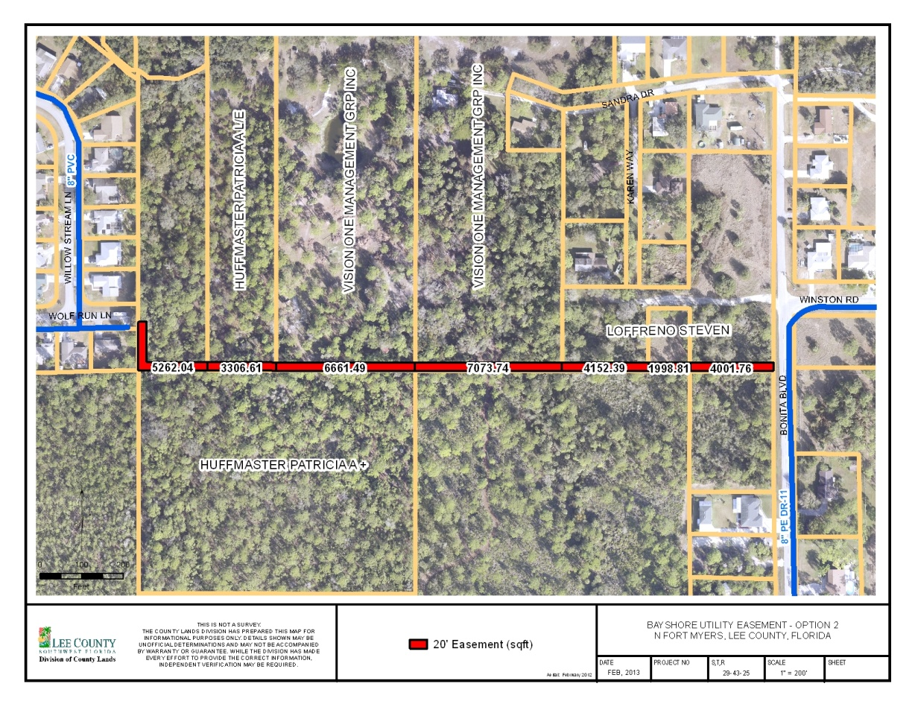
County Lands
Utility Expansion Easement Options
Calculate area of land needed from each property owner

Slide 25
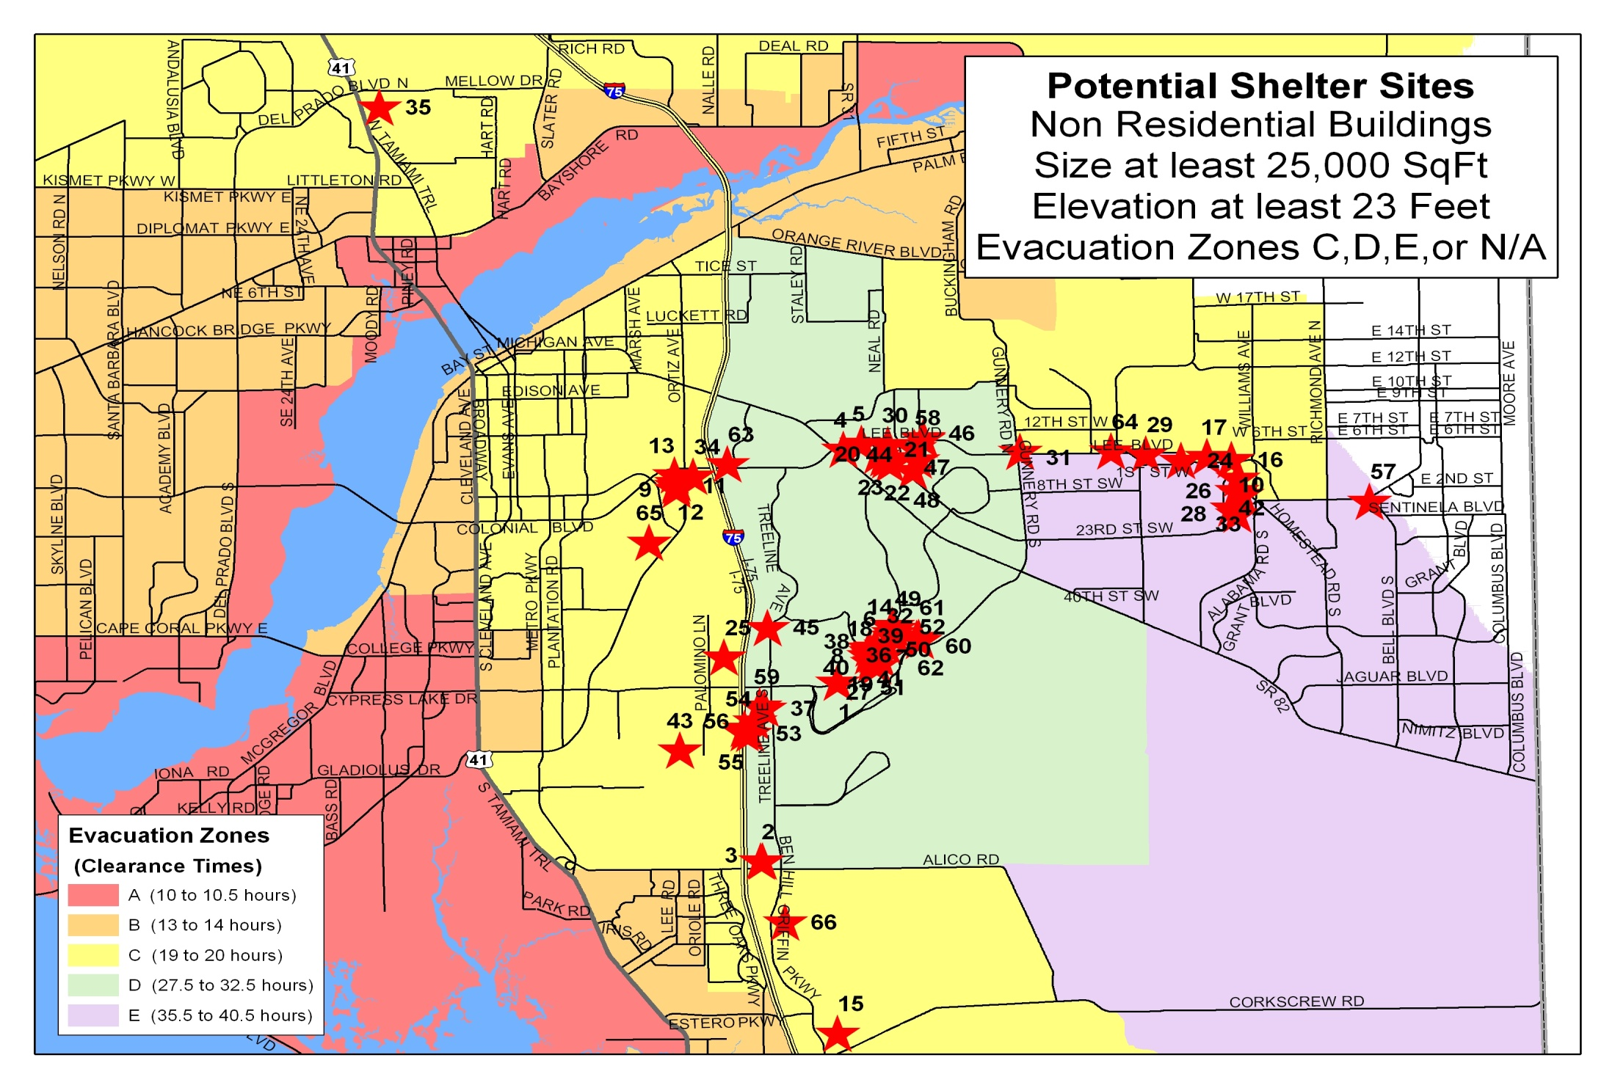
EOC

Slide 26
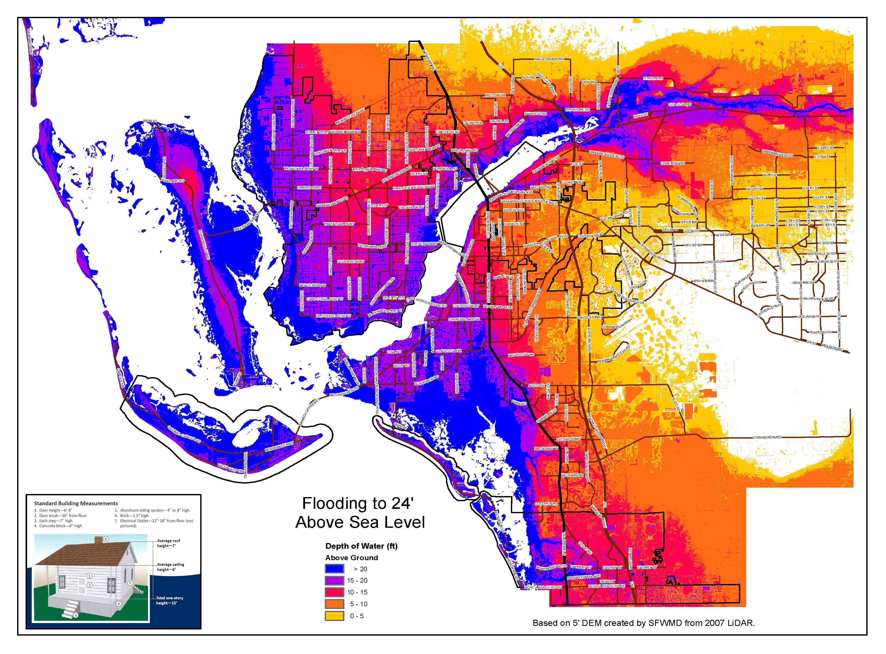
EOC

Slide 27
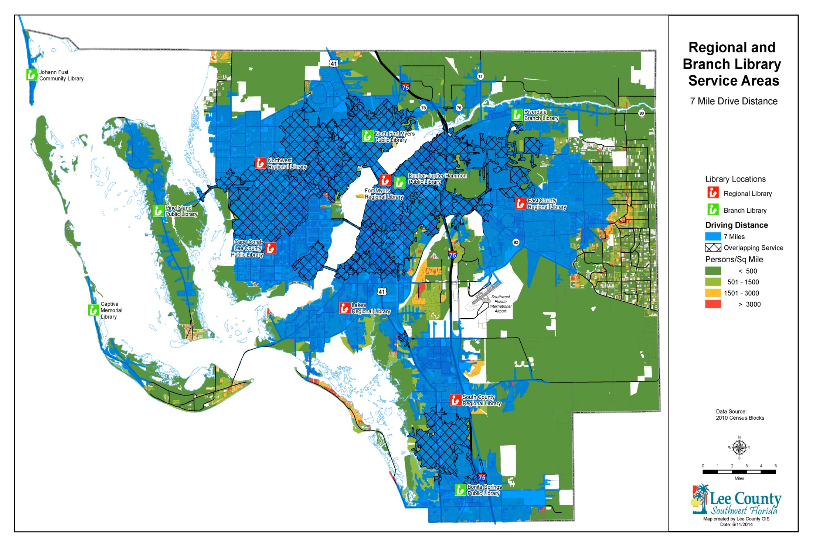
Library

Slide 28
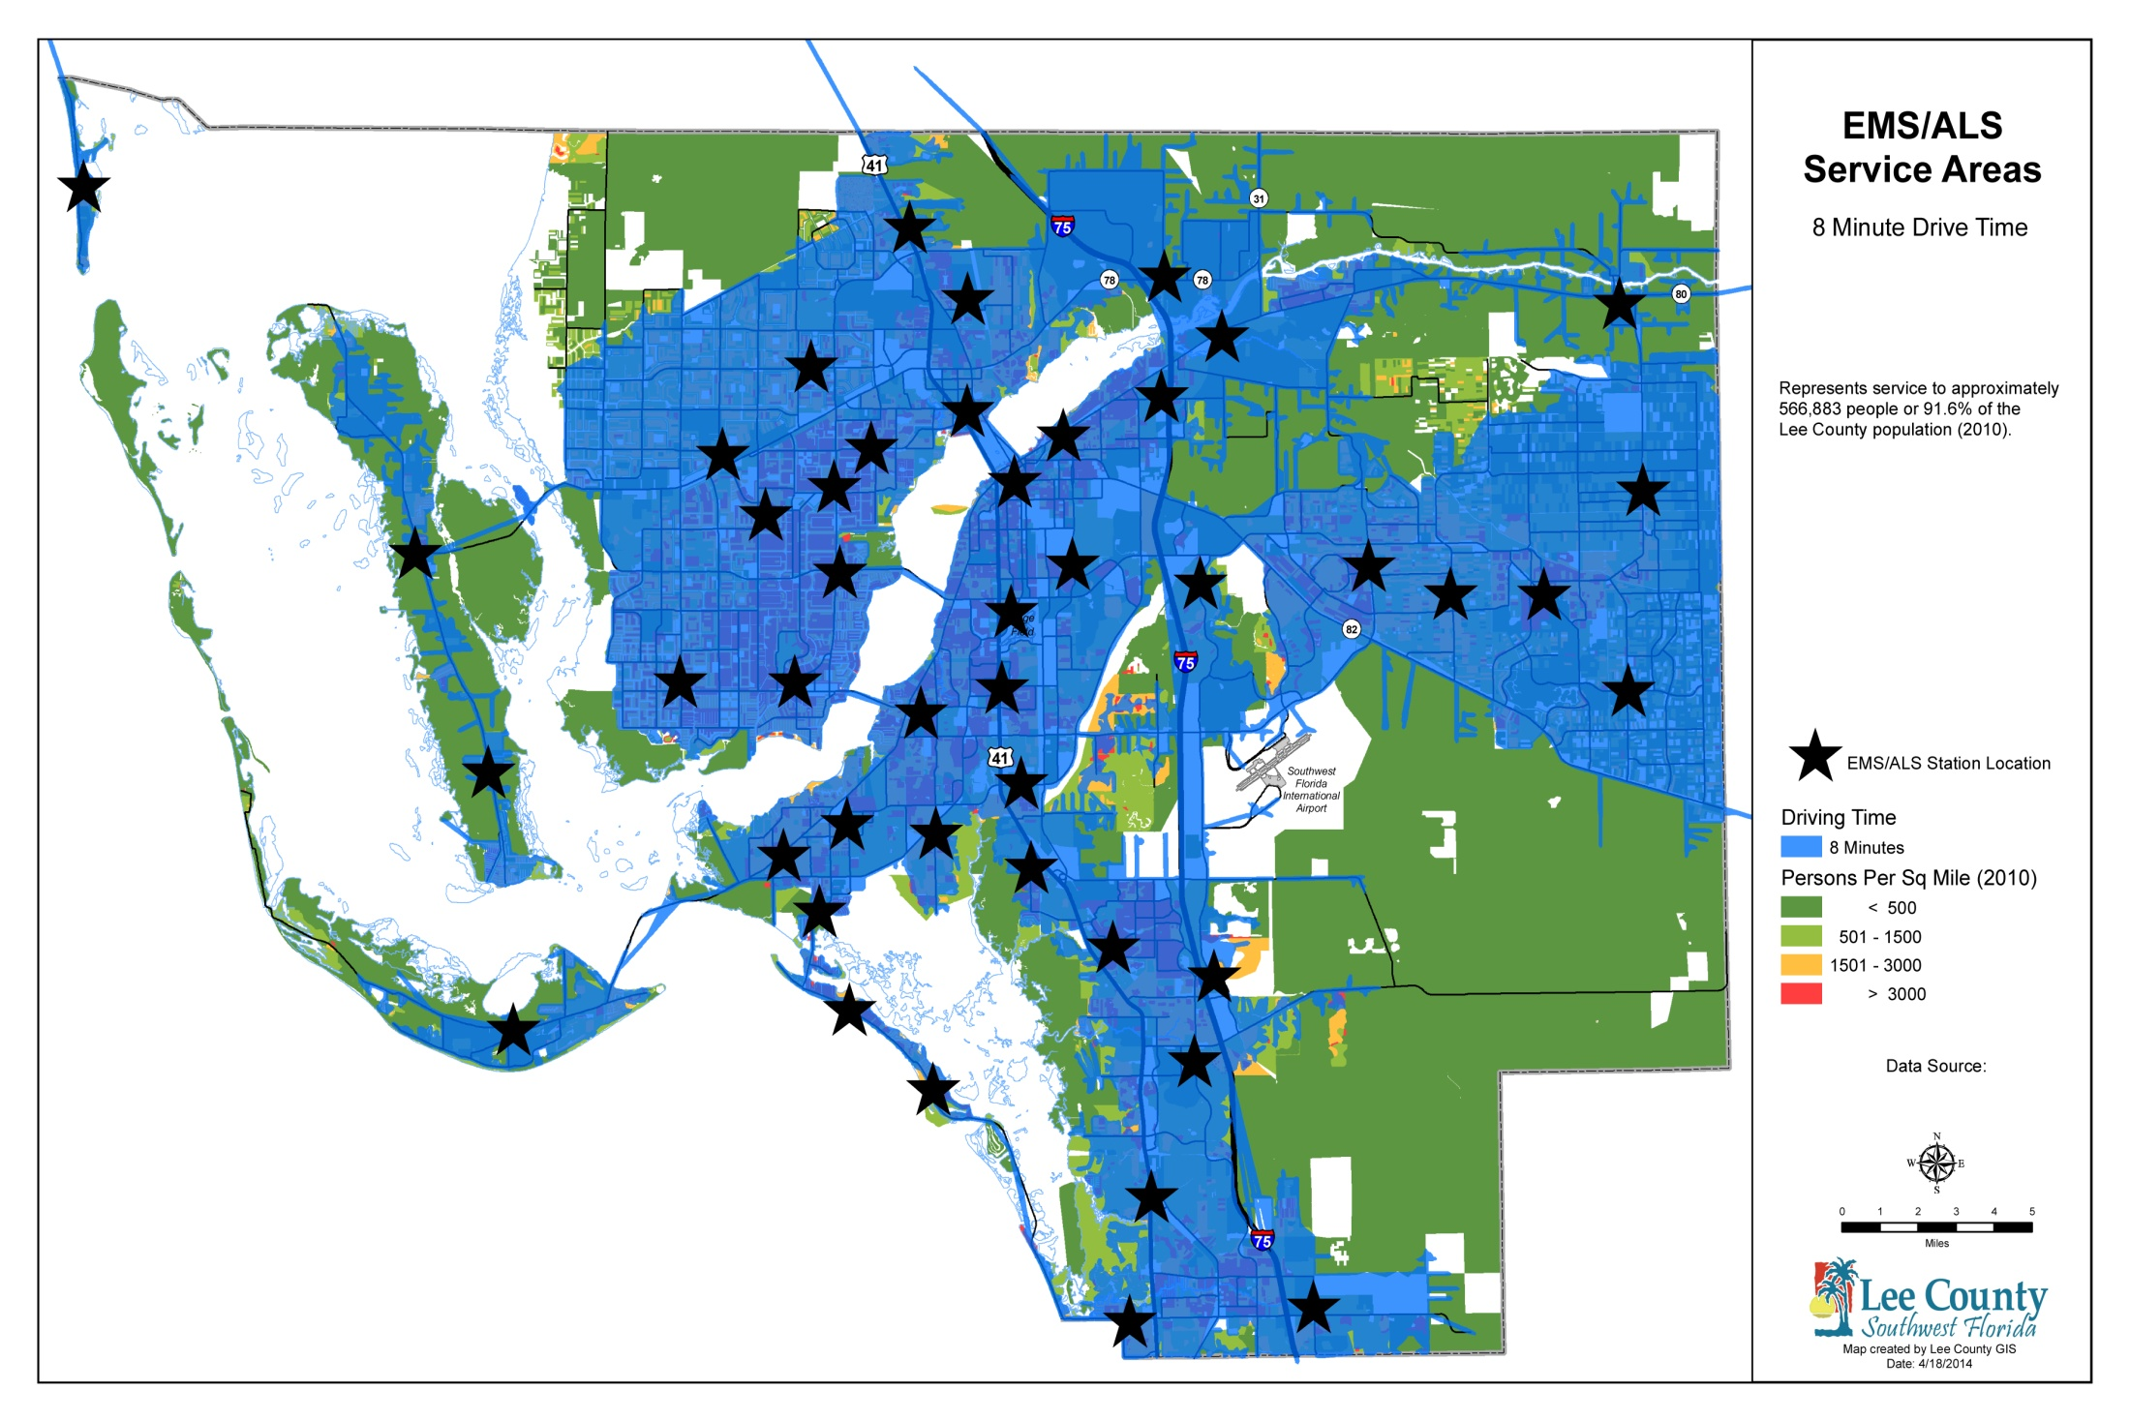
Public Safety

Slide 29
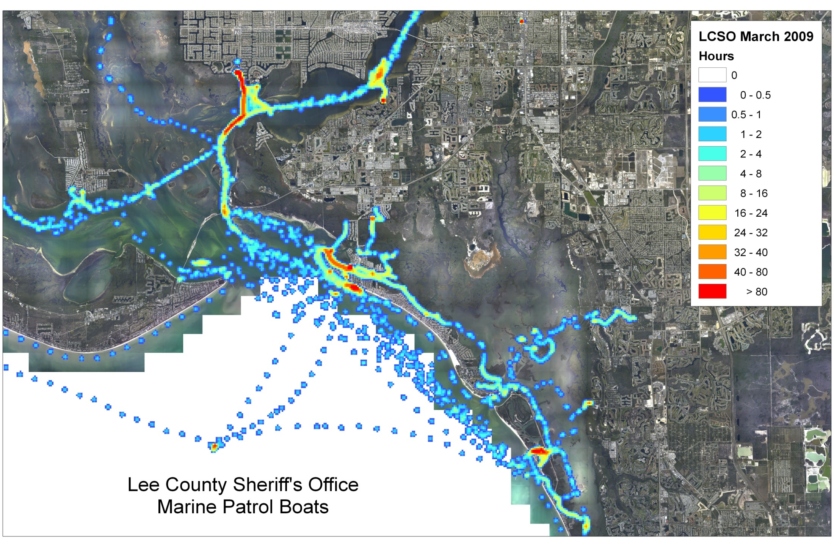
Natural Resources

Slide 30
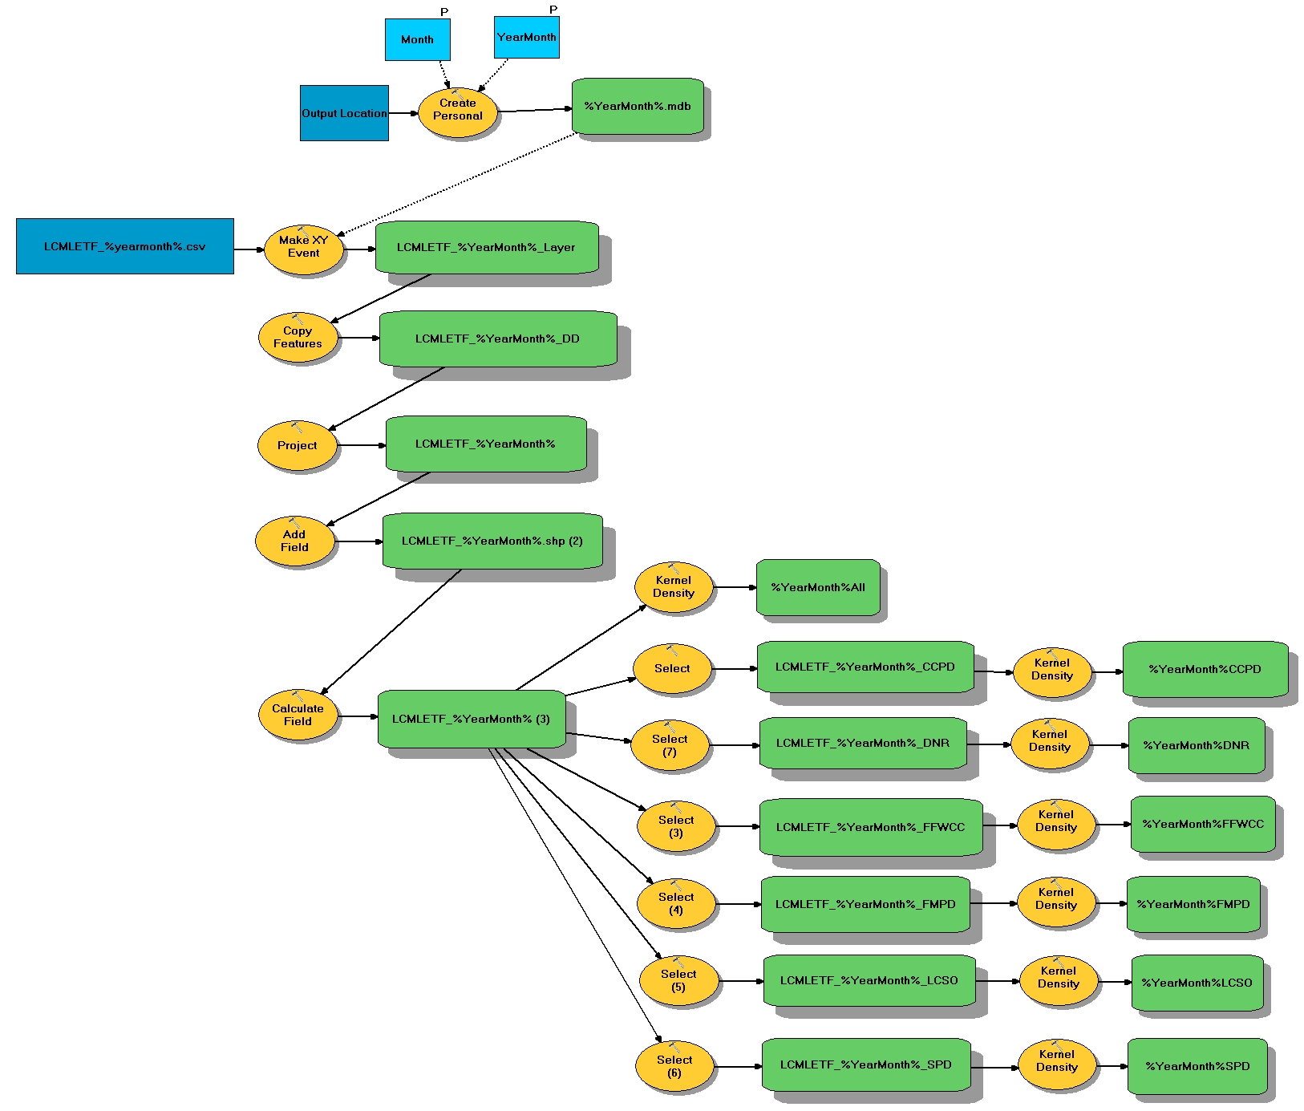
Natural Resources

Slide 31
Sustainability

Slide 32
Map Services

Slide 33
Map Services

Slide 34
Map Services

Slide 35
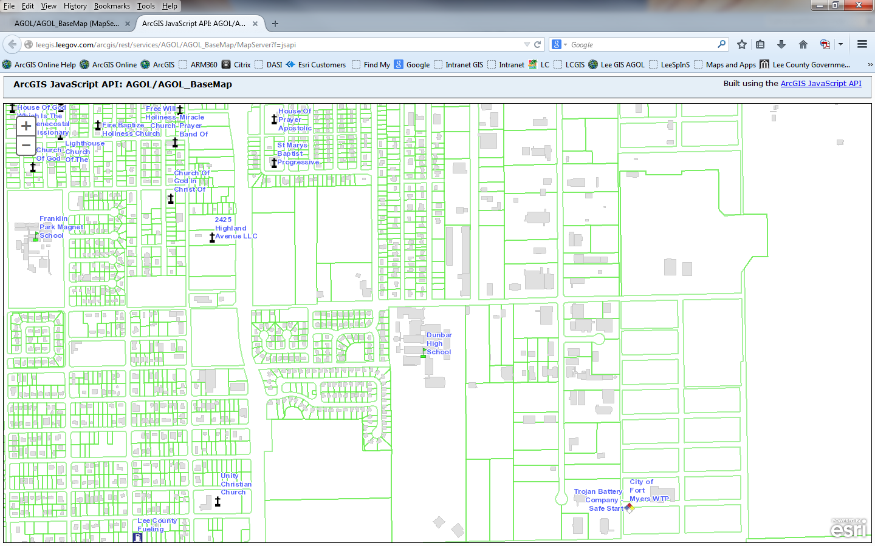
Map Services

Slide 36
Map Services

Slide 37
Map Services

Slide 38
ArcGIS Online for Organizations
Web Maps to Web Apps
ArcGIS Online is a cloud-based, collaborative content management system for maps, apps, and data.
Connected viewing/editing to hosted data and/or your own data.
Create your own Web Maps, enable pop-ups, Access with free ArcGIS app for smartphones, and tablets.
Create your own Web Apps using your web maps.

Slide 39
ArcGIS Online for Organizations
Cloud Portal
Maps & Apps – Viewing or Editing
Your Own Data
Shared Data
Lee County GIS
Servers
Data and Aerials
iPhone, iPad, Android, PC

Slide 40
Web Maps
Install free apps (itunes app store, google play store)
ArcGIS - to view all public Web Maps
Collector for ArcGIS – field collection
Start ArcGIS app
Search: lcgis
My Groups: Lee County Florida GIS

Slide 41
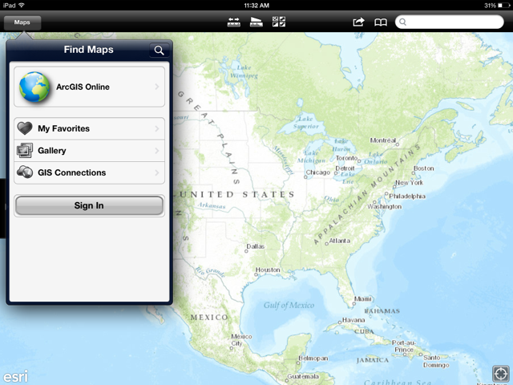
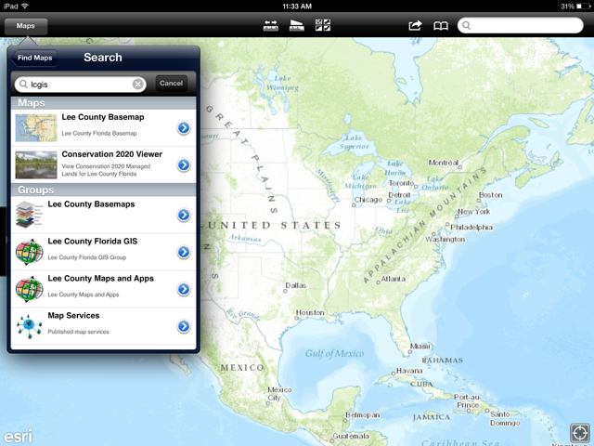
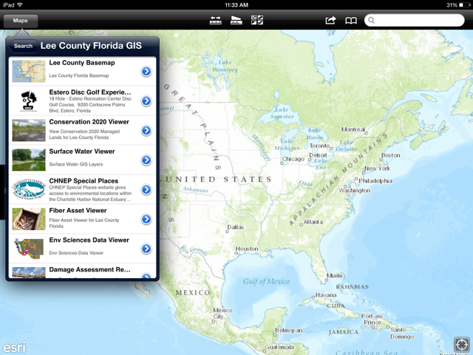
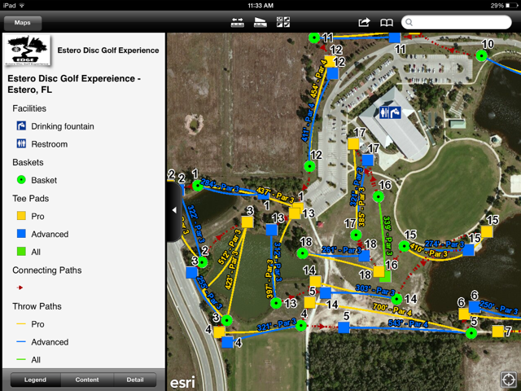
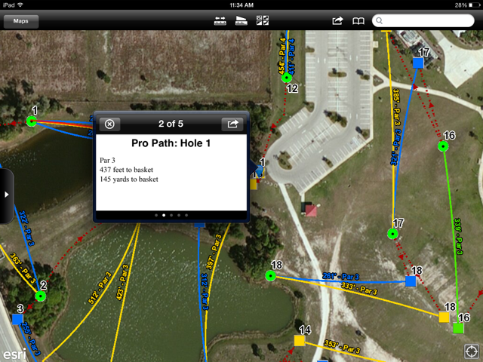
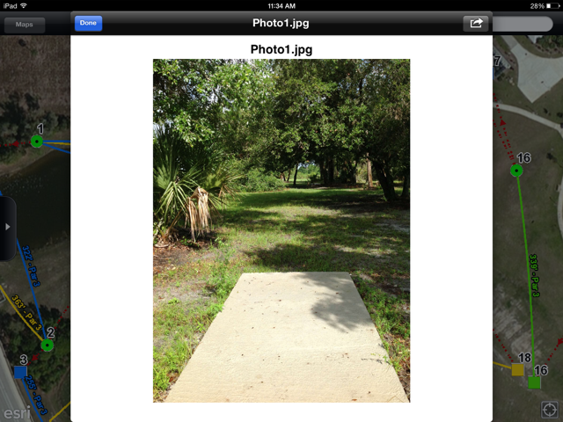

Slide 42
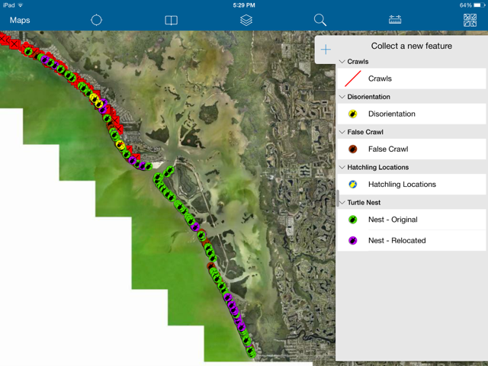
Turtle Nest Field Collection

Slide 43
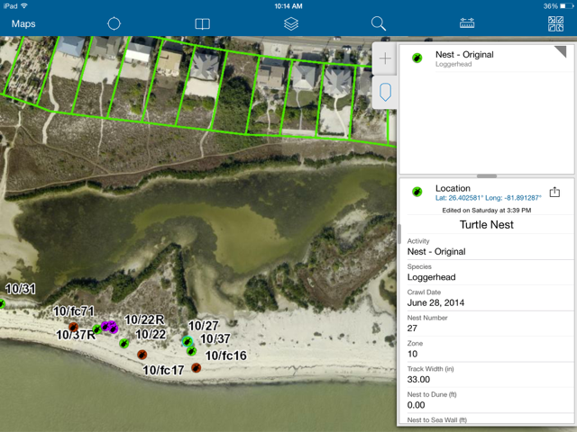
Turtle Nest Field Collection

Slide 44
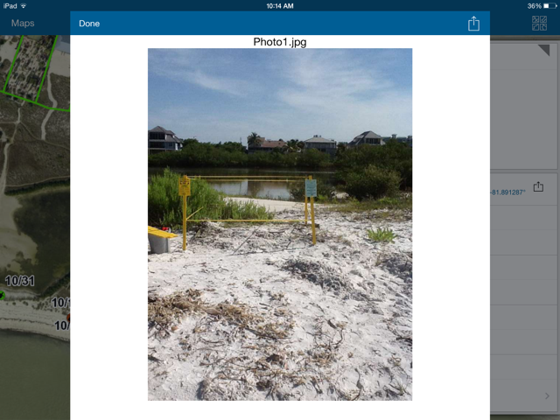
Turtle Nest Field Collection

Slide 45
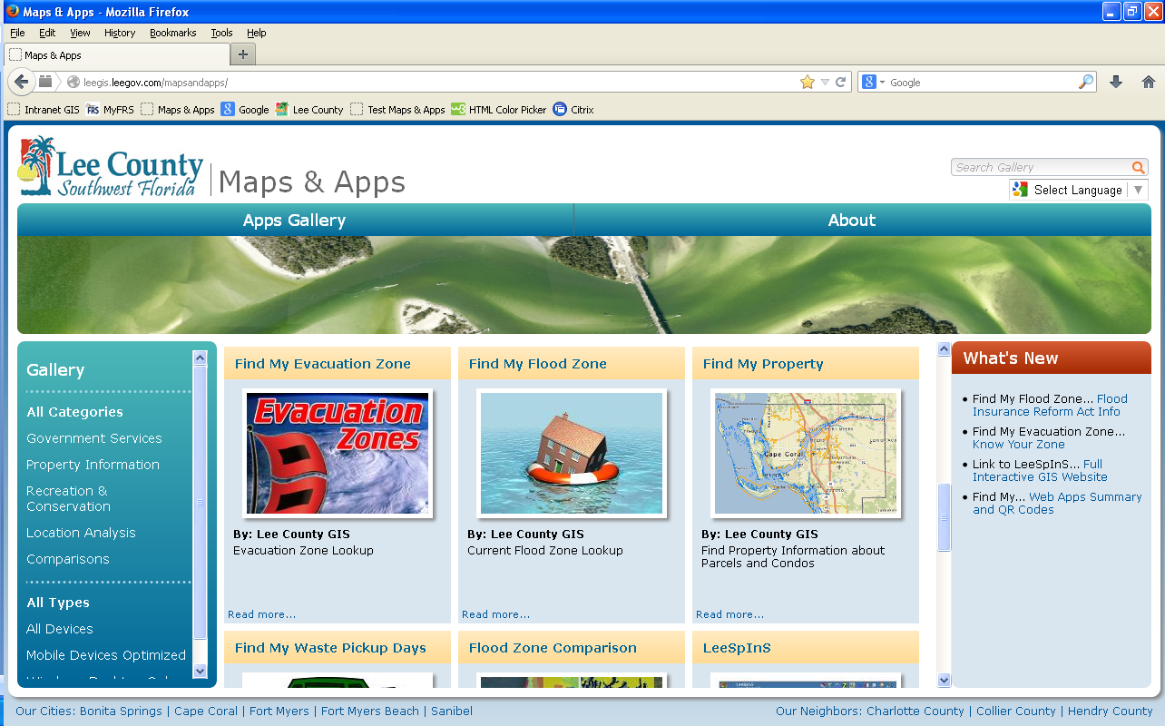
Web Apps
http://leegis.leegov.com/mapsandapps/

Slide 46
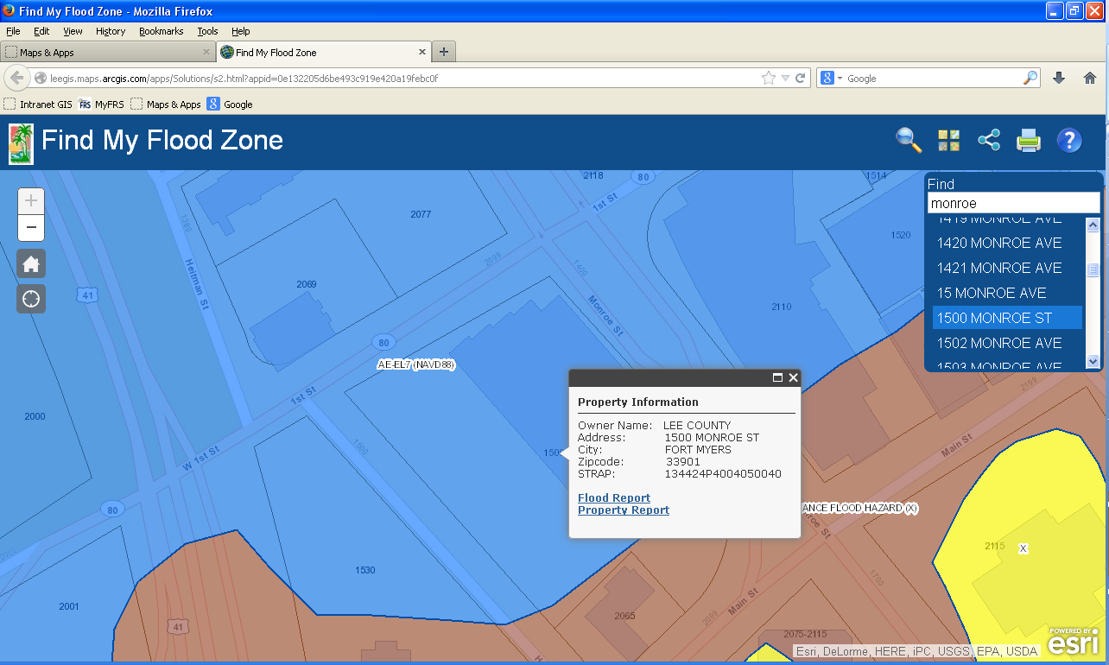
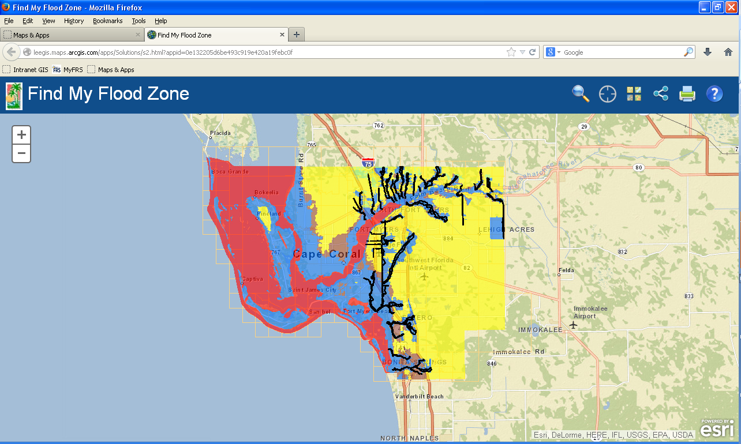
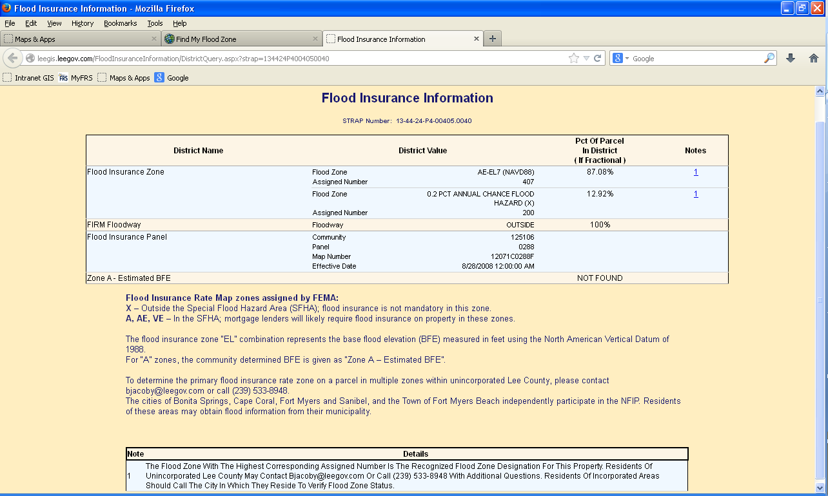
Web Apps - Finder
Find My Flood Zone

Slide 47
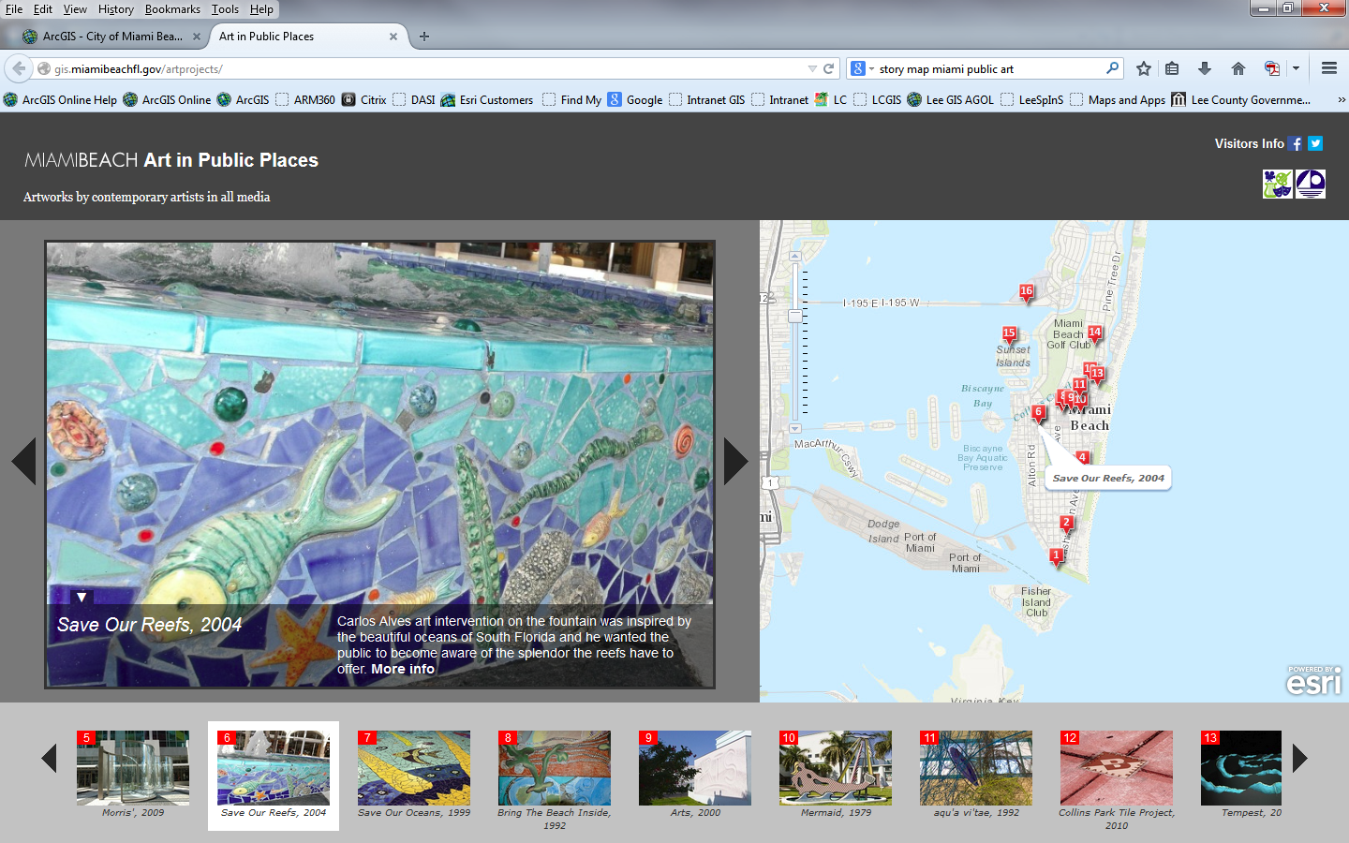
Web App – Map Tour

Slide 48
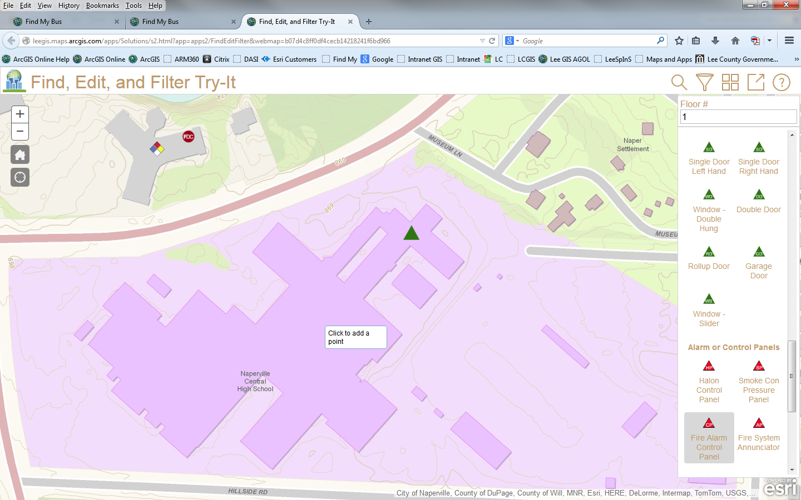
Web App – Find, Edit, and Filter

Slide 49
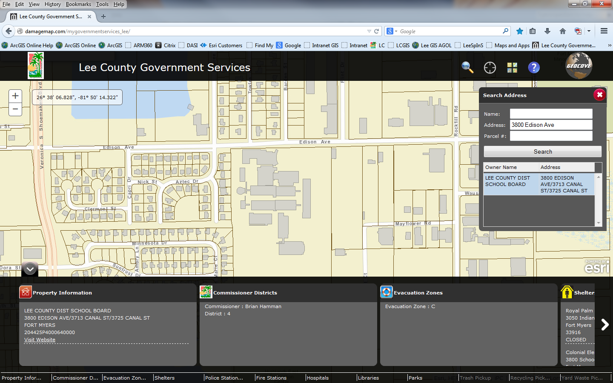
Services Dashboard - JavaScript

Slide 50
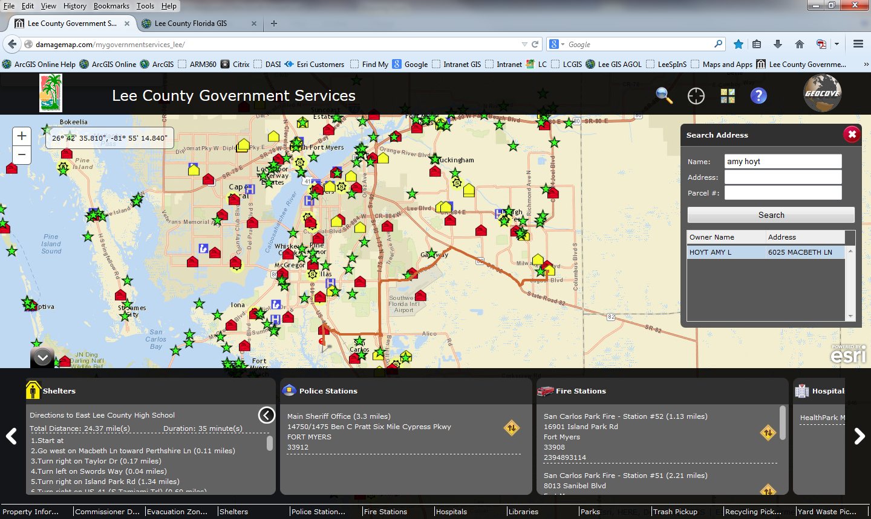
Services Dashboard - JavaScript

Slide 51
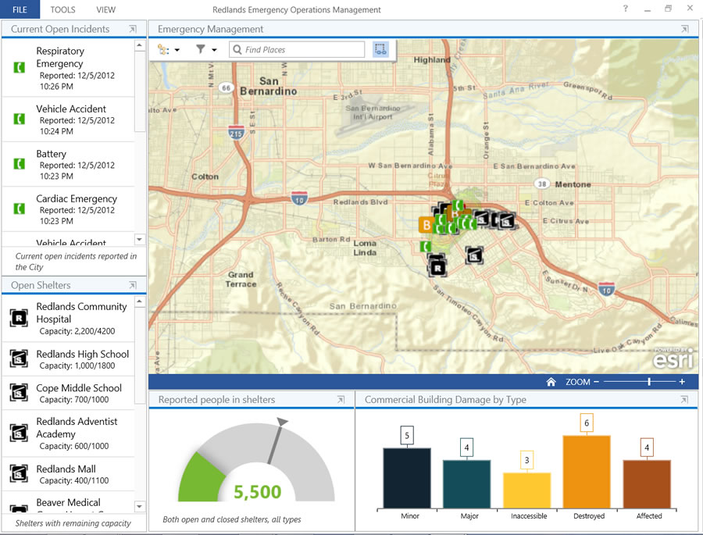
Operations Dashboard - JavaScript

Slide 52
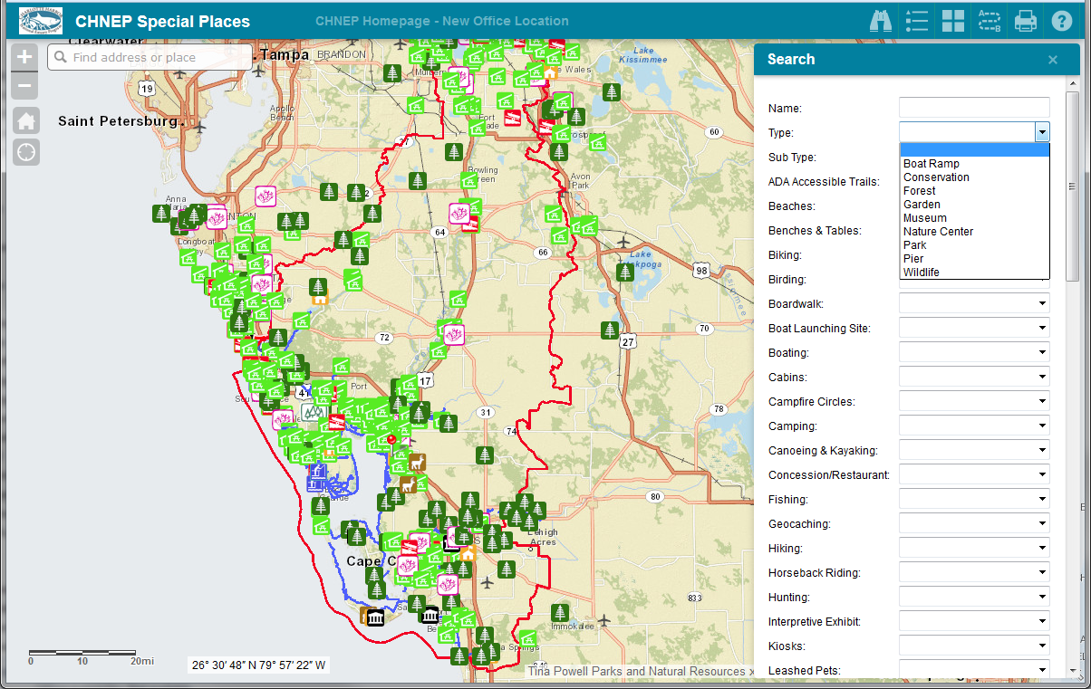
Web AppBuilder - JavaScript

Slide 53
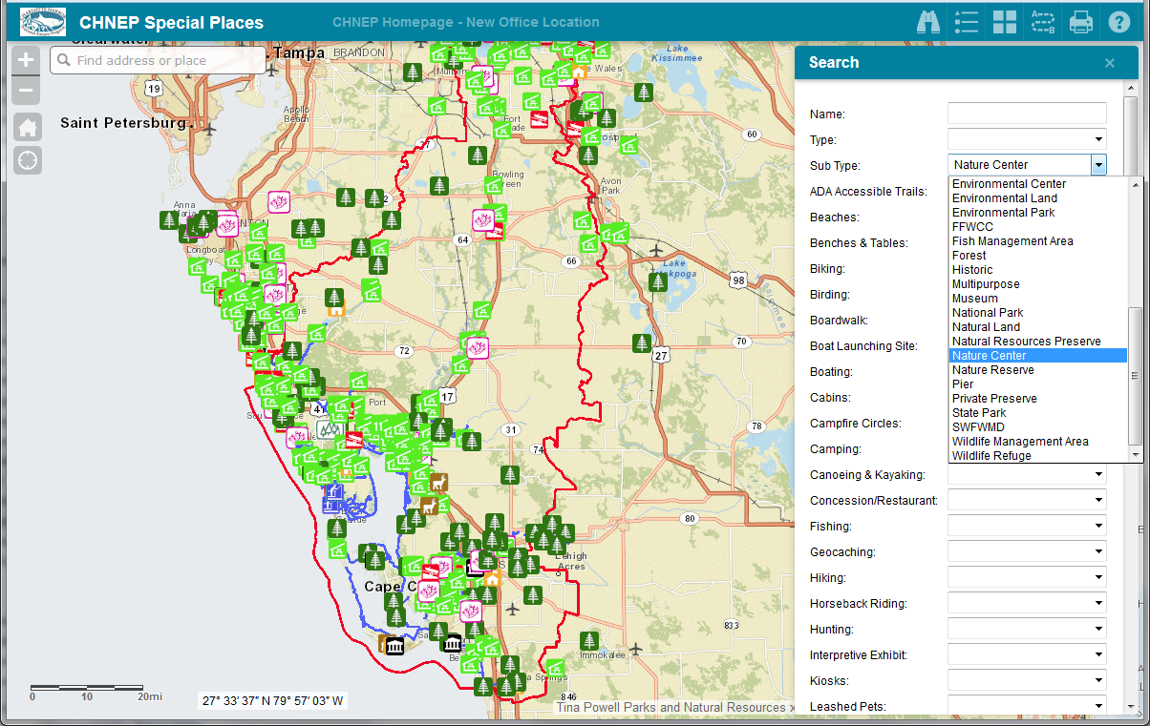
Web AppBuilder - JavaScript

Slide 54
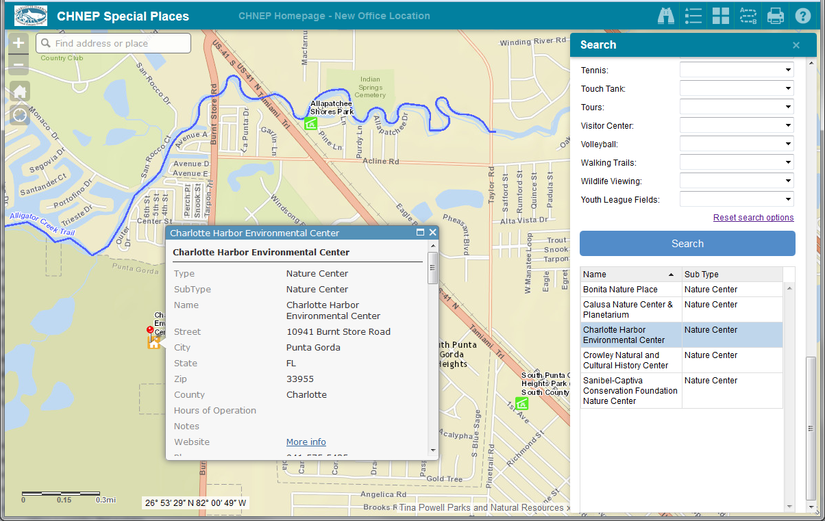
Web AppBuilder - JavaScript

Slide 55
Web AppBuilder - JavaScript

Slide 56
Web AppBuilder - JavaScript

Slide 57
Web AppBuilder - JavaScript

Slide 58
LeeEvac – Evacuation App What evacuation zone do I live in? Am I being evacuated? Can I come back now? Automatic Notifications…
Mobile Apps
Install FREE App: LeeEvac
iTunes App Store
Google Play Android App Store
iPhone, iPad, Android phones and tablets

Slide 59
Reports Evacuation Zone, Active Evacuations, and links to EOC Shelter Page

Slide 60
Questions??
http://leegis.leegov.com
*Links to Web Applications *Data Downloads *Map Downloads
Amy Hoyt, GISP ahoyt@leegov.com

